Slide 1
Tomographies Beyond x-rays
Emphasizing neutron & Electron-enabled tomographies
Allan Treiman, Lunar and Planetary Institute

Slide 2
Plan of Presentation
1. Requirements for tomographic reconstruction
2. Types of tomographic imaging
  Quick look at synchrotron X-ray sources
  Focus on tomography in electron microscopy
  Focus on neutron tomography
3. Coordinated X-ray & Neutron Tomography
  Lab exercises

Slide 3
Requirements for Tomographic Reconstruction
1. Penetrating Radiation
External source – Mostly what we consider
  X-rays
  Gamma-rays
  Electrons
  Neutrons
  Muons
  Cosmic rays
  Neutrinos ?
  Acoustic energy (like seismic tomography)
Internal source
  X-ray emission (XRF) induced by X-rays or electrons
  Positron emission tomography (PET)
  Neutron-induced gamma emission
2. Contrast Generation
Differential attenuation by absorption
  X-rays
  Electrons (e.g., to produce X-rays)
  Neutrons (e.g., to cause fission)
Differential scattering attentuation
  Elastic scattering
  Diffraction
  Inelastic scattering
Notes:
Degueldre, C., Pleinert, H., Maguire, P., Lehman, E., Missimer, J., Hammer, J., Leenders, K., Böck, H. and Townsend, D., 1996. Porosity and pathway determination in crystalline rock by positron emission tomography and neutron radiography. Earth and Planetary Science Letters, 140(1-4), pp.213-225.
Barnes, S., Georgadze, A., Giammanco, A., Kiisk, M., Kudryavtsev, V. A., Lagrange, M., & Pinto, O. L. (2023). Cosmic-ray tomography for border security. Instruments, 7(1), 13.
Bae, J., Chatzidakis, S., & Ughade, R. (2024). Gamma-Ray and Cosmic Ray Muon Modalities for Cargo Inspection. In Emerging Radiation Detection: Technology and Applications (pp. 207-238). Cham: Springer Nature Switzerland.

Slide 4
Requirements for Tomographic Reconstruction
3. Directionality: source or/and detector
Tomography requires spatial resolution of response to radiation
Directionality of detector
  Imaging camera / detector, with spread source
  E.g., XCT
Directionality of source
  Focused, collimated source, general or imaging detector
  E.g., Elemental imaging in transmission electron microscope
  E.g., STXM – scanning transmission X-ray microscopy
4. Relative motion of source, object, and detector
X-ray & Neutron CT
  Source & detector fixed
  Translate and rotate sample
Medical CAT scan
  Target fixed
  Translate and rotate source and detectors
Scanning Transmission Electron CT
  Scan (source) electron beam
  Rotate / tilt sample
  Detector fixed

Slide 5
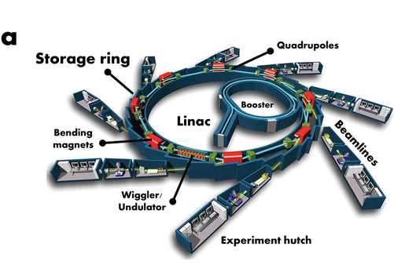
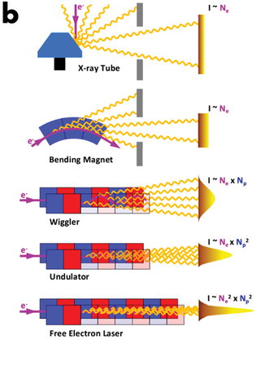
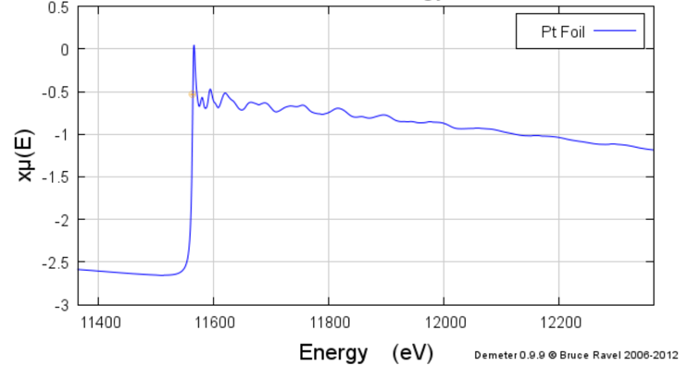
Synchrotron X-ray Sources
“High brilliance, orders of magnitude brighter than conventional X-ray tubes.”
Highly polarized (linear, elliptical, circular).
High collimation, i.e., small angle of beam divergence.
Tuneable energy: sub-eV to MeV.
  Element-specific mapping across absorption edges.
Pulsed emission, to nanoseconds.
PtL₃ edge
From(?) NSLS
From/after Wikipedia

Slide 6
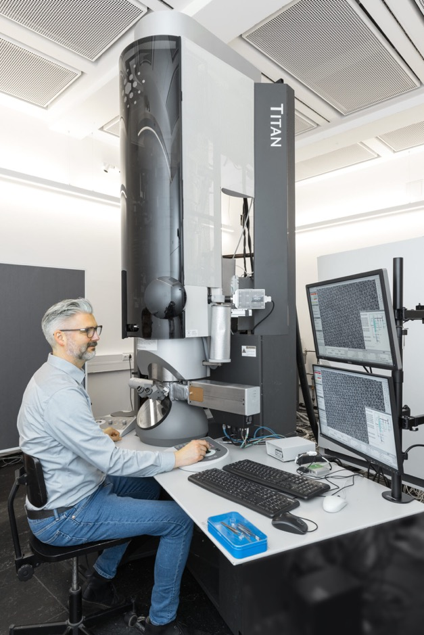
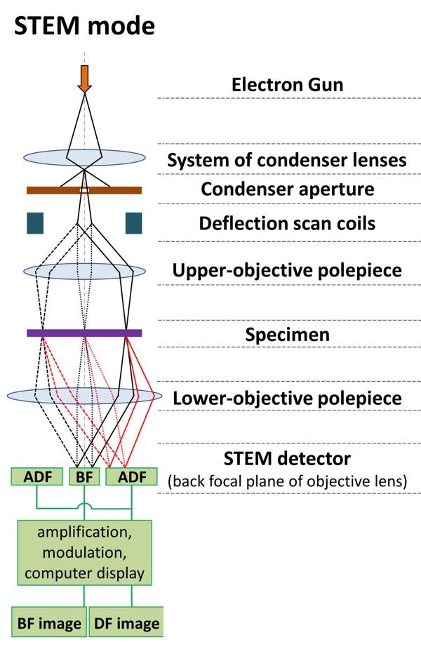
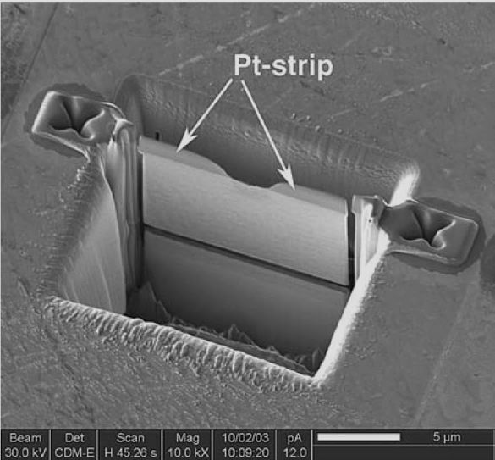
Tomographies Via Transmisison Electron microscopy
Samples Electron-Transparent => sub-micron
  Microtome slice
  Ion-thinned
  FIB extracted section
Sample Issues
  Stablity under high vacuum
  Heating by e-beam
  Amorphization by e-beam
FIB-cut foil. 120 nm thick
By Black Tubus - File:STEM fig.tif, CC BY-SA 4.0, https://commons.wikimedia.org/w/index.php?curid=73810330
Notes:
FIB cut foil image from:
Wirth, R. (2004). Focused Ion Beam (FIB) A novel technology for advanced application of micro-and nanoanalysis in geosciences and applied mineralogy. European Journal of Mineralogy, 16(6), 863-876.

Slide 7
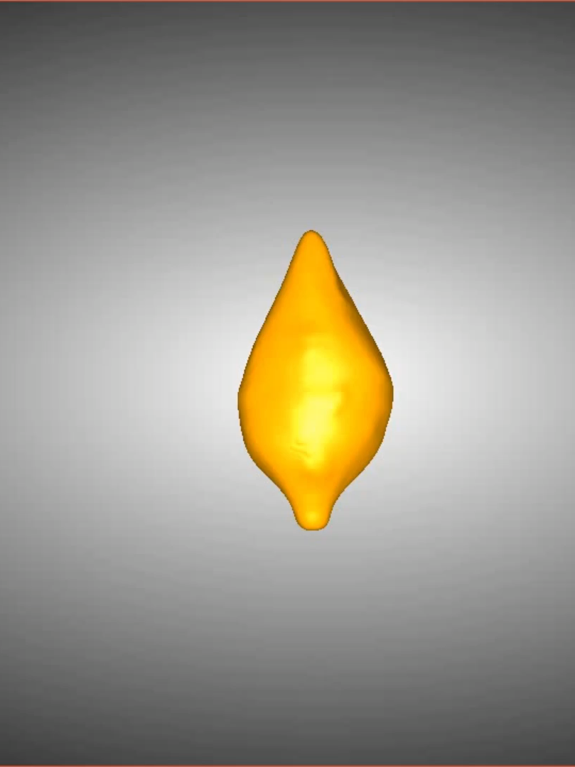
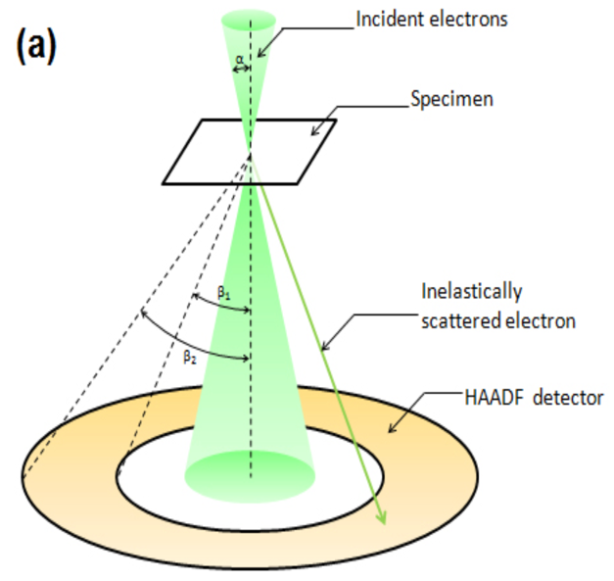
STEM (Scanning TEM)– Darkfield elastic Scattering
To avoid diffractions, use High Angle Annular Dark-Field Detector (HAADF)
Magnetite magnetosome, ~1.5 µm tall
Pei, Z., Ringe, E., Chang, L., Harrison, R. J., Xue, P., & Williams, W. (2025). Three-dimensional structure, crystallography, and magnetism of giant magnetofossils. Communications Earth & Environment, 6(1), 410
From JEOL website
Thomas-Keprta K.L., Clemett S.J., Shimmin J., Morphew M., McIntosh J. R., Bazylinski D.A., ... & Romanek C.S. (2003) Three-dimensional morphological analysis of ALH84001 magnetite using electron tomography. Lunar and Planetary Science Conference 34, Abstract # 1669.

Slide 8
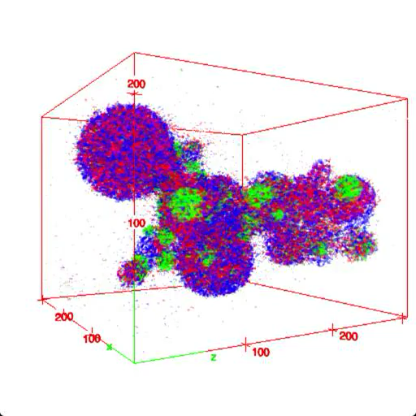
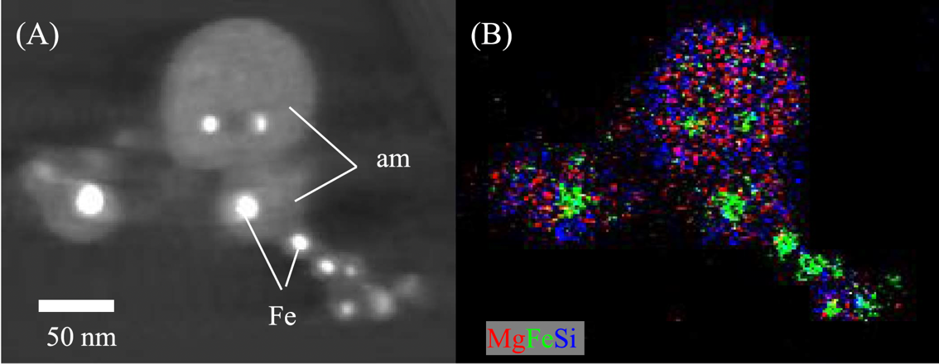
STEM – X-ray (energy-dispersive Detector (EDS)
R=Mg, G=Fe, B=Si, scale nanometers
Matsuno, J., Tsuchiyama, A., Watanabe, T., Tanaka, M., Takigawa, A., Enju, S., ... & Miyake, A. (2021). Condensation of glass with multimetal nanoparticles: Implications for the formation process of GEMS grains. The Astrophysical Journal, 911(1), 47.

Slide 9
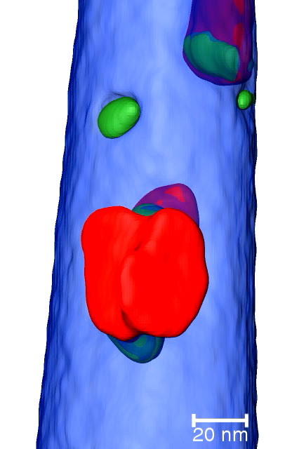
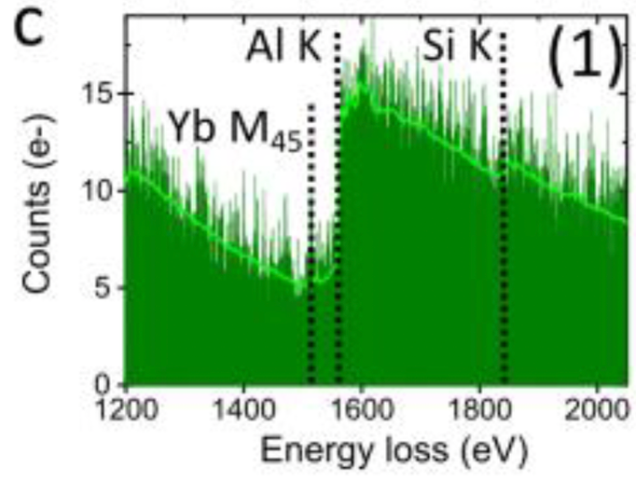
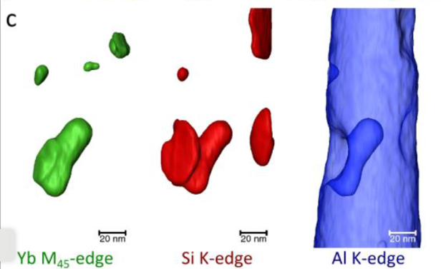
STEM – Energy Electron Loss (EELS)
Tomography
Habenfehlner et al. (2104).
” …procedures [of] … electron tomography are demonstrated on an Al-5 wt.% Si alloy with 50 ppm Na and 6100 ppm Yb. A needle shaped sample, suitable for tomography, was prepared from the surface of the Al-Si sample using focused ion beam (FIB) milling.”
Notes:
Haberfehlner, G., Orthacker, A., Albu, M., Li, J., & Kothleitner, G. (2014). Nanoscale voxel spectroscopy by simultaneous EELS and EDS tomography. Nanoscale, 6(23), 14563-14569.

Slide 10
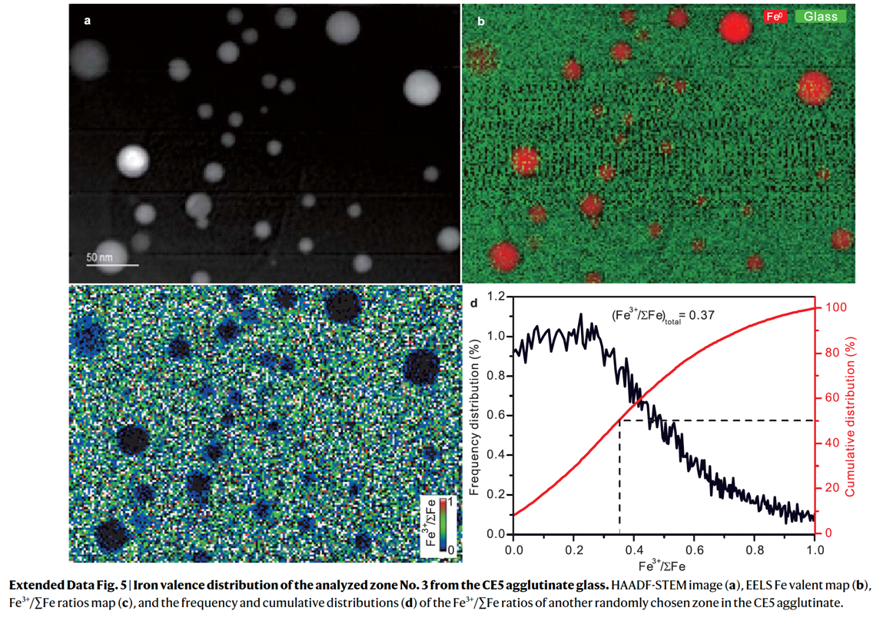
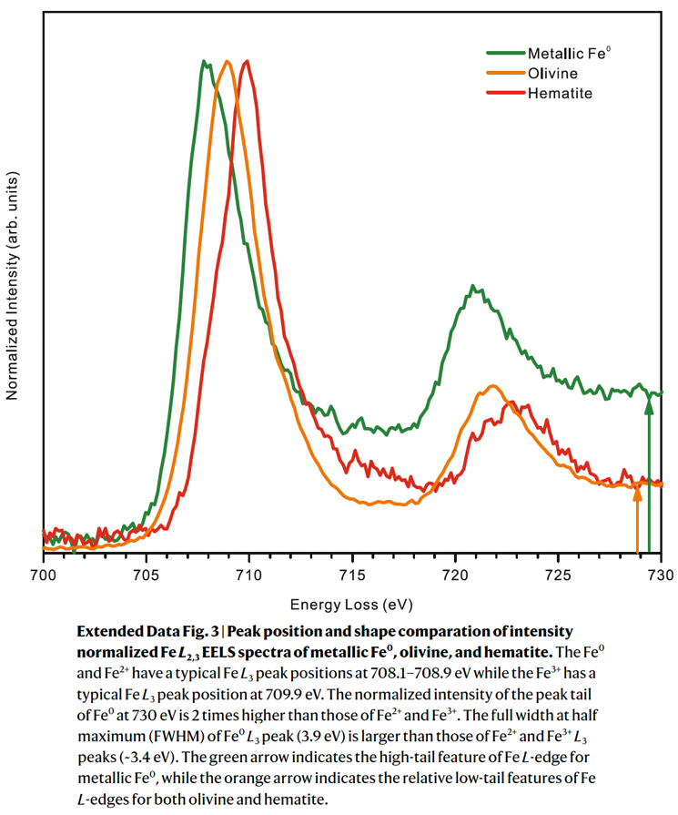
STEM – EELS Valence States
Xian, H., Zhu, J., Yang, Y., Li, S., Lin, X., Xi, J., ... & Xu, Y. G. (2023). Ubiquitous and progressively increasing ferric iron content on the lunar surfaces revealed by the Chang’e-5 sample. Nature Astronomy, 7(3), 280-286.

Slide 11
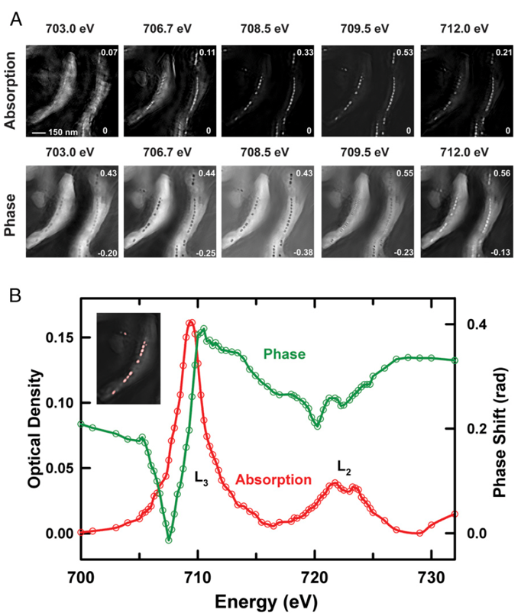
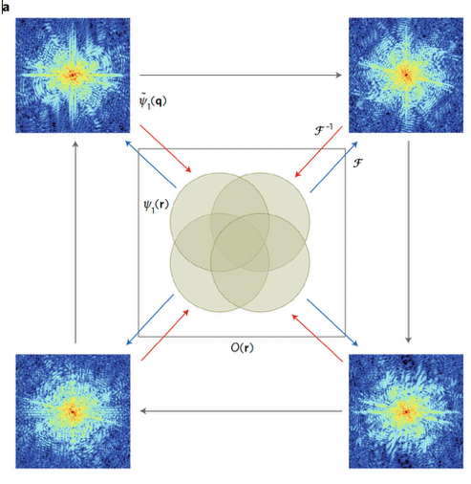
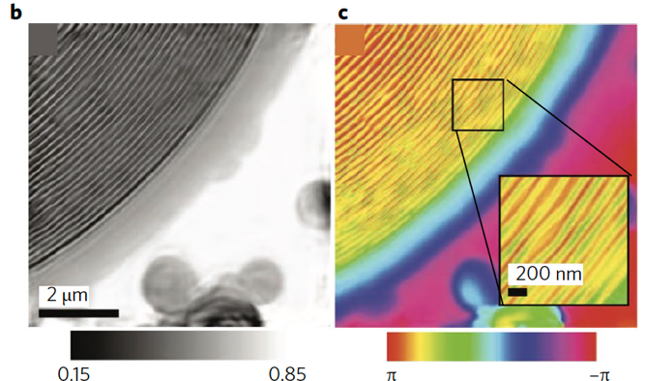
(S)TEM – PtychographY
Electron ptychography is a high-resolution imaging technique in electron microscopy that uses coherent diffractive imaging and computational algorithms to reconstruct an image of a sample by analyzing a series of overlapping diffraction patterns. It achieves deep sub-angstrom to atomic resolution by overcoming traditional lens limitations and is especially valuable for imaging beam-sensitive materials and achieving high-dose efficiency for 3D reconstructions of both physical and biological samples. [AI explanation, FWIW]
Pfeiffer F. (2018). X-ray ptychography. Nature Photonics 12, 9-17.
Thibault P., Dierolf M., Menzel A., Bunk O., David C., & Pfeiffer F. (2008) High-resolution scanning x-ray diffraction microscopy. Science 321(5887), 379-382.
Zh, X., Hitchcoc, A.P., Bazylinsk D.A., Denes P., Joseph J., Lins, U., ... & Shapiro D.A. (2016) Measuring spectroscopy and magnetism of extracted and intracellular magnetosomes using soft X-ray ptychography. Proc. Nat. Acad. Sci. 113(51), E8219-E8227.
Notes:
Pfeiffer, F. (2018). X-ray ptychography. Nature Photonics, 12(1), 9-17.
Yu, R., Sha, H., Cui, J., & Yang, W. (2024). Introduction to electron ptychography for materials scientists. Microstructures, 4(4), N-A.
Clark, L., & Nellist, P. D. (2025). Electron Ptychography. arXiv preprint arXiv:2503.10917.
Zhu, X., Hitchcock, A. P., Bazylinski, D. A., Denes, P., Joseph, J., Lins, U., ... & Shapiro, D. A. (2016). Measuring spectroscopy and magnetism of extracted and intracellular magnetosomes using soft X-ray ptychography. Proceedings of the National Academy of Sciences, 113(51), E8219-E8227.

Slide 12
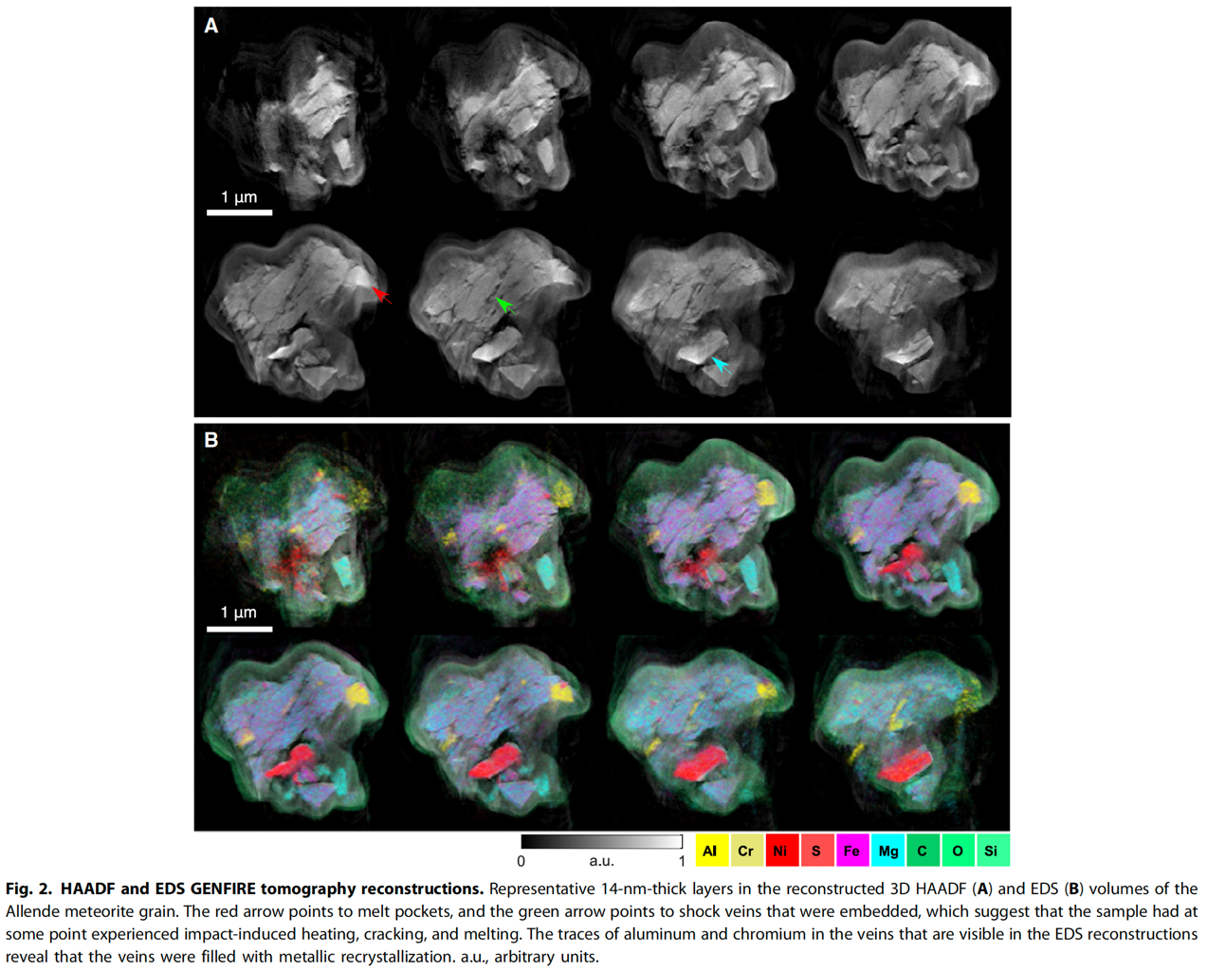
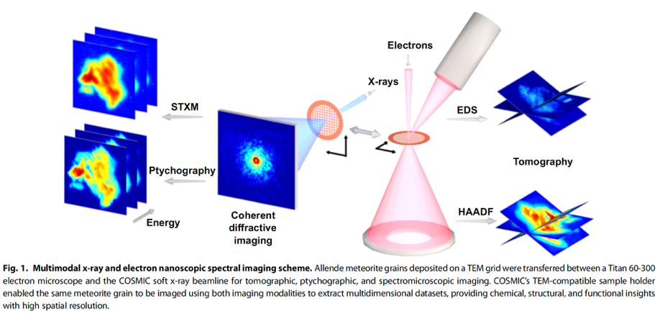
STEM – Multimodal
Lo, Y. H., Liao, C. T., Zhou, J., Rana, A., Bevis, C. S., Gui, G., ... & Miao, J. (2019). Multimodal x-ray and electron microscopy of the Allende meteorite. Science advances, 5(9), eaax3009.

Slide 13
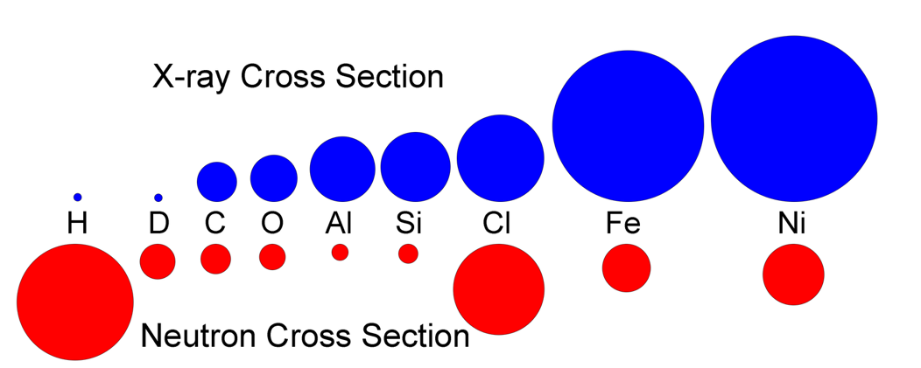
Neutron Tomography
Why use neutrons?
  Thermal neutrons have wavelengths comparable to interatomic spacings
  Attenuations different from those of X-rays
    Detect different elements/properties.
    Most sensitive to H, Cl, Cd, some rare earths
  Complementary to X-ray tomography.
Difficulties
  Requires a neutron source
    Nuclear reactor (huge overhead)
    Spallation source (low fluence)
  Induces radioactivity in target
    Requires radiation safety protocols
X-ray scattering cross sections depend on density of electrons in a target volume; i.e. with atomic number.
Neutron attenuation cross sections depend on scattering and absorption by element nuclei – not explained simply. ¹H has a large scattering cross-section. ³⁵Cl has both large scattering and absorption cross-sections. Some isotopes (e.g., ¹¹³Cd, ¹⁴⁷Sm, ¹⁵⁷Gd) have humongous absorption cross-sections.
Teflon and aluminum have very low neutron cross-sections!
X-ray and neutron cross-sections not at same scales. Neutron attenuations are ~ 1/4 of those for X-rays
Notes:
Diagram from
Treiman, A.H., LaManna, J.M., Hussey, D.S., DeClue, I. and Anovitz, L.M., 2022. Coordinated Neutron and x‐ray computed tomography of meteorites: Detection and distribution of hydrogen‐bearing materials. Meteoritics & Planetary Science, 57(10), pp.1820-1835.

Slide 14
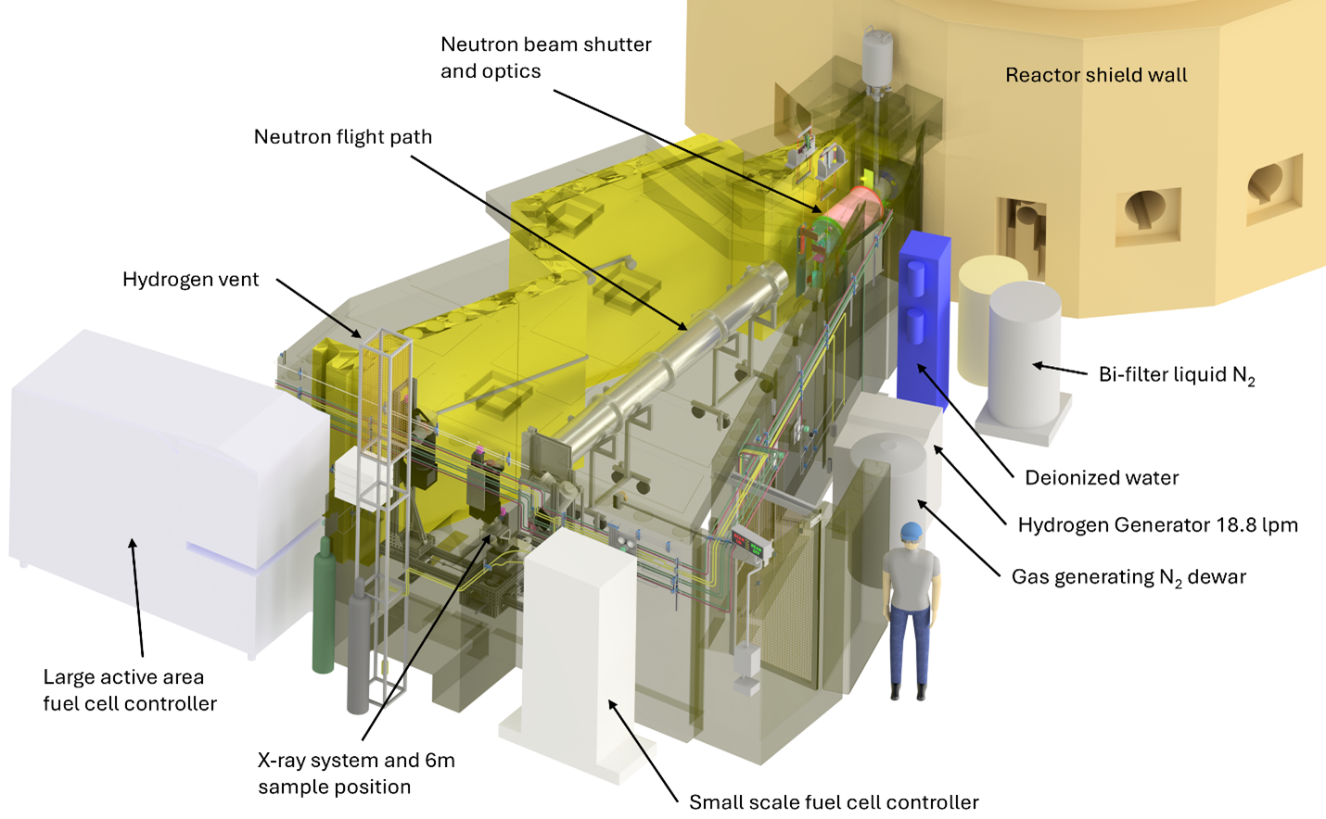
Neutron Tomography Facility: NIST’s
National Center for Neutron Research (NCNR)
Notes:
Images from NIST – National Center for Neutron Research – Neutron Imaging Facility
https://www.nist.gov/laboratories/tools-instruments/neutron-imaging-facility-nif
https://www.nist.gov/programs-projects/imaging-neutron-and-x-ray-tomography-next-system

Slide 15
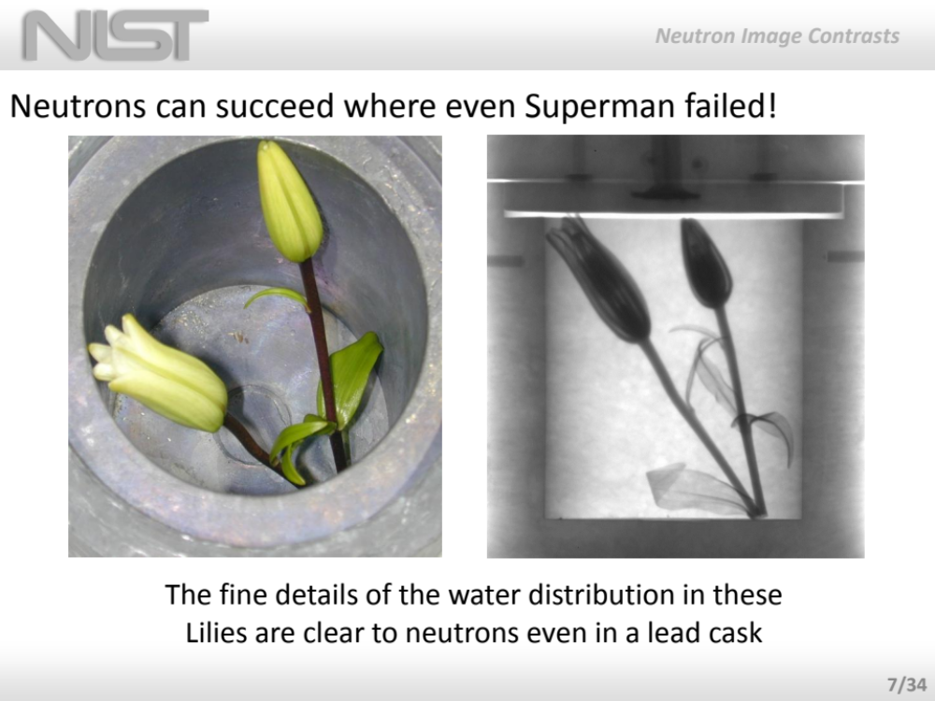
Notes:
After Jake Lamanna 2014 presentation.

Slide 16
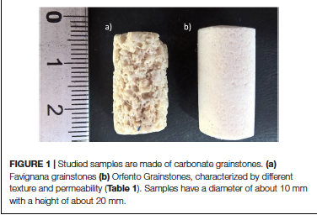
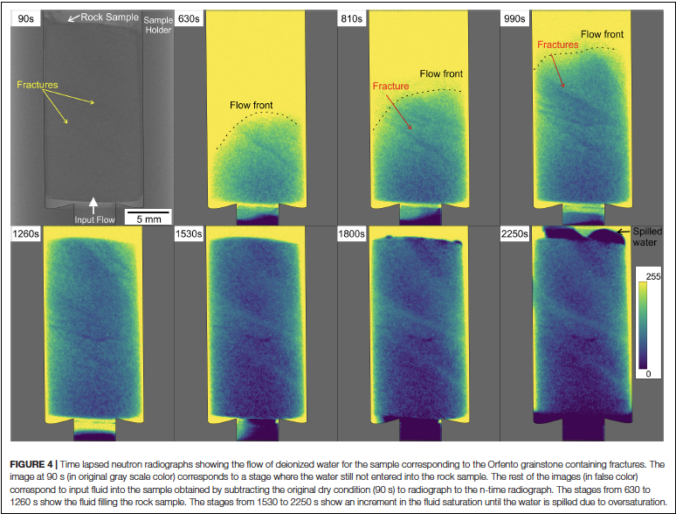
Neutron Imaging – example Rock Permeability
Zambrano, M., Hameed, F., Anders, K., Mancini, L., & Tondi, E. (2019) Implementation of dynamic neutron radiography and integrated X-ray and neutron tomography in porous carbonate reservoir rocks. Frontiers in Earth Science, 7, 329.
Notes:
Zambrano, M., Hameed, F., Anders, K., Mancini, L., & Tondi, E. (2019). Implementation of dynamic neutron radiography and integrated X-ray and neutron tomography in porous carbonate reservoir rocks. Frontiers in Earth Science, 7, 329.

Slide 17
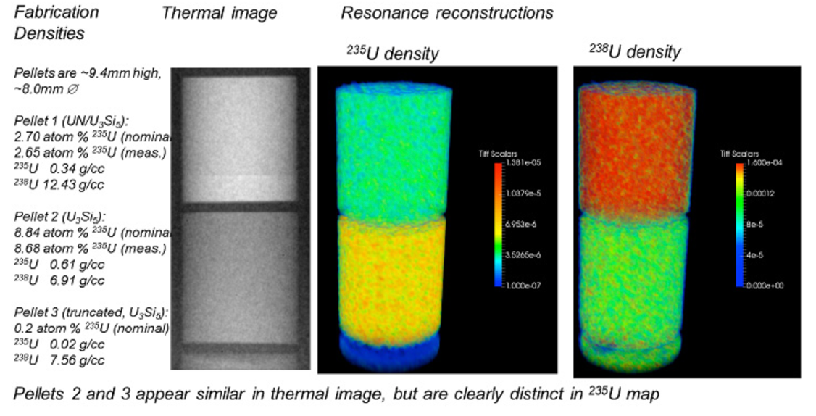
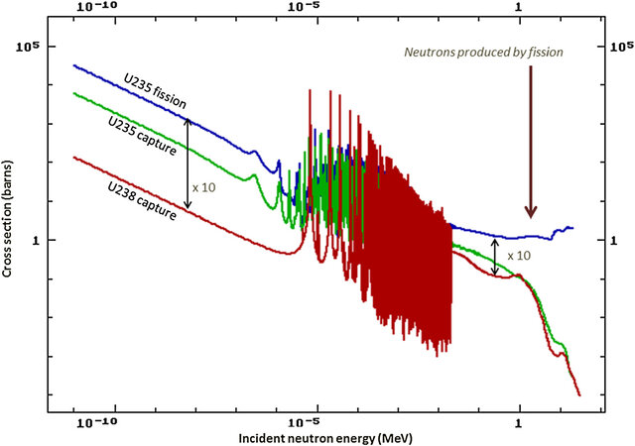
Multi-Energy Neutron Tomography
Measurement of enrichment levels in nuclear fuels and 3D measurement of isotope densities (collaboration with the LANL Accident Tolerant Fuel program) Kenneth J. McClellan and Andy Nelson). https://lansce.lanl.gov/facilities/lujan/instruments/fp-5/index.php
Notes:
Williams, G.J., Aufderheide, M., Champley, K.M., Djordjević, B.Z., Ma, T., Ryan, C., Simpson, R.A. and Wilks, S.C., 2022. Dual-energy fast neutron imaging using tunable short-pulse laser-driven sources. Review of Scientific Instruments, 93(9).
Vitucci, G., Minniti, T., Di Martino, D., Musa, M., Gori, L., Micieli, D., ... & Gorini, G. (2018). Energy-resolved neutron tomography of an unconventional cultured pearl at a pulsed spallation source using a microchannel plate camera. Microchemical Journal, 137, 473-479.
Tremsin, A. S., Vogel, S. C., Mocko, M., Bourke, M. A. M., Yuan, V., Nelson, R. O., ... & Feller, W. B. (2013). Energy resolved neutron radiography at LANSCE pulsed neutron facility. Neutron News, 24(4), 28-32.
https://lansce.lanl.gov/facilities/lujan/instruments/fp-5/index.php

Slide 18
Many other imaging modes in Neutrons
Polychromatic
Diffraction
Phase Contrast
Magnetism
  Lee S.W., et al. (2010) Observation of Magnetic Domains in Insulation-Coated Electrical Steels by Neutron Dark-Field Imaging. Appl. Phys. Express 3 106602.
  Manke,I., et al.(2010). Three-dimensional imaging of magnetic domains. Nature communications, 1(1), 125.
https://www.isrdrcn.org/wp-content/uploads/2023/08/July27_T3_LaManna.pdf

Slide 19
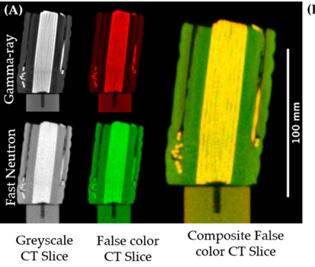
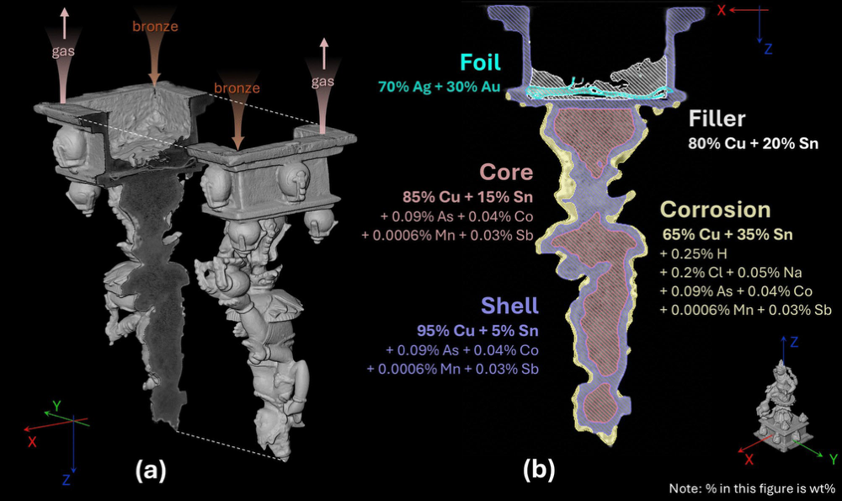
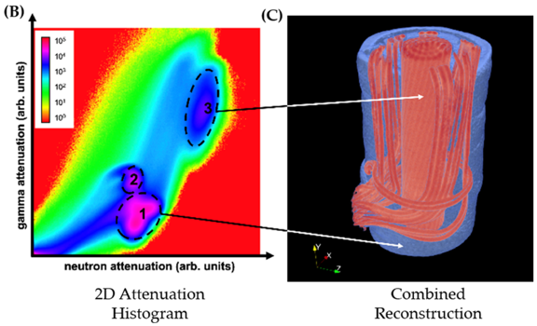
Neutron & Gamma-Ray Tomographies
Gammas produced with neutrons
Gammas induced by neutron iradiation
Yueer Li, S. Creange, Z. Zhou, W. Southworth, A. Pappot & L. van Eijck (2024) Exploiting activation radiation from neutron tomography reveals the hidden elemental composition of 3D art objects for free. Scientific Reports 14:28982
Kumar R., Sommer L., Tremsin A.S., & Losko A.S. (2023) Gamma in addition to neutron tomography (giant) at the nectar instrument. Scientific reports 13(1), 20120.

Slide 20

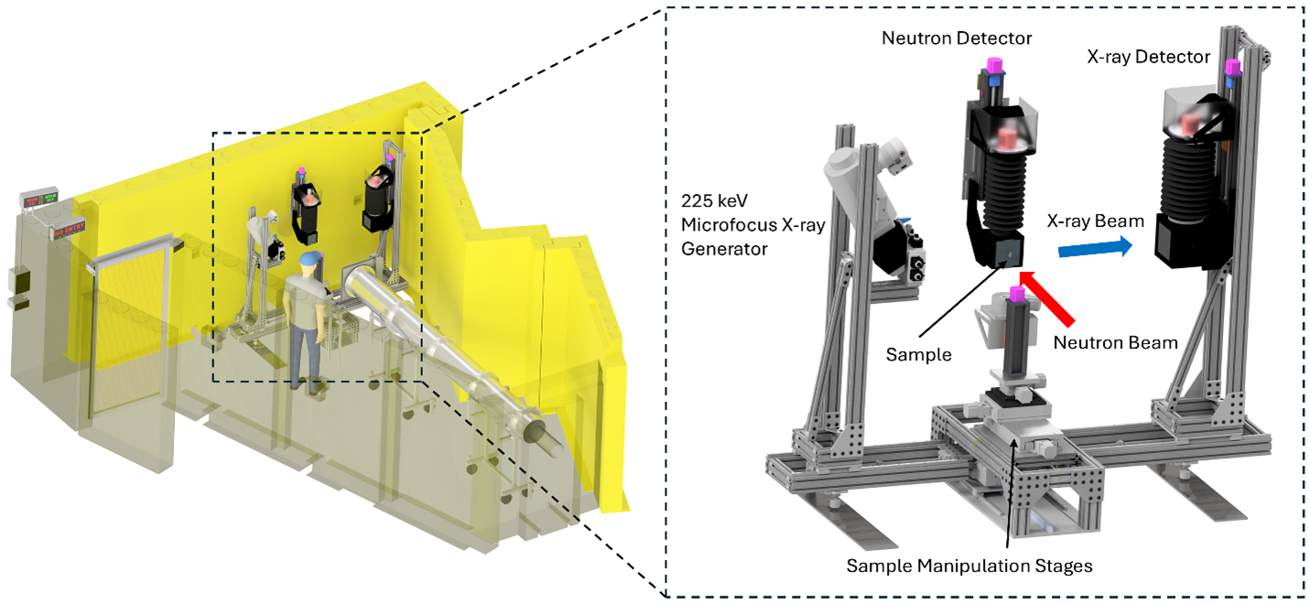
Coordinated Neutron & X-ray Tomography: NIST’s
National Center for Neutron Research (NCNR)
Notes:
Images from NIST – National Center for Neutron Research – Neutron Imaging Facility
https://www.nist.gov/laboratories/tools-instruments/neutron-imaging-facility-nif
https://www.nist.gov/programs-projects/imaging-neutron-and-x-ray-tomography-next-system

Slide 21
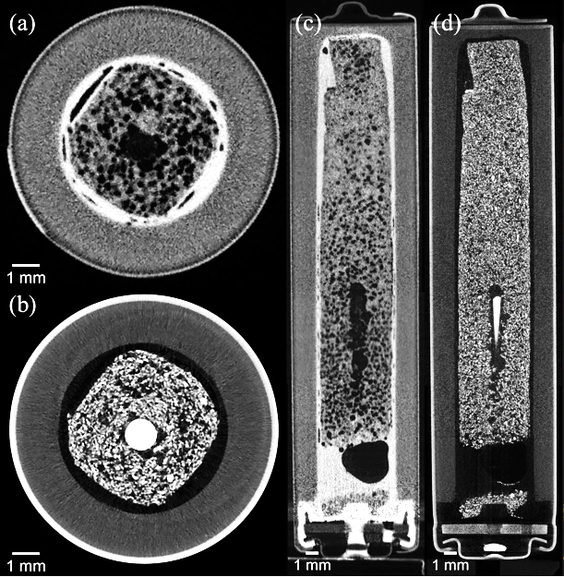
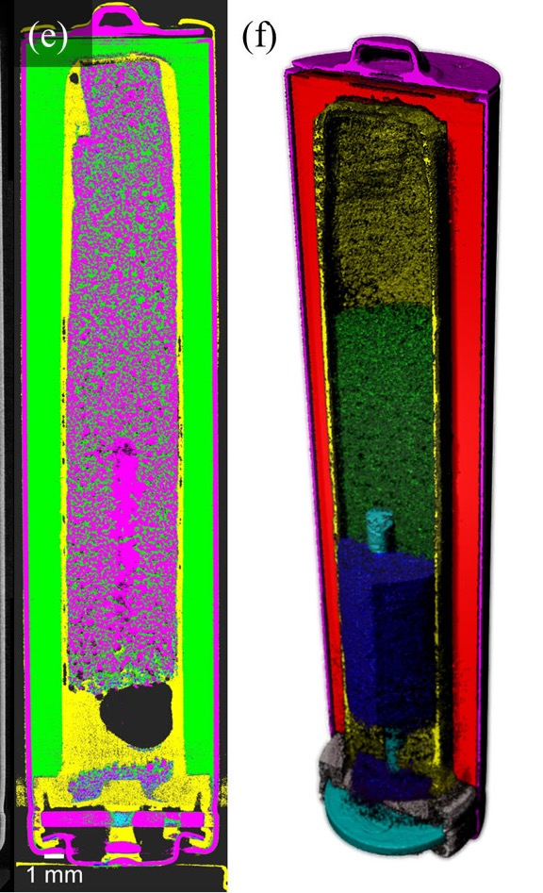
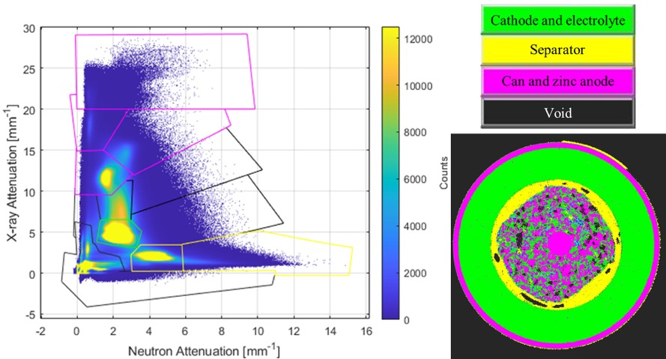
NXCT – AAA BATTERY
From LaManna et al. (2020)
Figure 5. (a) Axial neutron slice through the AAA alkaline battery. (b) Corresponding axial X-ray slice through the battery. (c) Vertical neutron slice through battery. (d) Corresponding vertical X-ray slice through battery. (e) The colorized vertical slice produced in the bivariate histogram segmentation tool. (f) 3D visualization of segmentation produced in Dragonfly [20] . Legend for (f): magenta – stainless steel, red – manganese cathode, yellow – separator, green – electrolyte, blue – zinc anode, cyan – anode current collector, grey – gasket.
Figure 4. The bivariate histogram (left) of the alkaline battery. Yellow, green, and magenta polygons on histogram are the corresponding regions of interest for the colorized segmented slice shown on the right. Black polygons correspond to regions
of interest not shown in this specific slice of the battery. Color legend shown in the top right.
Notes:
LaManna, J. M., Hussey, D. S., DiStefano, V. H., Baltic, E., & Jacobson, D. L. (2020, September). NIST NeXT: a system for truly simultaneous neutron and x-ray tomography.
In Hard X-Ray, Gamma-Ray, and Neutron Detector Physics XXII (Vol. 11494, pp. 61-71). SPIE. . Figs 4 & 5..

Slide 22
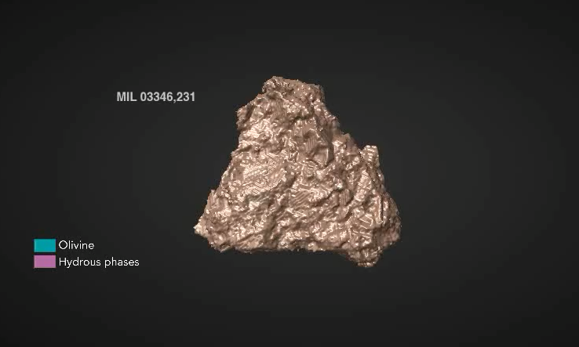
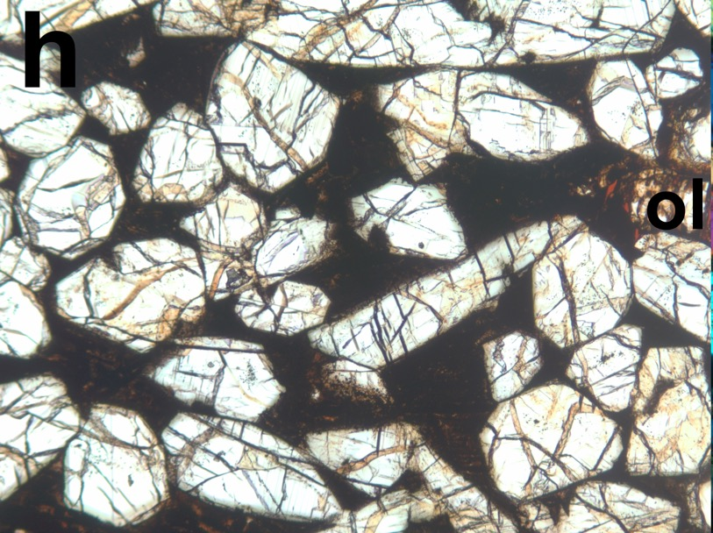
Coordinated X-ray and Neutron Tomography
Nakhlite Meteorite Aqueous Alteration
NWA 03346: nakhlite meteorite from Mars (thin section, 2.3 mm, across), with brown aqueous alteration material that formed on Mars. Rock consists of augite pyroxene (clear), olivine (clear), and devitrified glass (dark). Treiman (2005) .
Martell, J., Alwmark, C., Daly, L., Hall, S., Alwmark, S., Woracek, R., Hektor, J., Helfen, L., Tengattini, A. and Lee, M. (2022) The scale of a martian hydrothermal system explored using combined neutron and x-ray tomography. Science Advances, 8(19), p.eabn3044. {Lund Univ., Swe.}
See also Treiman et al. (2022) & Martel et al. (2024)
Notes:
Treiman, A. H. (2005). The nakhlite meteorites: Augite-rich igneous rocks from Mars. Geochemistry, 65(3), 203-270.
Martell, J., Alwmark, C., Daly, L., Hall, S., Alwmark, S., Woracek, R., Hektor, J., Helfen, L., Tengattini, A. and Lee, M., 2022. The scale of a martian hydrothermal system explored using combined neutron and x-ray tomography. Science Advances, 8(19), p.eabn3044.
Treiman, A.H., LaManna, J.M., Hussey, D.S., DeClue, I. and Anovitz, L.M., 2022. Coordinated Neutron and x‐ray computed tomography of meteorites: Detection and distribution of hydrogen‐bearing materials. Meteoritics & Planetary Science, 57(10), pp.1820-1835.
Martell, J., Alwmark, C., Woracek, R., Alwmark, S., Hall, S., Ferrière, L., Daly, L., Koch, C.B., Hektor, J., Johansson, S. and Helfen, L., 2024. Combined neutron and x‐ray tomography—A versatile and non‐destructive tool in planetary geosciences. Journal of Geophysical Research: Planets, 129(2), p.e2023JE008222.

Slide 23
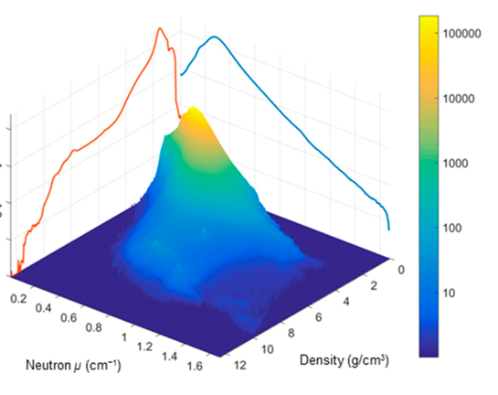
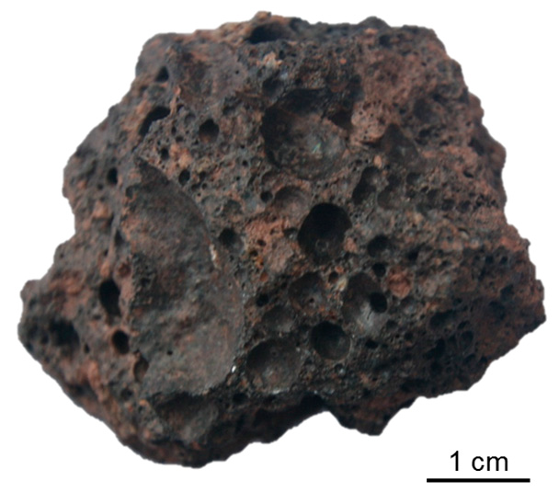
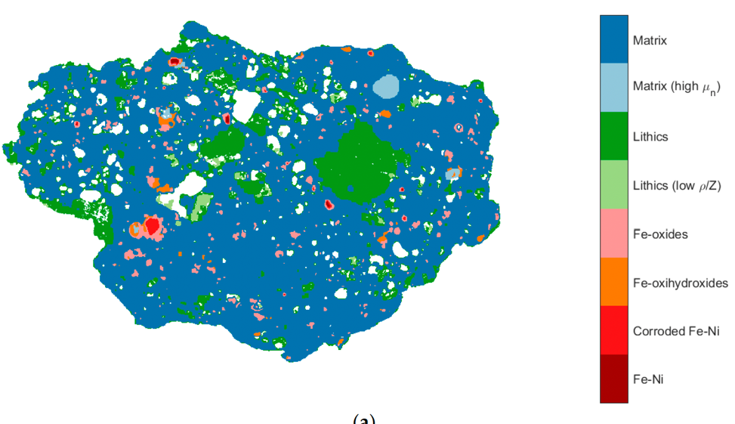
Coordinated X-ray and Neutron Tomography:
Monturaqui Impactite
Fragment of impact ejecta from the Monturaqui meteorite impact crater, Chile. ”…demonstrating the potential for non-destructive characterisation of key features of complex multi-phase objects ….”
Fedrigo, A., Marstal, K., Bender Koch, C., Andersen Dahl, V., Bjorholm Dahl, A., Lyksborg, M., ... & Strobl, M. (2018). Investigation of a Monturaqui impactite by means of bi-modal X-ray and neutron tomography. Journal of Imaging, 4(5), 72. {Lund & DTU}
Notes:
Fedrigo, A., Marstal, K., Bender Koch, C., Andersen Dahl, V., Bjorholm Dahl, A., Lyksborg, M., ... & Strobl, M. (2018). Investigation of a Monturaqui impactite by means of bi-modal X-ray and neutron tomography. Journal of Imaging, 4(5), 72.

Slide 24
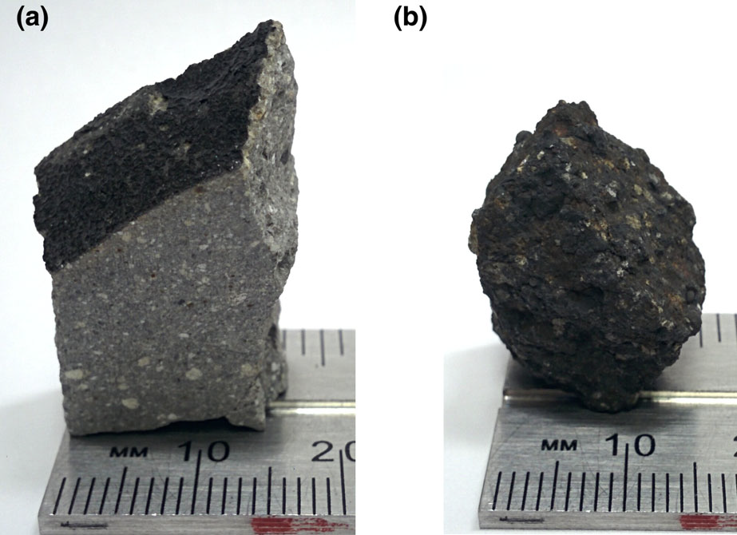
Lab Exercises: NXCT of Meteorites!
Import X-ray and neutron image stacks into Dragonfly
Compare N- and X-CT tomograms
Create bivariate histogram
Segment on bivariate histogram
Explore segmented bivariate tomograms
Treiman, A.H., LaManna, J.M., Hussey, D.S., DeClue, I. and Anovitz, L.M., 2022. Coordinated Neutron and x‐ray computed tomography of meteorites: Detection and distribution of hydrogen‐bearing materials. Meteoritics & Planetary Science, 57(10), pp.1820-1835.
  Done at NIST.
EET 87503 – a howardite
With CM-chondrite fragments
GRO 87503 – a CR 2? chondrite
Altered or not?

Slide 25
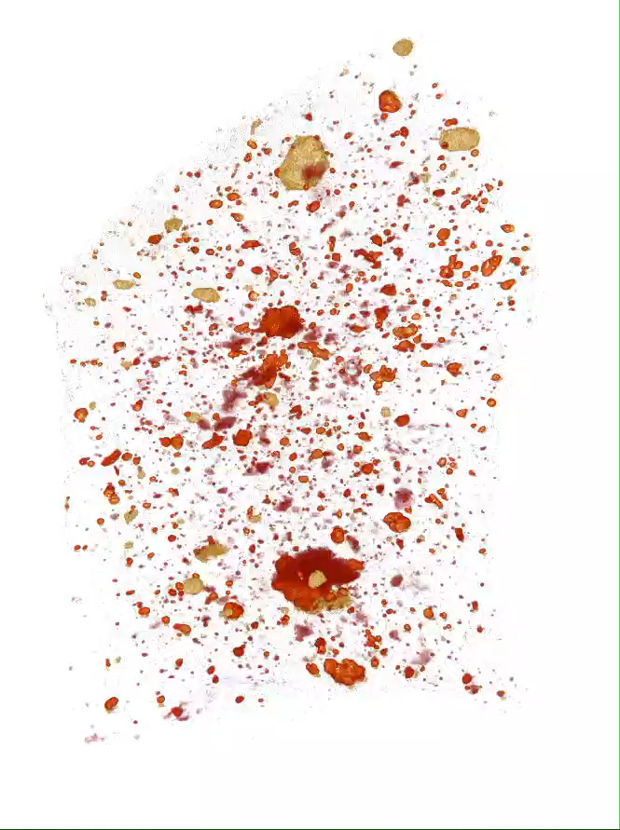
EETA 87503 – a howardite
Red = X-ray attenuation
  Iron
    Darker = metal
    Paler = basaltic fragments
Yellow = Neutron attenuation
  Hydrogen (+ iron)
    CM-ish chondrite fragments
  Clear = little attenuation
    Neither Fe nor H
      Diogenitic opx

Slide 26
Requirements for Tomographic Reconstruction
5. ? Isotropic Response (?)
Attenuation or emission is independent of the orientation or polarization of source or detector
  Must avoid or suppress diffraction (X-rays, neutrons)
Eliminates interactions that depend on polarization, like pleochroism in anisotropic minerals
  Biological stuff is mostly isotropic to light and X-rays
  Crystals are effectively isotropic to X-rays, except near absorption edges.
    Dyar et al. (2002) Canadian Mineralogist 40, 1375.
Dichroic (pleochroic) X-ray tomography is done for polycrystalline single-substances.
  Asperos A. et al. (2024) Nature 636, 354.
Notes:
Ade, H., & Hsiao, B. (1993). X-ray linear dichroism microscopy. Science, 262(5138), 1427-1429.
Dyar, M. D., Gunter, M. E., Delaney, J. S., Lanzarotti, A., & Sutton, S. R. (2002). Systematics in the structure and XANES spectra of pyroxenes, amphiboles, and micas as derived from oriented single crystals. The Canadian Mineralogist, 40(5), 1375-1393.
Apseros, A., Scagnoli, V., Holler, M., Guizar-Sicairos, M., Gao, Z., Appel, C., ... & Ihli, J. (2024). X-ray linear dichroic tomography of crystallographic and topological defects. Nature, 636(8042), 354-360.

