Slide 1


Overview of UTCT and XCT in Planetary Sciences
Romy Hanna
UTCT
Jackson School of Geosciences
University of Texas at Austin

Slide 2
Part I: An Introduction to UTCT
Notes:
So, part one, an introduction to our lab.

Slide 3
UTCT Lab and its History
1997: First instrument acquisition
1999: Became NSF-supported multi-user facility
  Renewed 2001, 2004, 2007, 2010, 2013, 2016, 2018, 2022, 2025 RCE
2023: Became NASA Planetary Science Enabling Facility (PSEF)
Notes:
We acquired our first instrument in 1997

Slide 4
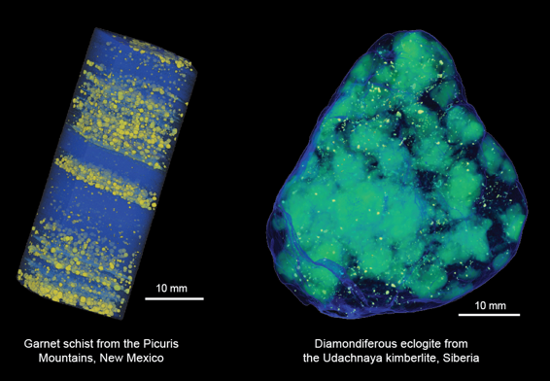
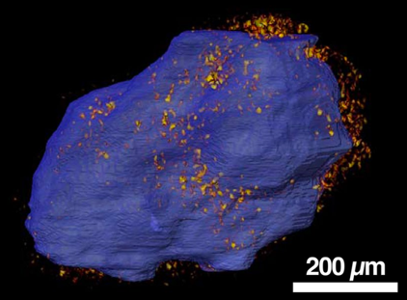
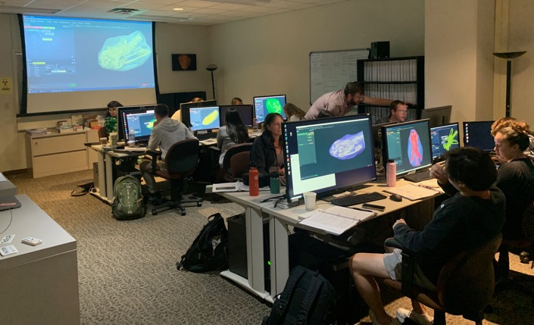
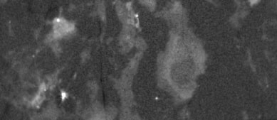
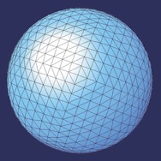
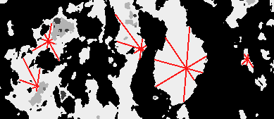
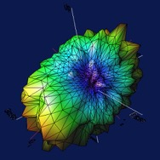
What We Do
XCT Imaging
Research
High porosity areas around CM Murchison chondrule (Hanna et al. 2022)
Quant3D
Software Development
Short Courses

Slide 5
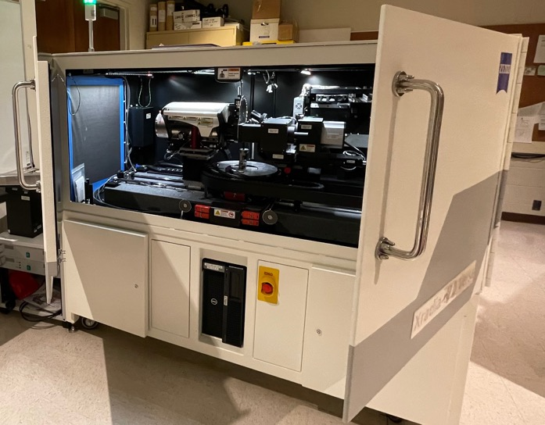
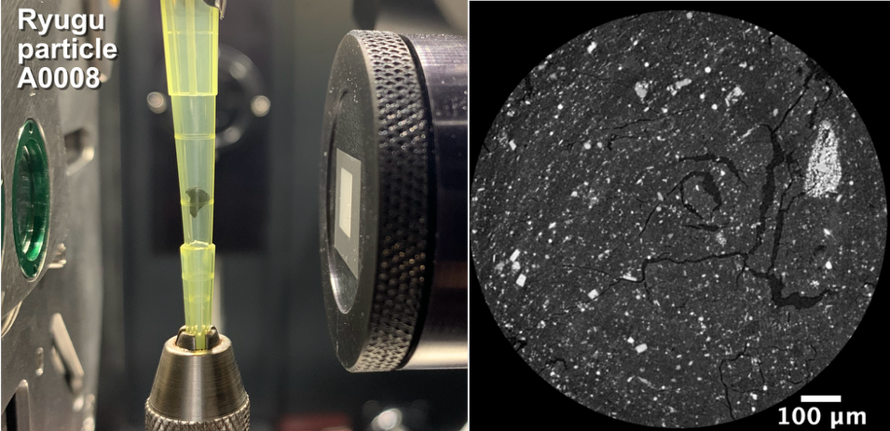
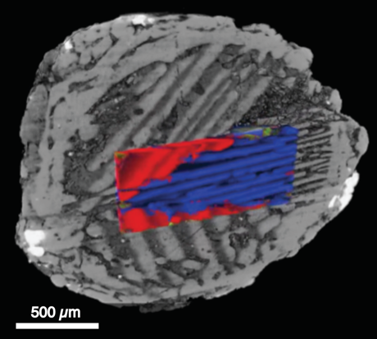
Zeiss 620 XRM
30-160 kV source up to 25 W
Imaging objects ranging from ~14 cm across to < 1 mm
Feature detectability to 0.5 µm and voxel size to ~0.04 µm (depending on sample size)
X-ray diffraction contrast tomography (DCT): 3D crystallographic orientations in sufﬁciently small samples (< 2 mm)
DCT: Barred olivine orientations

Slide 6
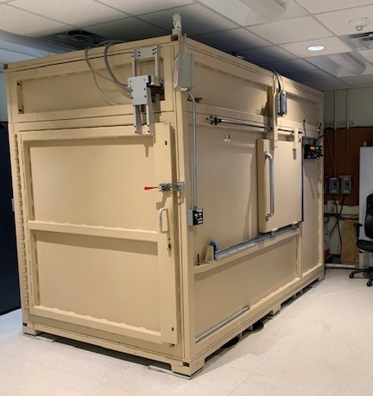
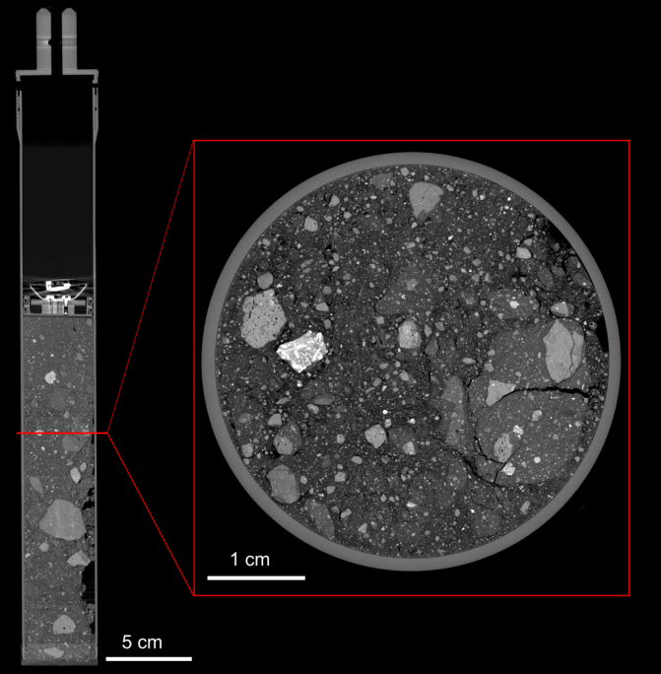
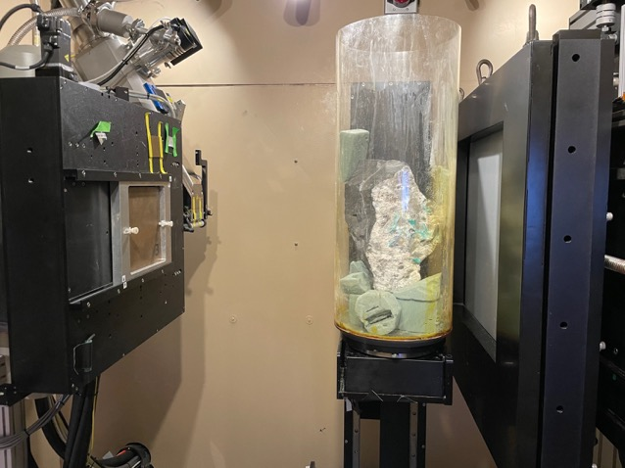
NSI Scanner
450 kV source for large (~dm-scale) or highly-attenuating objects
225 kV source with 5-µm spot size for detailed imaging of most samples
Helical scanning for objects with high aspect ratios such as cores
'SubpiX' mode for creates a virtual detector with ~2X higher spatial resolution than traditional scanning
Apollo Drive Tube 73002 with SubpiX imaging
Emerald-bearing rock imaged with 450 kV source

Slide 7
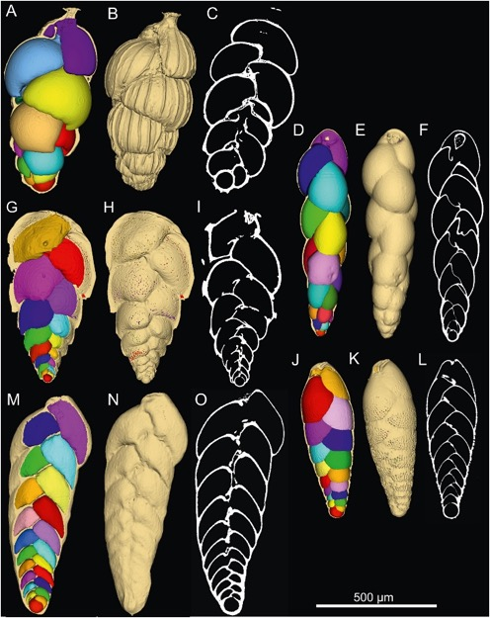
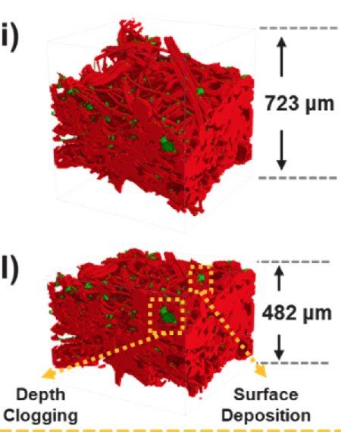
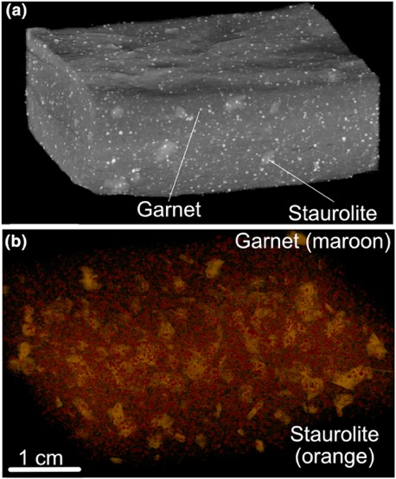
Wide Variety of Clients and Projects
In last 3 years alone, 209 PI-led projects for over 8,000 hours of scanning
Clients and applications span many disciplines
Deep-sea foraminifera; Belanger 2022
Dust in filter media; Song and Shim 2022
Metapelite; Nagurney et al., 2022
Notes:
In the following slides I highlight some research led by UTCT-supported PIs that has significantly contributed to research
These three recent figures show the breadth from biology, to engineering, to geology on the right, all using data produced by our lab.
Nagurney – garnet P/T conditions for crystallization by analyzing their 3D distribution and CSD

Slide 8
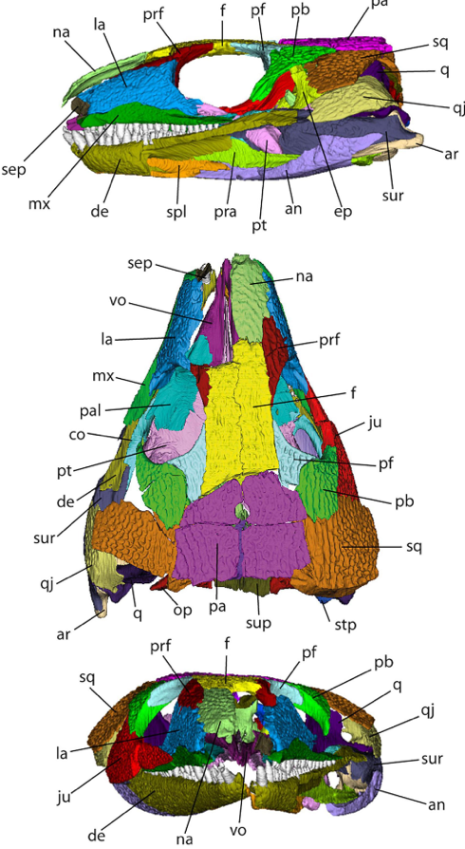
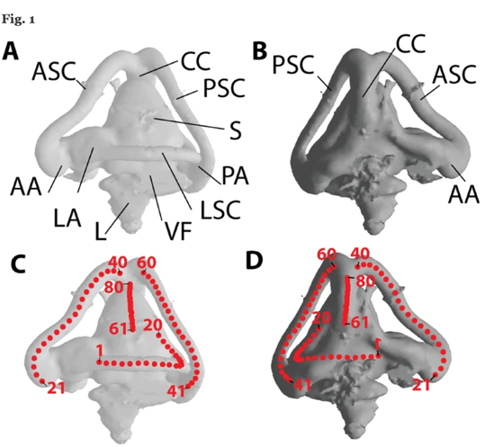
Paleontology
Descriptive and quantitative morphology
Curatorial
  Library of Digital Morphology http://www.digimorph.org
  Contributions to MorphoSource.org (biological specimens)
Digitally isolated skull bones of a fossil reptile Abel et al. 2022
Inner ear morphological analysis of lizards; Latimer et al. 2023
Notes:
- In paleontology CT is now used for the majority of descriptive and quantitative morphology research.
It also has a large Curatorial aspect.
Our lab developed the Digimorph Digital Morphology library that is widely used to examine the 3D structure of fossilzed and recent vertebrates, and we have also recently begun a collaboration with Morphosource, which is it’s biological counterpart, run out of Duke University.

Slide 9
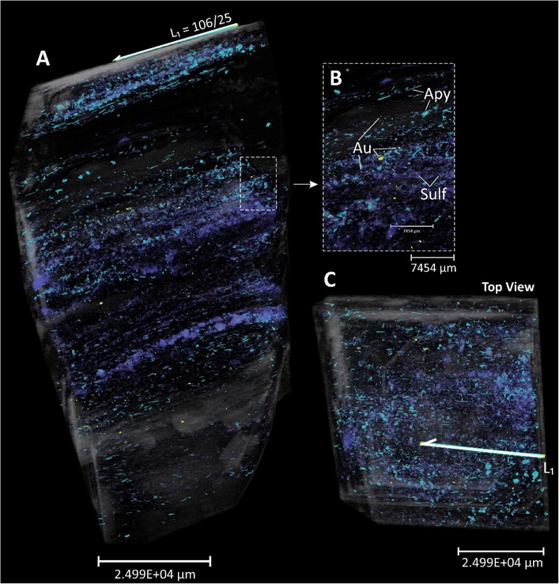
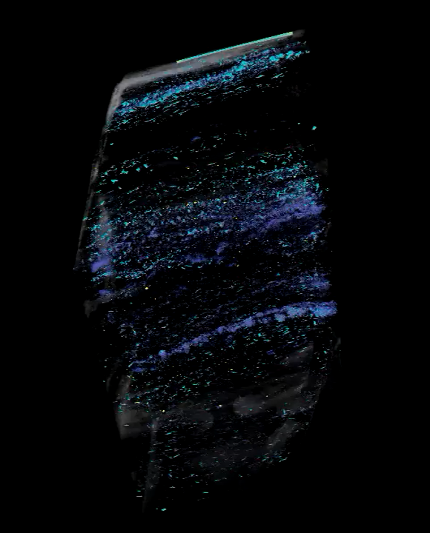
3D Petrography
2D: Like having 1000s thin sections, in all orientations
3D: Volume rendering
Hunting for tiny stuff like
gold grains
Ferraz de Costa et al., 2022
Notes:
- When it comes to classical geology, CT essentially provides a way to do 3D petrography.
-Trying to find gold grains in an ore via thin sectioning is painful, but with xCT one can quickly find these highly attenuating grains in the volume and measure their abundance as well as investigate their distribution and 3D relationship to other phases. Purple – sulfide, blue arsenopyrite, yellow gold

Slide 10
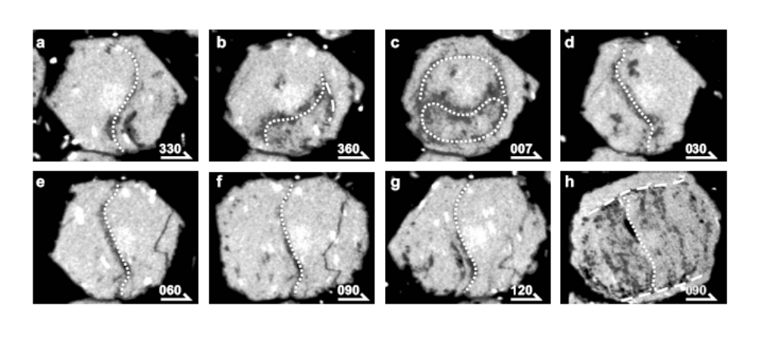
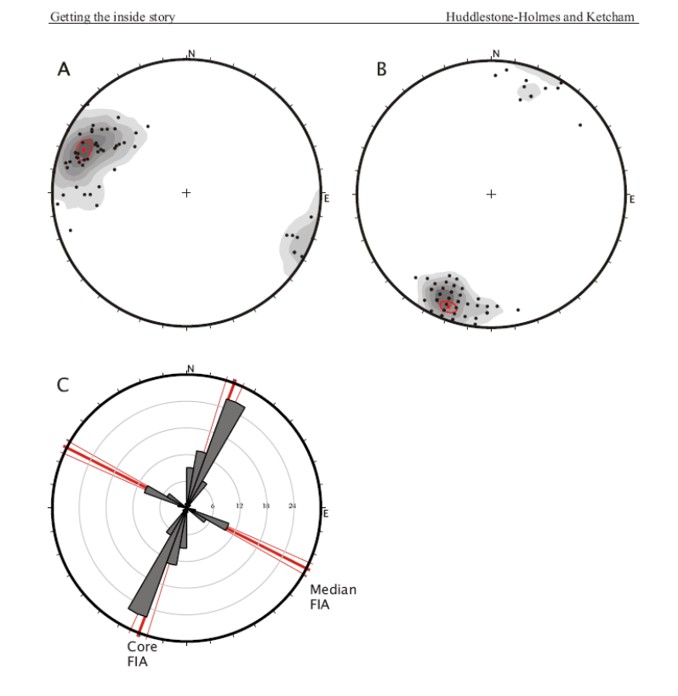
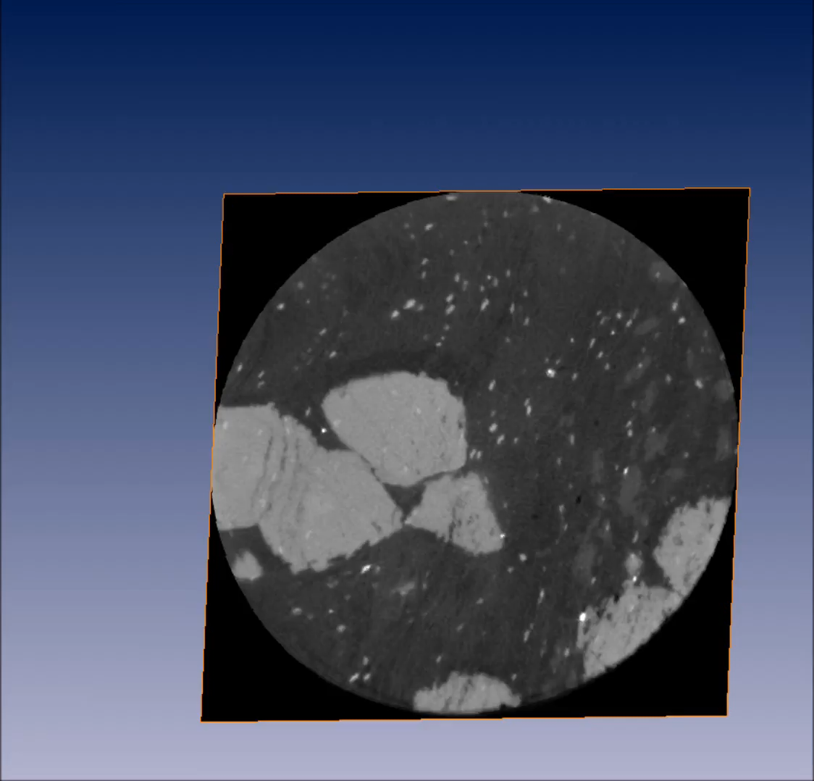
Structural Geology
Can find “asymmetry flip” orientation for each porphyroblast in volume using the inclusion trails
Huddlestone-Holmes and Ketcham (2010)
Notes:
XCT has also done a lot for structural geology research
Specifically, the inclusion fabric orientations within the garnets can be used to rescontruct the local strain orientation during their formation.
- The application of XCT to this problem was pioneered by a student from our lab.

Slide 11
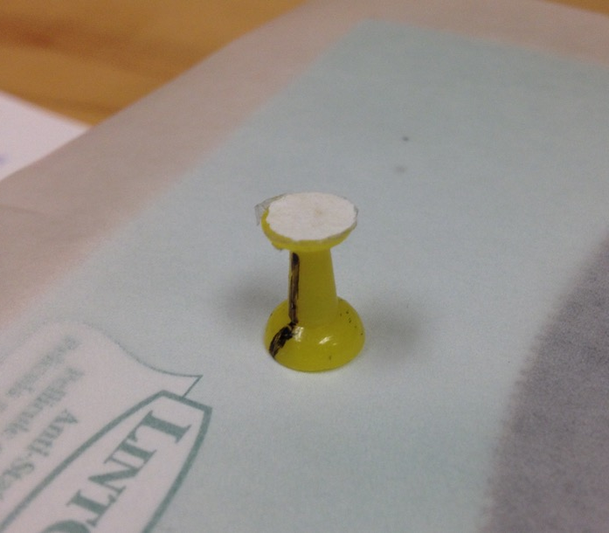
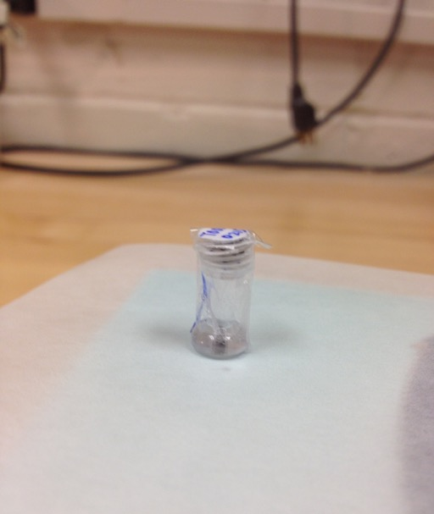
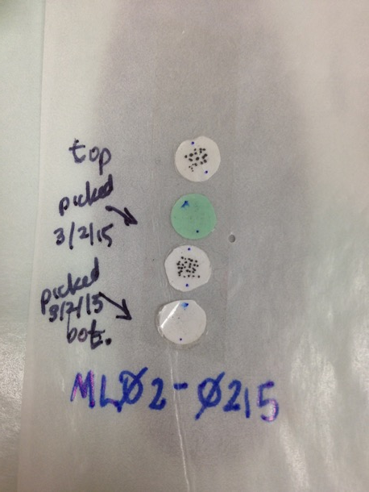
“Look before you dissolve”
Mounting and screening magnetite for (U-Th)/He work (Emily Cooperdock; former UTCT PhD student)
Notes:
- This last example is more recent work we’ve been doing integrating geochronology and XCT.
- These images show a new process developed by a previous student Emily Cooperdock, for screening magnetites prior to Uranium thorium He dating.

Slide 12
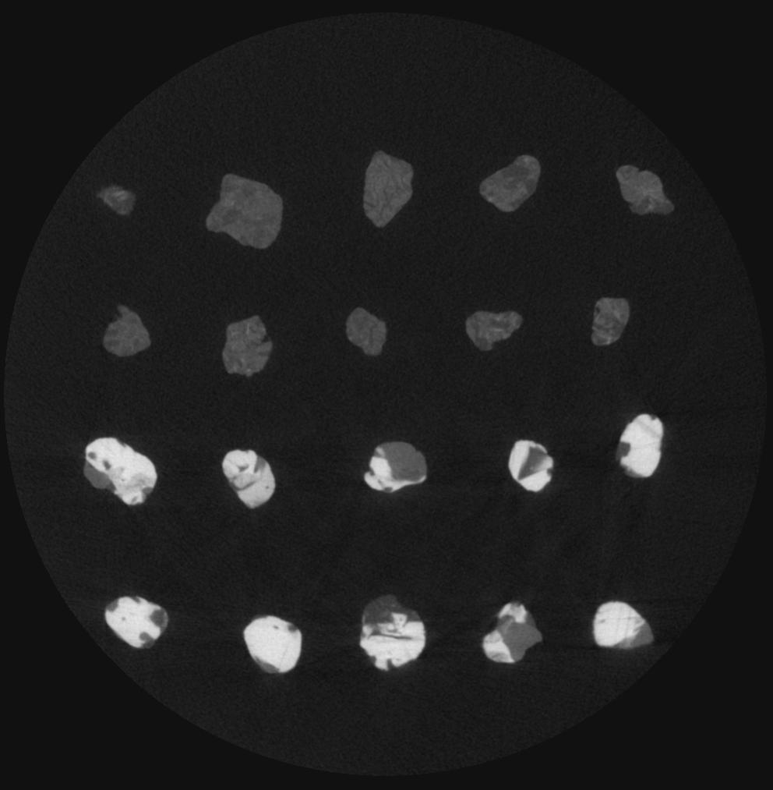
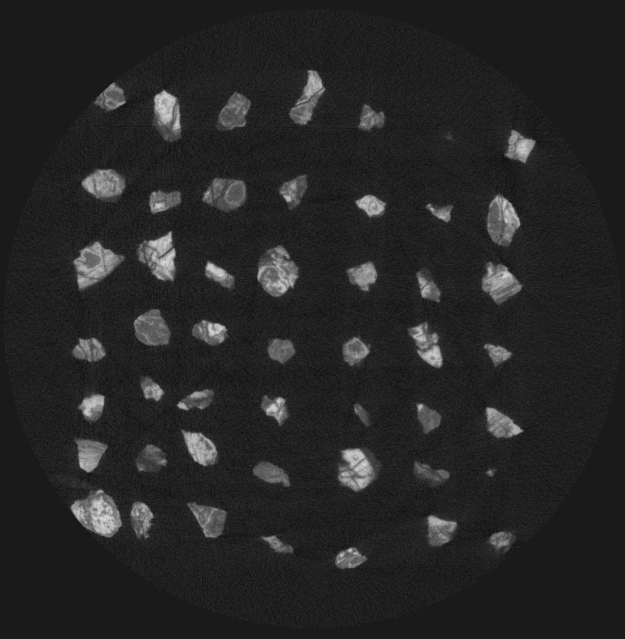
“Look before you dissolve”
Is it magnetite just because a magnet grabs it?
1 mm
1 mm
Cooperdock and Stockli, 2016
Notes:
She found that screening individual magnetites prior to dissolution was key, as many seemingly magnetite particles picked out using the traditional technique of a magnet where not pure magnetite and thus not suitable for combining to derive a single thermochron date.

Slide 13
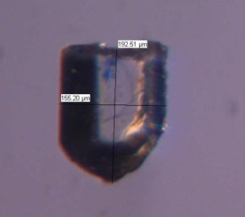
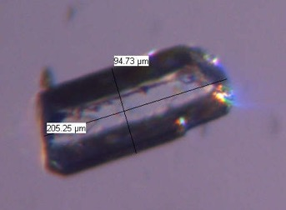
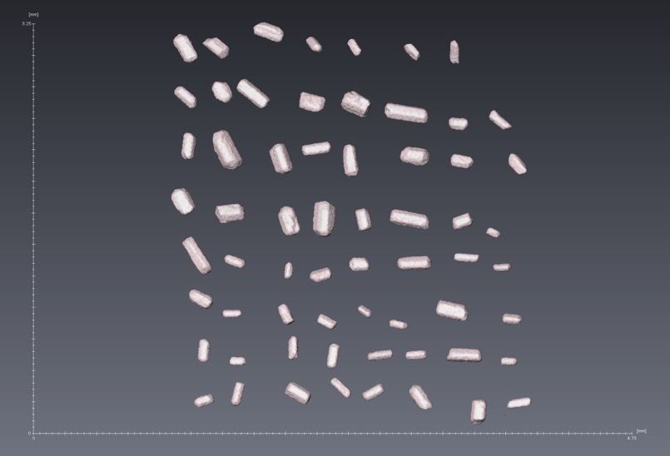
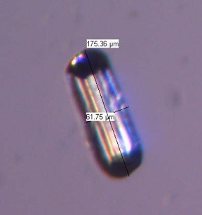
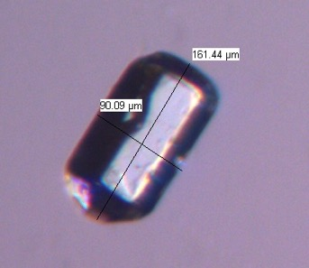
CT and geo/thermochronology
Apatite
2D measurement
CT Scan
1 mm
Find inclusions; measure precise volume, FT; shape analysis – Rich Ketcham new work
Notes:
Our director Rich ketcham is also heavily involved in geo/thermocronology is extending Blob3D to do shape analysis using spherical harmonics on detrial zircons.

Slide 14
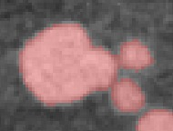
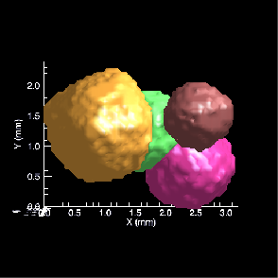
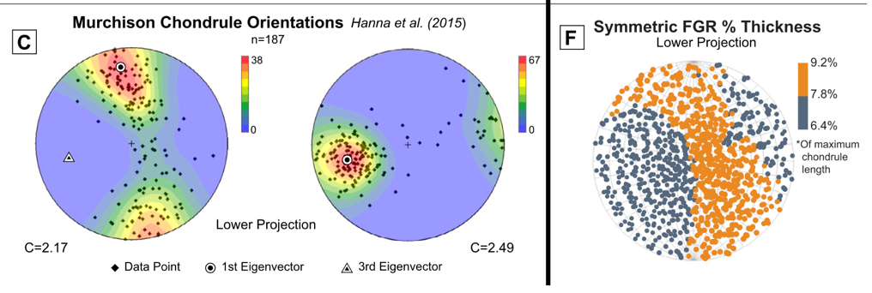
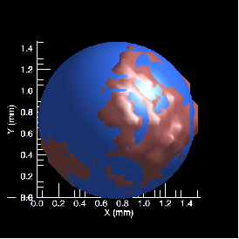
Object Measurement with Blob3D
Segmentation of object (phase/mineral/void) voxels
Separation of touching objects
Measurement of objects, including shape and orientation analyses

Slide 15
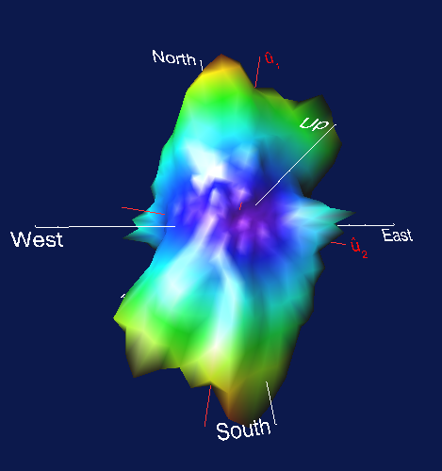
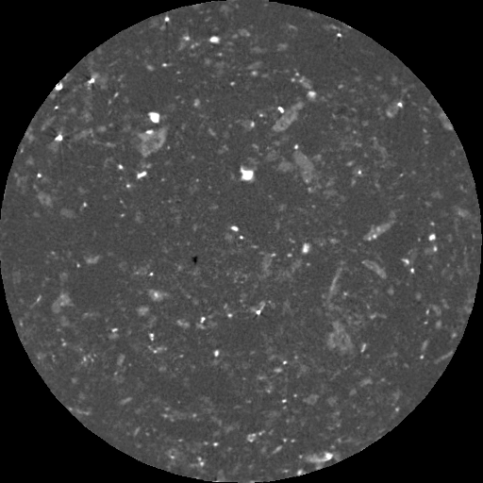
Mineral Fabrics with Quant3D
Foliated Rhyolite
Henry Mountains, Utah
SVD, 3D Rose Diagram
Amphibole Orientations
Amphibole
Oxide
5 mm
Sample courtesy of E. Horsman, University of Wisconsin

Slide 16
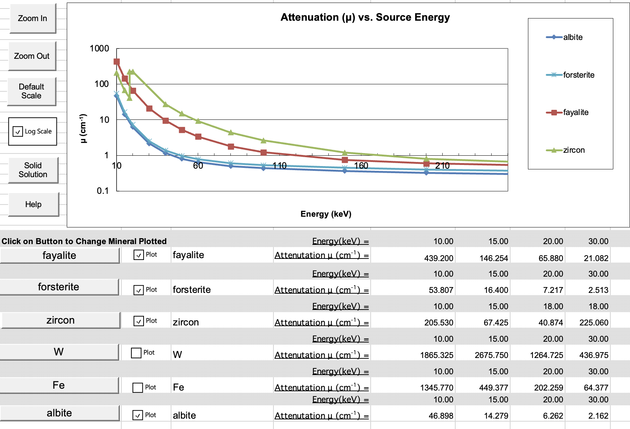
MuCalc Worksheet

Slide 17
Part II: XCT in the Planetary Sciences
A tour of what is possible with XCT!

Slide 18
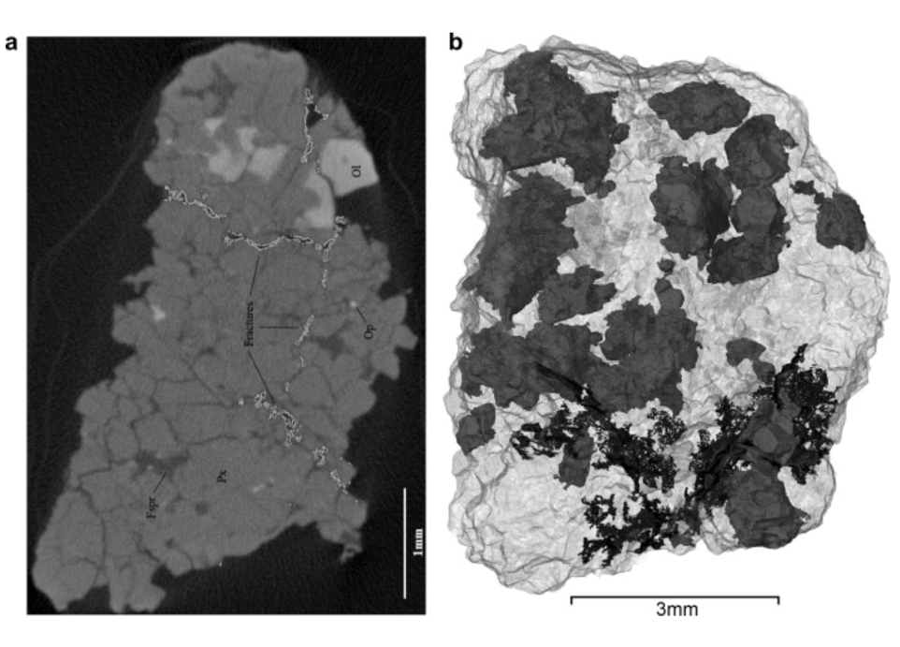
Nakhlite Fracture Networks
3D fracture network from XCT and 2D thin section analyses allowed mapping of alteration pathways
Needham et al. (2013)

Slide 19
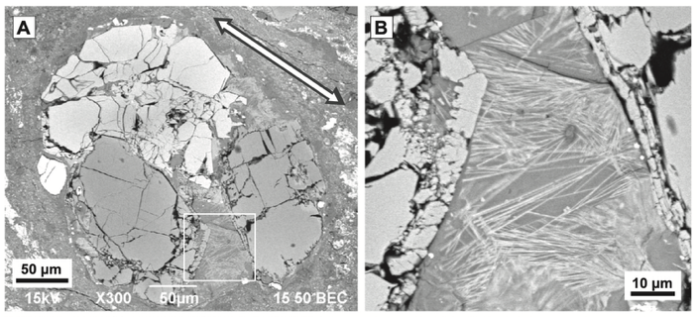
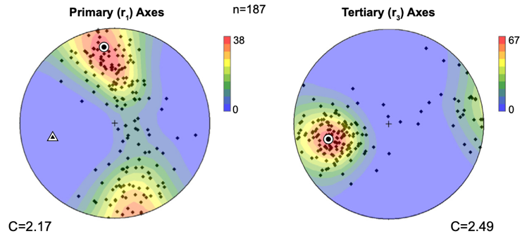
Chondrule Deformation
CM Murchison chondrules
Hand-drawn orthogonal planes
Hanna et al. (2015)
Orientated thin section
Chondrules foliated from impact

Slide 20
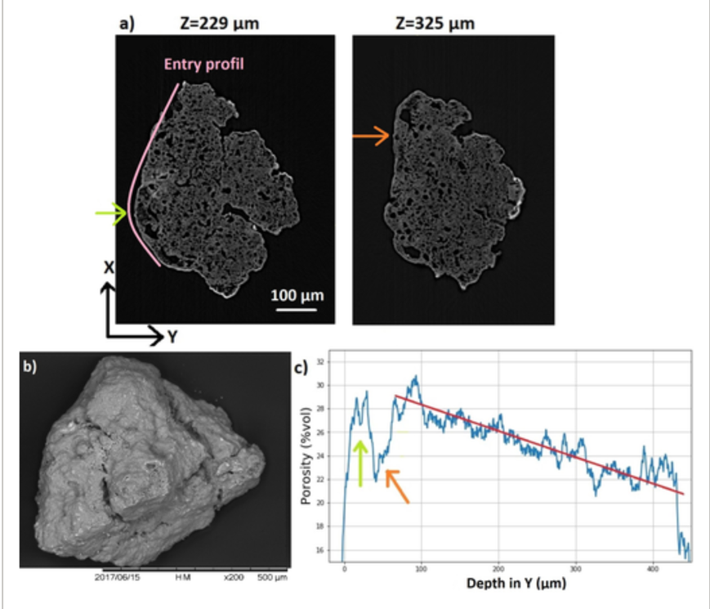
Micrometeorite Entry Dynamics
3D porosity profiles (temperature proxy) and shape analysis demonstrate spinning atmospheric flight entry of MMs
Dionnet et al. (2020)

Slide 21
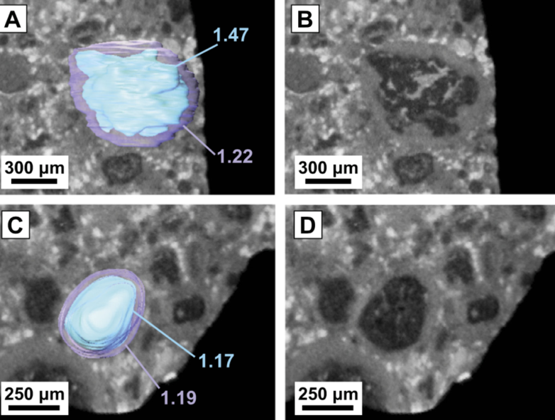
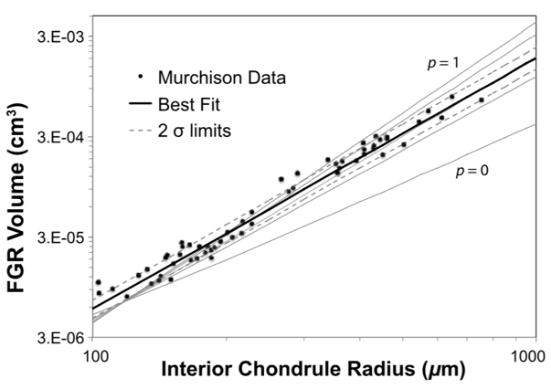
Nebular Accretion Models
Rim volume – chondrule size / rim volume relationship supports nebular formation model for dust rims in meteorite CM Murchison.
From Hanna and Ketcham (2018)

Slide 22
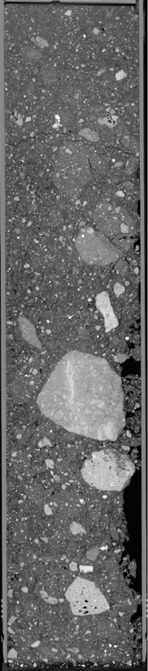
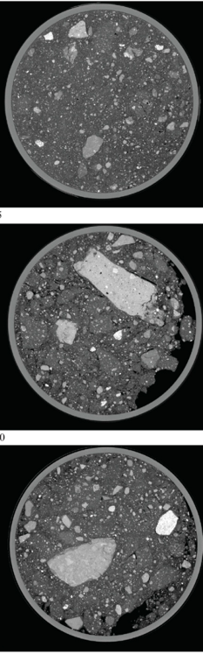
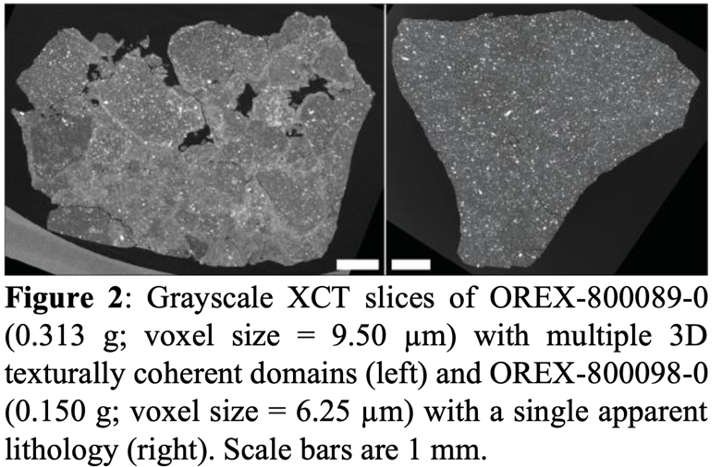
Curation
Apollo drive tubes (ANGSA)
Bennu particles
(OSIRIS-REx)
Eckley et al. 2025
73002
Eckley et al. 2025

Slide 23
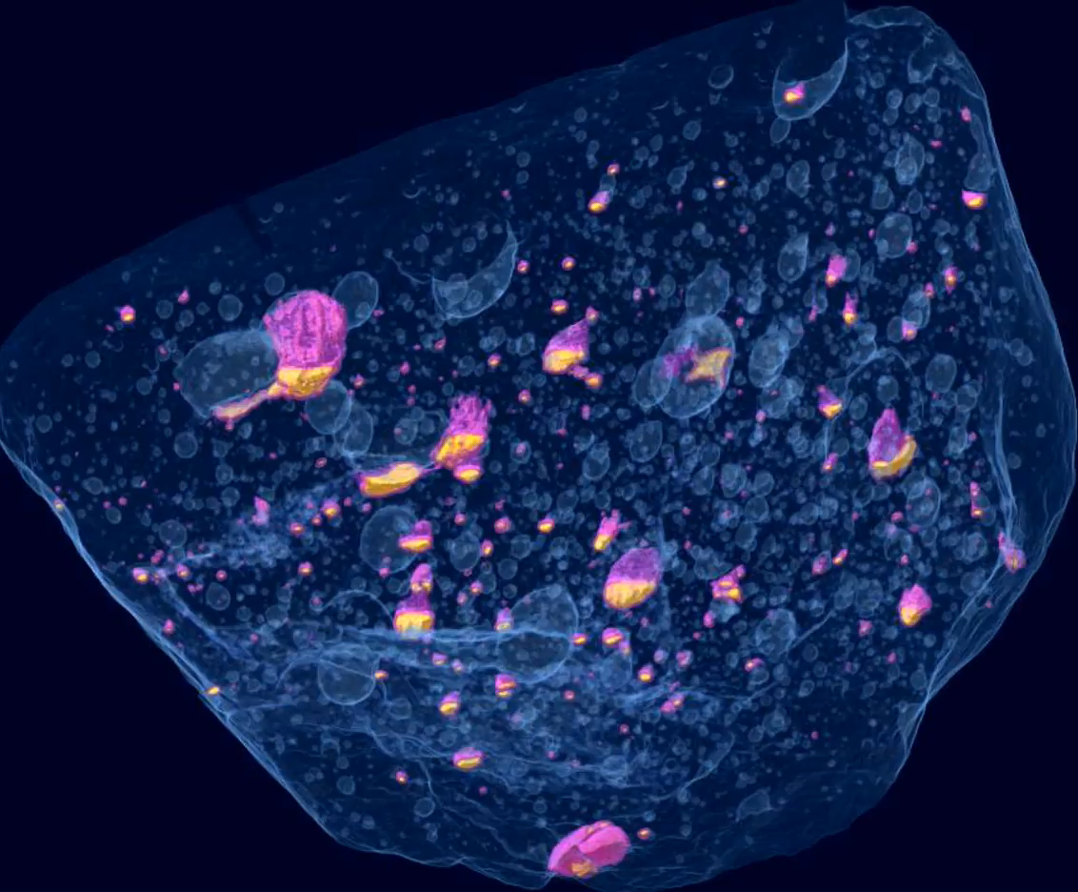

Impact Melt Cooling History
Impact melt sheet cooled on asteroid
Metal-sulfide contacts record gravitational field
Vesicles elongated due to flow
2 cm
L Chondrite
PAT 91501
From Benedix et al. (2008)
and Hanna and Ketcham (2017)

Slide 24


Silicate Partial Melting
H7 Watson 012
Plagioclase 3D grain connections showing melt network in grain-supported matrix – slow cooling at depth.
Tait et al. (2014)

Slide 25


CI Chondrite “Sediments”
Segmented clasts show weak lineation consistent with linear alignment during shear-dominated movement (impact? Seismic shaking?)
CI Ivuna
Friedrich et al. (2025)

Slide 26


Planetary XCT Data Repositories and Archival

