Slide 1
Quantification from CT data
Romy Hanna
UTCT
Jackson School of Geosciences
University of Texas at Austin
Notes:
The next part of our lecture series for the UTCT shortcourse is quantification from CT data, with a special emphasis on software called BLob3D that we have developed in the lab to measure discrete objects in CT data.

Slide 2
What are your data, really?
Gray-scale images?
A bunch of ones and zeros
  16-bit unsigned (0-65535)
  8-bit (0-255)
  Others
    Hounsfield units (-1000-3095)
    Floating point (anything, but 32 bits/pixel)
  Stored in some file format
    Uncompressed or lossless compression: TIFF, RAW, DICOM
    Lossy compression: JPG (DO NOT USE)
Notes:
- So, first to understand what you can really get out your data, you need to understand what the data are and are not.
At first glance they are grayscale images, but really, behind that your data is represented a bunch of ones and zeros, that were determined by the reconstruction software
This data can be stored in your computer in a variety of ways
The raw, highest fidelity data is currently 16 bit unsigned numbers – this is most commonly what comes from the reconstruction software.
They can also be stored as 8 bit data, but this is downgraded from the original 16bit data and so some data is lost upon this conversion, but is usually more than sufficient for quantification work.
There are other data units too, such as Hounsfield, which is a an older, medical data format, and occasionally floating point but in the vast majority of cases this is just wasted space, as the original data were 16bit data integers anyway.
There are a couple of different file formats the can be stored in the most common ones being TIFF, RAW, and DICOM which are uncompressed or lossless formats
Sometimes CT data can be stored in a lossy compression, such as JPGs, but this is compressed data, heavily downgraded from its original state, and should never be used.

Slide 3
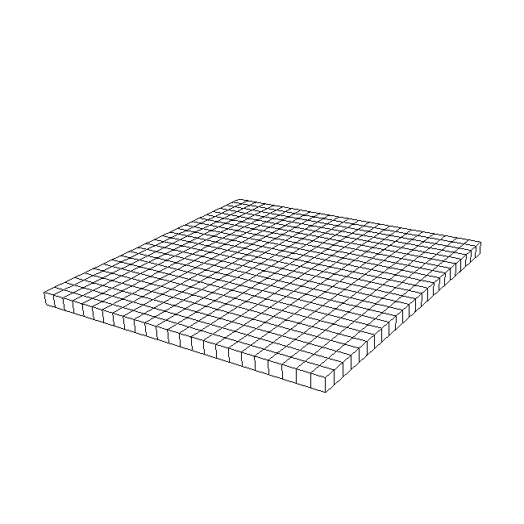
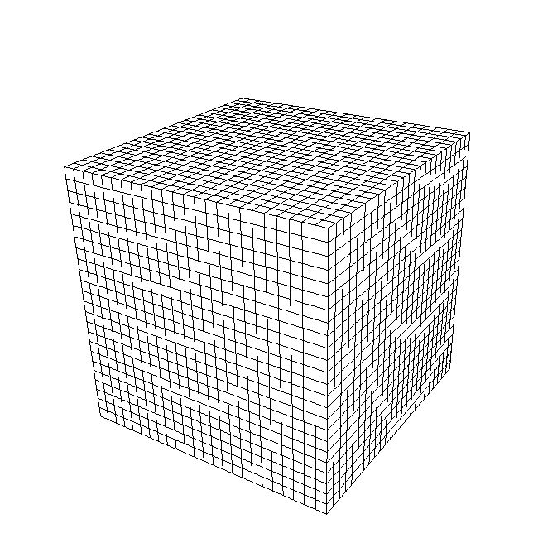
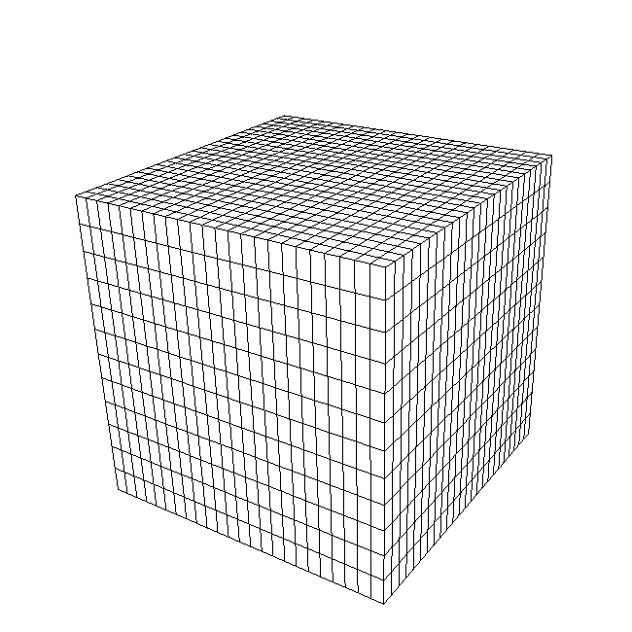
What are your data, really?
One slice image
Set of slices = volume
(a.k.a. “data brick”)
Volume
Slice thickness ≠
pixel spacing
Notes:
- CT data is stored as a series of slice images that make up a data volume, where each element is a voxel, or a 3D pixel
Usually the voxel is equant, but for data for some older scanners, the slice thickness of each image is not equal to the pixel spacing within the image, and the voxels have aspect ratios greater than 1

Slide 4
Quantification
Large discrete things (Blob3D)
  Objects spanning many voxels
Small discrete things (various)
  Features at the few/partial voxel level (thin fractures, small pores or grains)
  WARNING: these require special approaches
Fabrics (Quant3D)
  Discontinuous or diffuse
Notes:
When examining volume data, there are three categories of features that can be quantified, and they each require a different approach to quantification
The first type are large discrete objects that span many voxels like large vesicles, porphyroblasts, etc.
These are measured with a program we developed called Blob3D, which will be covered by our next set of tutorials
If the objects are stlll discrete but only at a few or partial voxel level, these can also be measured with Blob but require specialized approaches
And finally, for fabrics, including those that are discontious or diffuse, we’ve developed another program called Quant3D that can measure these which will be covered in a separate tutorial

Slide 5
Part I:
Blob3D
For measuring discrete objects, large or small.

Slide 6
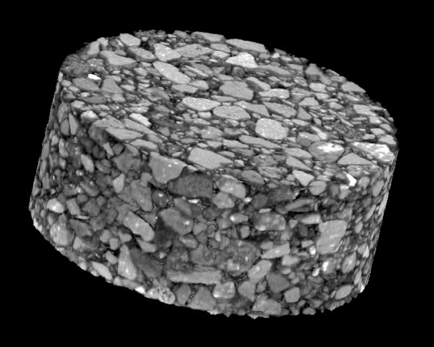
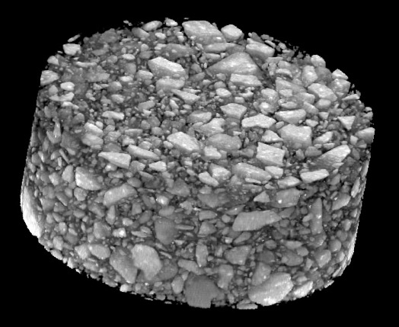
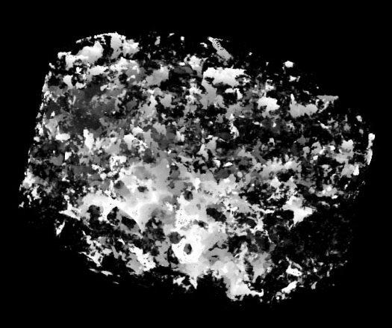
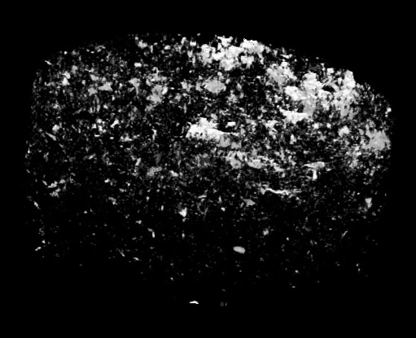
Qualitative Evaluation
Asphalt concrete
Everything opaque
Binder transparent
Solids transparent, voids opaque
Voids in different sample
Notes:
- So, say you have a core, in this particular case it’s asphalt.
- Generally the first thing you do with the data, as we’ve seen in our tutorials with Dragonfly, is to play around with visulazation of the data to understand the phases and their distribution, and perhaps look for patterns
On the upper left we have the core rendered completely opaque, to visualize everything
The next step might be the upper right, where we render only the matrix, or binder transparent.
This looks neat but doesn’t really say much quantitatively
And finally, on the bottom, we’ve rendered all the solids transparent and just the voids opaque, in two different samples, so we can see that the void space varies between samples.
But at this point it’s unclear WHY the void space varies

Slide 7
Taking it the next step
Qualitative visualization “easy”
Goal: Quantitative analysis
  Obtain complete “architecture” of concrete
  Characterize each particle (10⁵-10^{6+?} per core!)
    Size distribution/grading
    Shape, orientation
    Spatial distribution, homogeneity
      Both aggregates and voids
    Contact contact surface areas and normals
Notes:
So visualization is the easy part, but really the goal is quantitative analysis
In this case we want to understand the architecture of the core, perhaps to understand why different samples have different void structures
We need to characterize the particles within it to examine their size distribution, any grading, shapes, orientations
Then we should quantify the void space and related to that, examine the grains for their contact surface areas and normal.
For a tightly packed sample we would expect this grain contact surface area to be large, and perhaps even show orientated contacts

Slide 8
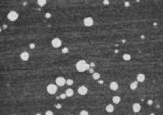
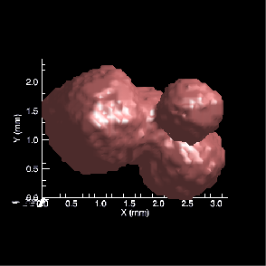
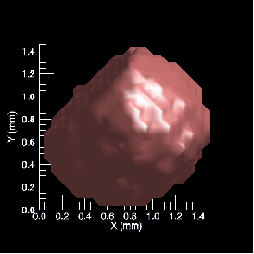
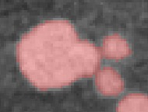
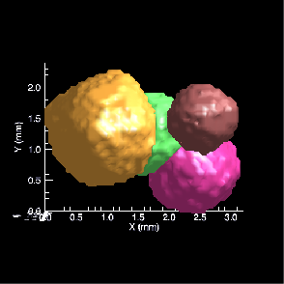
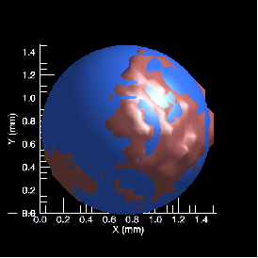
Blob3D
SEGMENT
SEPARATE
EXTRACT
Garnet example by Charna Meth
Notes:
So Blob is the program we would use to quantify these particles and voids
While some other commercial programs such as Avizo and Dragonfly can do segmentation and extraction (or measurement) of objects, Blob3D is the only one that will let the user effectively separate objects that are touching into multiple discrete objects
Blob3D also has very geo-specific measurements, including primitive fitting and particle orientation information that other programs don’t provide.

Slide 9
Blob3D Components
SEGMENT
  Determine which voxels correspond to which materials
SEPARATE
  Separate all touching (or impinging) objects
EXTRACT
  Calculate properties, statistics based on interpreted data volume
Notes:
The first step, called Segment, is labeling of data voxels that comprise each object.
The second step, separate, separates groups of objects into multiple discrete ones.
In the best cases this step is not necessary if all of the objects are sufficiently separated
The third and final step is extraction of measurements for these each of these objects

Slide 10
Segmentation
Objective: Classify voxels
  Select which ones contain the component of interest
Filters available
  Grayscale to grayscale
    Noise reduction, edge enhancement
  Grayscale to binary
    Threshold, seeding, expand/contract
  Binary to binary
    Final tweaking: remove holes, islands, noise, etc.
Notes:
Before we do the tutorial we will look at each of these steps in a little more detail.
The objective of the first step Segmentation is to classify the voxels into materials or objects of interest
There are three filter types.
Greyscale to greyscale filters are designed to filter the data to make it easier to auto segment.
Examples include smoothing or noise reduction, and edge enhancement
The next type of filter, greyscale to binary, does the actual classification, and assigns voxels to labels or compoents you have defined
Examples of this would be thresholding, seeding, or expand/contract filters.
Again, the purpose of this filter is that the objects can be automatically segmented using an algorithm, so there are no manual tools like that which are available in some commercial programs like Avizo and Dragnonfly.
So if you’re data are particularily noisy or are difficult to segment using automatic methods, we very often go through manual segmentation in another program and import that data into Blob for measurement.
I’ll show an example of that kind of workflow shortly.

Slide 11
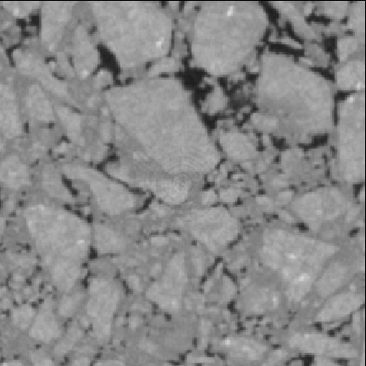
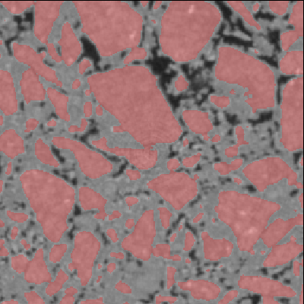
SEGMENT in action
Notes:
This gives a visual example of what Segment does.
The image of the left is the raw CT data, and the image on the right shows what Segment selected, colored in red, for the particles

Slide 12
Segmentation challenges
Multiple components
  Allow sequential, exclusive processing of each identifiable type
Large data sets (100’s-1000’s MB)
  Process reduced “test” portion interactively first
Complex, overlapping grayscales for different phases
  Use both grayscale and neighborhood/connectivity data
  Use manual or ML approaches pre-Blob
Notes:
Some challenges that may be encountered in Segmentation are:
If you have multiple components that you wish to segment, Blob allows you to do sequential, exclusive processing of each component
And, if you have a fairly large dataset Blob that may take a while to process, Blob allows you to test the filters and processing on a smaller subvolume first, and evaluate the results, before applying it to the entire dataset.
If you do have a complex segmentation task, it is still possible to use automatic methods in Blob3D by utilizing specialized filters
And while I mention that you can do manual segmentation in another program, it is highly preferable to do automatic segmentation, whenever possible, because it is much faster and also more reproducible and less prone to error.
Examples of complex filters that can enable automatic segmentation include incorporating neighborhood/connectivity data or local gradient information.

Slide 13
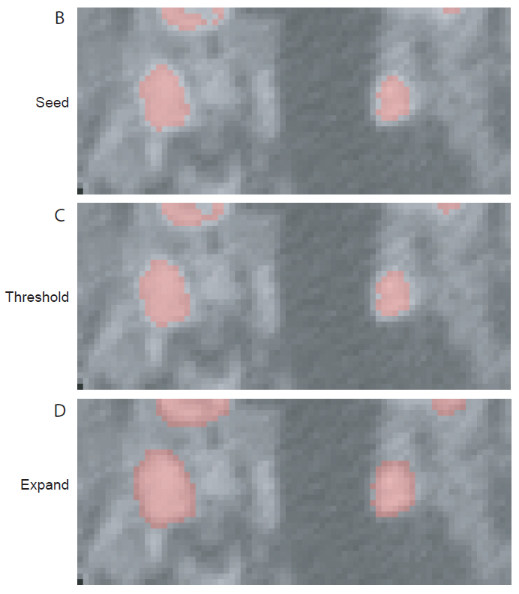
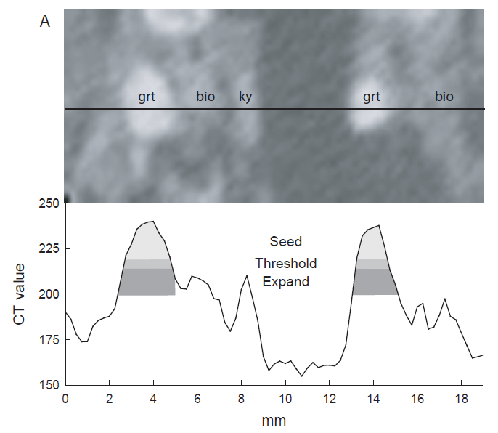
Seed / Threshold / Expand
“Correct” garnet threshold is halfway between garnet and surrounding matrix (mostly qtz+plag)
BUT, biotite and kyanite have intermediate CT numbers
Ketcham (2005)
Notes:
- One example of a connectivity filter to improve automatic segmentation is a Seed filter
Let’s say you are trying to segment garnets, which are the brightest material from the matrix which is the darkest
This line profile on the left shows the greyscale values of the various phases.
Looking at the distribution of grayscales between garnet and matrix you determine that 200 is a good threshold value
But in between you have biotite and kyanite, so that when you define 200 as your lower threshold,you will pick up some of these phases too. (point to those peaks)
The way around it is seeding. You create a seed value (perhaps 218 and above) that only covers garnets (top) but obviously not all of each garnet.
Then you do a general threshold to a lower number, to allow any seeded regions to grow further down to, for example 212
The final step is to expand by one voxel, down to the full lower threshold of 200
Because only regions that were seeded with the highest numbers unique to garnet are allowed to grow, you avoid the intermediate phases biotite and kyanite that you would otherwise pick up.

Slide 14
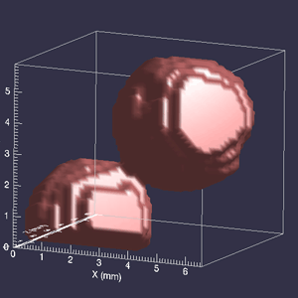
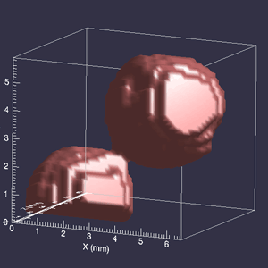
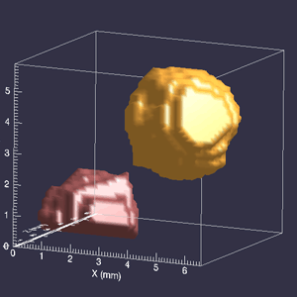
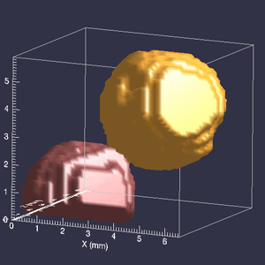
SEPARATE in action
Notes:
The next step after segmentation is separation, where you manually separate objects that were touching.
In this case of garnets, in the top left image the two garnets are touching so if you were to measure this as a single object it would give an incorrect answer for size, shape, etc,
So here are are eroding around the edge to separate them, the upper right is one erode step, the lower left is a second erode step and at this point and we see that they are two individual objects.
We then dilate the objects to their original full size but keeping the information that they are each separate objects.

Slide 15
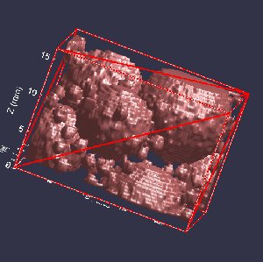
Separation challenges
Methodology
  Manual and semi-automated methods
    Erode/dilate, plane cutting, watershed
Oversized blobs
  User-settable size cutoff
Notes:
- So, challenges that might be encounted in the separate stage
The main one is just deciding deciding which tool will give you the quickest results as this step can be fairly time consuming
There are both manual and semi-automated methods available which we will see in the tutorial.
There are also specialized methods available like watershed, which will use greyscale values to help separate the objects
Other things to consider include what happens when you have a large amount of interconnected blobs – you don’t want it to grow indefinitely but want it to be able to capture multiple whole blobs
This is a user defined setting, and shown on the right, the red diagonal on the cut faces indicate that some of these blobs could have continued.

Slide 16
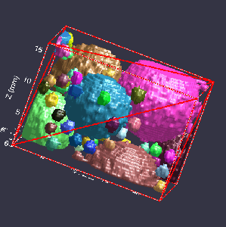
SEPARATE in action
Notes:
So, after using all the tools at your disposal in Separate, you make the blob on the left took like the individual blobs on the right, so they can also be discretely measured with Extract

Slide 17
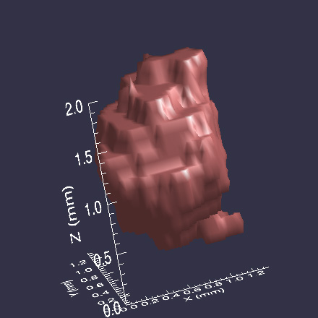
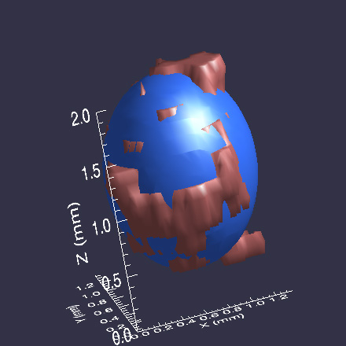
EXTRACT in action
Notes:
The final step in Blob is extract, where each individual blob is measured in a variety of ways, depending on what the user selects
One of the more unique and powerful functions of blob is the ability to find their orientations, by approximating them as ellipsoids or spheres, and determining their axes orientations
The blob here has been fit with an ellipsoid whose long axis is nearly vertical.

Slide 18
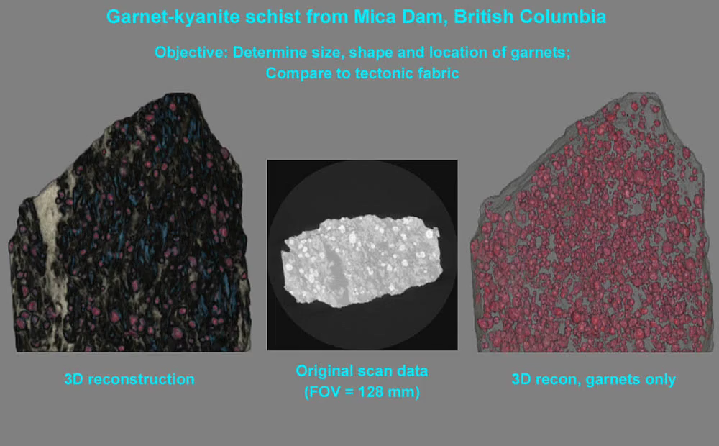
3D Quantification
Notes:
- This is a helpful video that shows the process from start to end, and also showcases Quant3D as well, which we will cover in our next lecture.
In this example we are segmenting and measuring individual garnets.
It starts with the garnets already segmented, and illustrates some manual separation
After separating all the garnets their aspect ratios are extracted and their orientations plotted, and some clustering is evident.
The final part shows the foliation defined by the quartz feldspar fabric that was measured using Quant3D, which we will go into detail in the next lecture

Slide 19
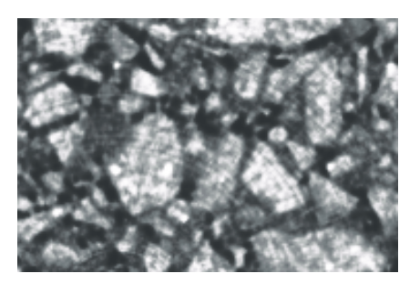
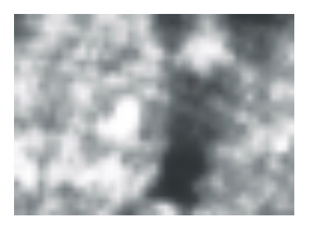
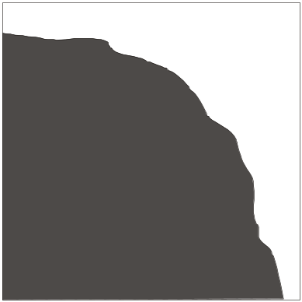
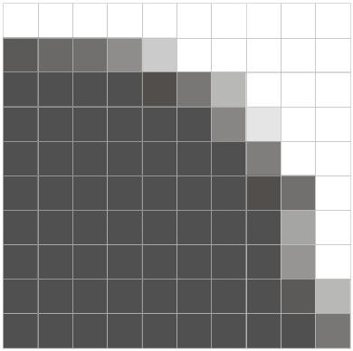
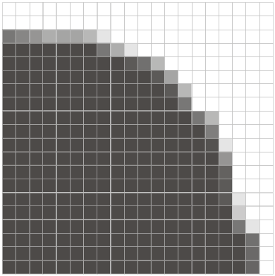
Resolution effects
Surface areas of complex objects are a function of resolution
Absolute measurement tricky; relative more achievable
Notes:
When doing any kind of quantitative measurement with CT data, there are some things particular to CT data that you have to keep in mind
The first is resolution effects.
in this case we are trying to find the edge, and measure the area of a particle
The actual edge of the particle is on the left and the two images on the right are what the particle looks like at two different resolutions.
At a lower resolution, it becomes apparent that the area of the particle might be somewhat underestimated, because the edge is not defined very well
But at higher resoltiosn the edge is more refined, and the area of the object that will be computed from these voxels more true to the actual area.
Regardless though, at any resolution the surface of complex objects are a function of the resolution, and a bit tricky to define in an absolute sense.
In reality, the pixelatoin of any surface will increase its measured surface area, so smoothing extracted surfaces, which is an option in Blob, is usually a good idea.

Slide 20
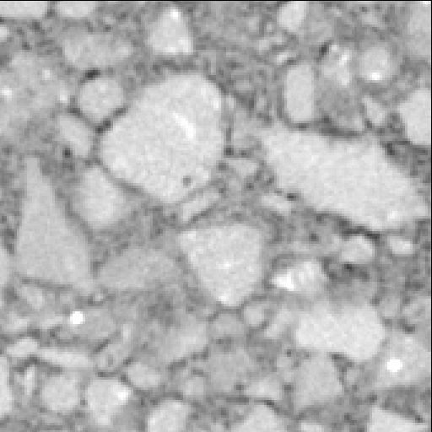
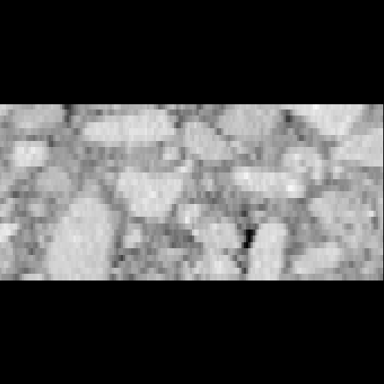
Voxel aspect ratio effects
XY
XZ
Aspect ratio = 3:1
Blob3D accounts for this, but it can lead to “anisotropy of detection”
Notes:
- The aspect ratio of your voxel also might influence your measurements
Again this is less of a concern now because the majority of newer scanners produce equant voxel data,
In this case presented here, the size of the voxel in the Z dimension is about a third of what is in the XY scan plane.
Blob does account for non equant voxels, if present, but it can still lead to anisotropy of dectection, which basically means it may skew your data, especially in regards to finding fabrics or measuring orientations.

Slide 21
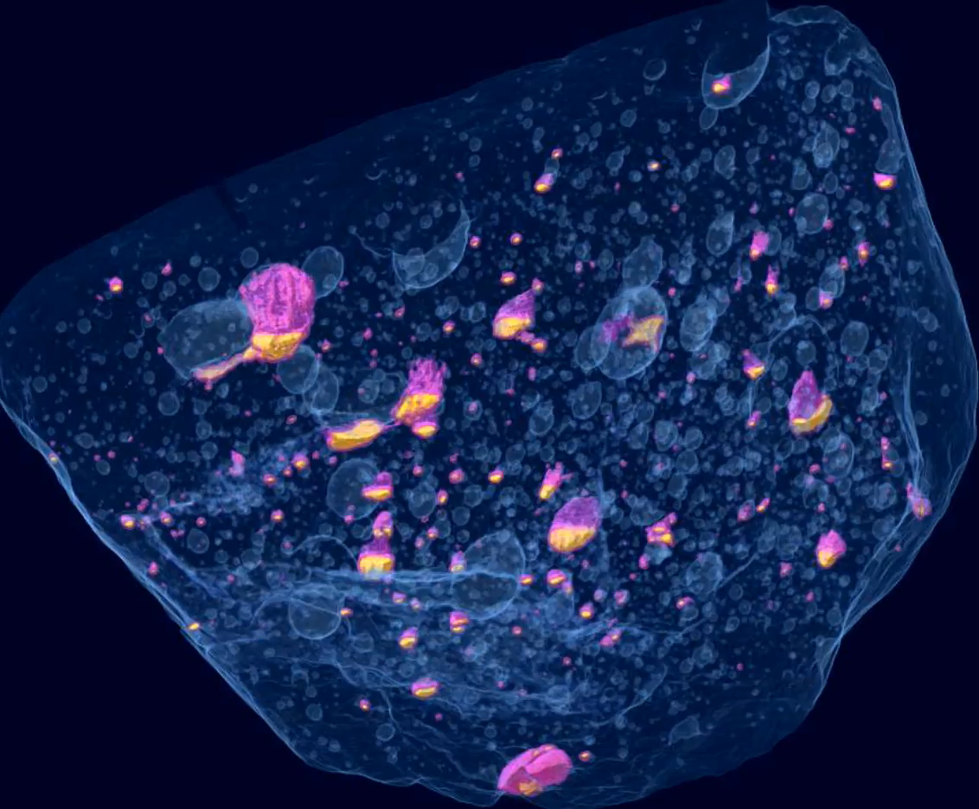
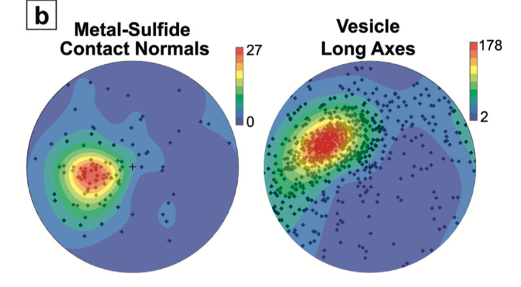
Orientations with Blob3D
Impact melt sheet cooled on asteroid
Metal-sulfide contacts record gravitational field
Vesicles elongated due to flow
2 cm
From Benedix et al. (2008)
and Hanna and Ketcham (2017)
Notes:
- So, just to show some examples of what you can accomplish with blob
- This is a study done in 2008 of a meteorite that was an impact melt sheet from an asteroid
By extracting measurements of the metal, sulfide, and vesicles, they were able to locate the orientation of the local gravitational field on the asteroid through the orientation of the contacts between metal and sulfide, because as the sulfide exsolved from the metal it floated up locally.
In addition, the vesicles were found to be elongated with a proffered orientation, indicating that they were still forming while the melt sheet was flowing.

Slide 22
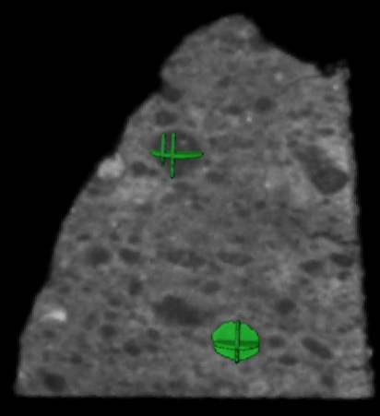
Orientations with Blob3D
Manual segmentation of CM Murchison chondrules in Avizo using orthogonal planes
Segmented chondrules measured in Blob3D
Notes:
Another example, this one of another meteorite, was the measurement of chondrules in a carbonaceous chondrite called Murchison
Because the greyscale values of the chondrules overlapped with the surrounding matrix, automatic segmentation was not possible so we manually segmented the chondrules in Avizo
To speed up the manual segmentation, though, we defined each chondrule with only a few orthogonal planes in Avizo and then imported these into Blob
We then wrote a new functionality into Blob where an ellipsoid is fit to the outer extent of these planes, to approximate the shape and orientation of the chondrule
-

Slide 23
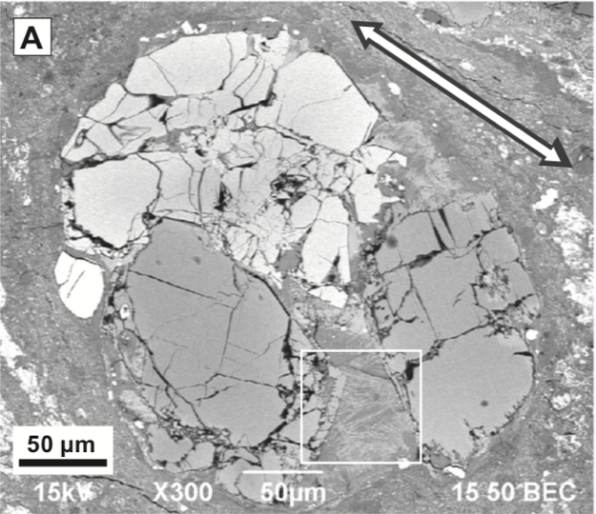
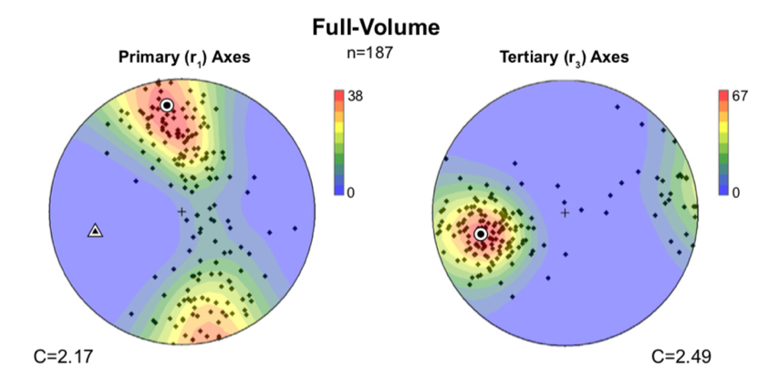
Orientations with Blob3D
Deformed chondrules define foliation with weak lineation
Macroscale fabric compared to microstructures in thin section
From Hanna et al. (2015)
Notes:
- We then found that the chondrules defined a foliation within the meteorite, implying than they had been deformed on the asteroid parent body
- And after cutting an orientated thin section from the sample we could compare this to microstructures in the sample to infer the source of the deformation, which we interpreted to be an impact

Slide 24
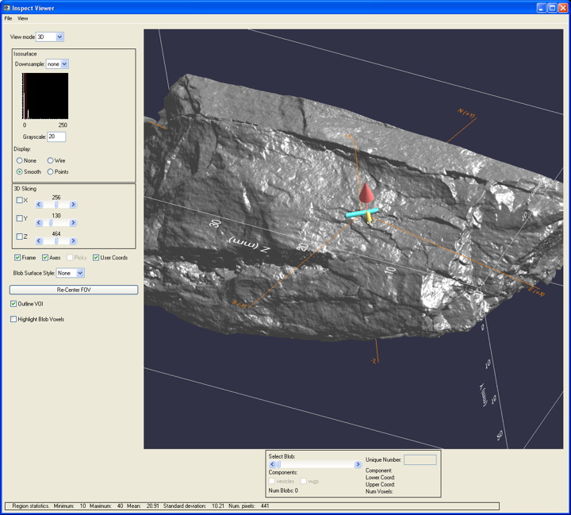
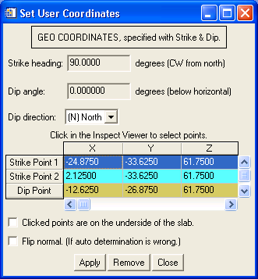
Defining geographic coordinate frame in Blob3D
One way: put strike and dip marker on sample
  Paperclip, staple
  Al rods nicer for scan
Lets you put each grain in your rock into regional context!
Notes:
For terrestrial rocks, a unique feature of Blob, and not available in any other program, is the ability to place your CT data in a geographic coordinate frame
For example, say you collect a metamorphic rock in the field
For structural geology work it is imperative that you put this in the context of the larger regional geology, and that would be possible by marking the strike and dip measured in the field on the sample, for instance using a staple
This can then be used in Blob to put each measured grain in your rock into a regional context!

Slide 25
Part II:
Quant3D
For measuring diffuse fabrics (but also discrete objects)

Slide 26
Fabric measurement
Continuum features
  Foliation
  Lineation
  Preferred orientation
Does not require identifying individual objects
  Just segment material of interest versus everything else
Notes:
Unlike for Blob, which measures discrete, individual objects, Quant3D measures fabrics that are more diffuse but still define a foliation or lineation
And because you don’t have to identify discrete objects, it can be useful in cases where objects are orientated but below the scan data feature resolution

Slide 27
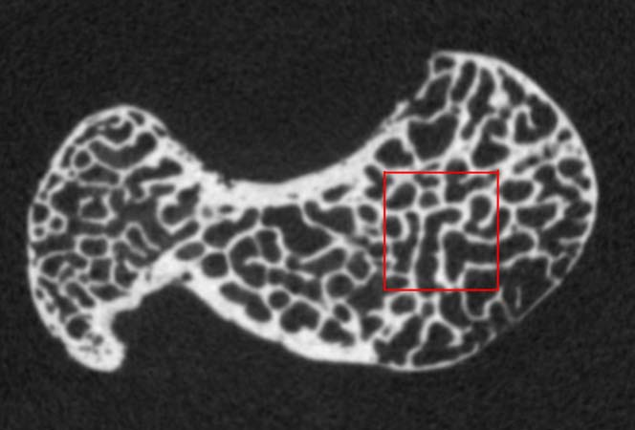
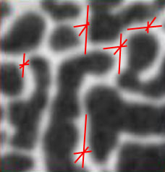
Fabric Measures
Star Length Distribution (SLD): L*(ω) = Σ L (ω)
Star Volume Distribution (SVD): V*(ω) = (π/3) Σ L³(ω)
  Star volume = volume for convex solid
3 mm
Based on Ryan and Ketcham (2002); Ketcham and Ryan (2004)
Notes:
Originally it was developed to measure fabric orientation in trabecular bone, which is found in the ends of long bones such as femurs
There are three measurements implemented in Quant that are able to quantify fabrics
The first two are somewhat related
For both of these measurements, random points are placed within the material of interest, in this case bone, and lines are drawn out in a variety of orientations, like a star
The length of each of these lines is recorded, and thus if there is a preferred orientation on the structure within the material, these lines will be longer in that direction
- The main practical difference between these measures is that the SVD uses cubed lengths, which will tend to amplify differences between major and minor components, increasing the inferred anisotropy (ANI_SOP_TROPY)

Slide 28
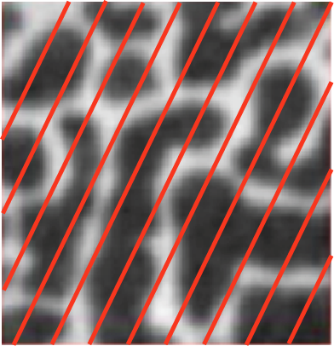
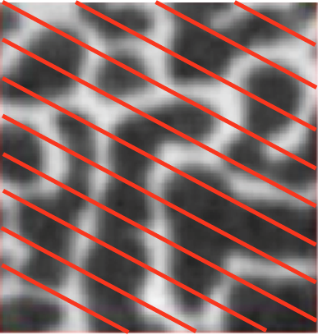
Fabric Measures
Mean Intercept Length (MIL)
Notes:
- The third measurement is the mean intercept length, which uses lines that traverse the volume and record boundaries between materials
Unlike for SLD and SVD, it is measuring the lengths of both materials present, and thus is a combined measurement of both materials.
This means it may be less useful for measuring the fabric of small, isolated phases in rock, like in the schist example we’ll do during our tutorial.

Slide 29
Measurement Comparison
MIL
  Measures both materials (e.g., bone and matrix)
  Sensitive to alignment of multiple elements
  All elements equally likely to be measured
SLD
  Only measures one material
  Elements isolated; volume biasing
SVD
  Same as SLD, with measurements cubed
  Anisotropy enhanced, but more noisy
Results similar… but different
Notes:
- So, to summarize,
The MIL measures both materials and therefore is sensitive to the alignment of multiple elements
SLD and SVD only measure one material, and the primary difference is that SVD uses cubed length so the anisotropy is enhanced.

Slide 30
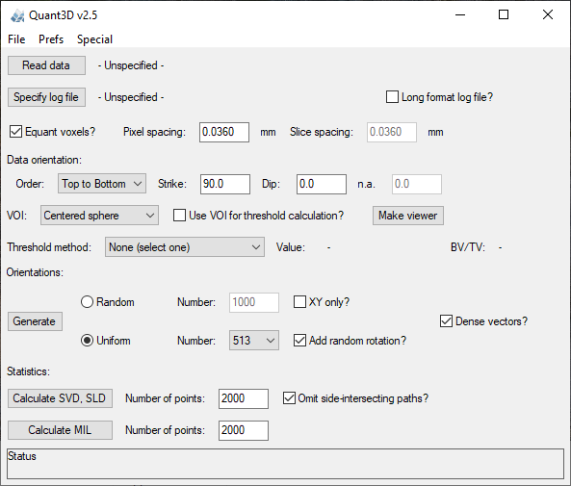
Quant3D Input Parameters
Data to Analyze
Measurement Orientations
Measurement Type

Slide 31
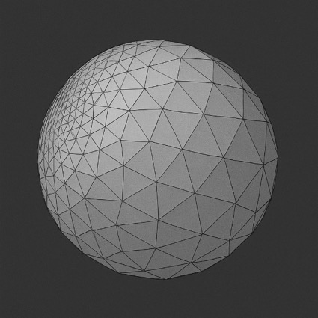
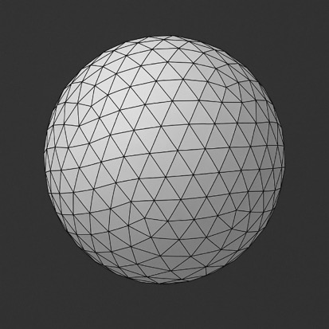
Measurement Orientations
“Random”
Distributed on a unit sphere
Center of sphere is the measurement data point
Random orientations
  Fabric tensor (orientation matrix) can be skewed by under- or over-sampling in particular orientations
  Can cause reproducibility issues
Uniform orientations
  Required for generating 3D rose diagrams
  Random rotations and dense vectors overcome biases caused by cubic voxels (discrete points on a rectangular grid)
Uniform

Slide 32
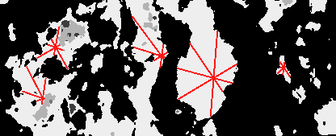

Measurement Type
Number of points = number of spheres
Placed only inside material of interest (thresholded/segmented data)
Number of points ~= 0.1% of material voxels
If material is very small part of sample, ignore calculation and use minimum of 1000
More points = longer calculation (especially MIL) but less noise
MIL requires ~1/10 the points for statistically comparable results to SVD/SLD because crosses multiple materials (lines extend to edge of volume)

Slide 33
Anisotropy
Based on eigenvalues of fabric tensor (orientation matrix): τ₁, τ₂ , τ₃.
  Strongest τ₁, weakest τ₃
Degree of anisotropy
  DA = τ₁ / τ₃
Shape indices
  Isotropy Index I = τ₃ / τ₁
  Elongation Index E = 1- τ₂ / τ₁
Can sometimes oversimplify fabric characterizations
Notes:
-So, how does Quant define Anisotropy?
- It is based on the eigenvalues of the derived fabric tensor
And the degree of anisotropy is the ratio of the 1st and 3rd eigenvalues
Two other shape indices that can be derived are the isotropy index, with is just the inverse, and the elongation index which useful for indentifying lineations.
Note that since it’s a single fabric tensor (matrix) if there is more than one spatial fabric within the data, it can oversimplify the results, leading to somewhat wrong interpretations.

Slide 34
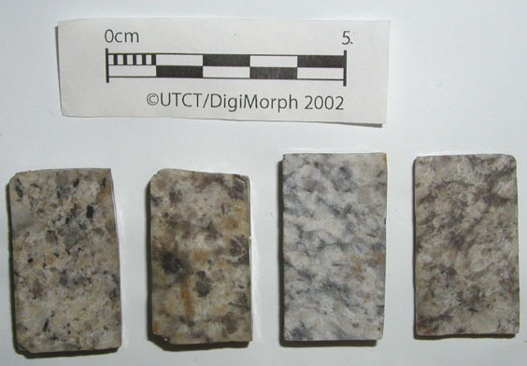
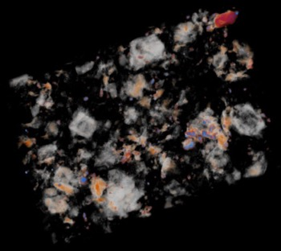




Mylonite development
C2-12, 3D reconstructions
CT grayscales
CT image
Quartz + Plagioclase
Orthoclase + Biotite
Gradational sequence from undeformed Wilderness Granite
(Santa Catalina Mtns., AZ) to fully developed S-C mylonite.
Notes:
So, taking a look at an example, these samples represent a gradually more deformed unit from an undeformed granite to a strongly foliated mylonite
Within the XCT data we can see quartz, feldspars, and micas as various grayscales

Slide 35


SVD calculation
Notes:
With quant we segment four phases which are shown here in black, white, dark gray, and light grey.
And use SVD to measure the preferred orientation of each of these phases.
In this case white is biotite, and so the SVD is measuring the orientation of that phase, but we could select one of the other phases as well.

Slide 36




Foliation development
Sample C2-1
Sample C2-12
Notes:
- And here are rose diagrams of phase fabrics within two samples, C2-1 on top and C2-12 on the bottom
Both sets of show orientation of biotite on the left and orthoclase + muscovite on the right
And it is apparent that both have similar fabric strengths for biotite but the orthoclase and muscovite is more foliated in the C2-12 sample

Slide 37


Phenocryst orientation vs. AMS
Foliated rhyolite
Henry Mountains, Utah
1” core
SVD, 3D rose
Amphibole orientations
Amphibole
Oxide
Study in collaboration with Eric Horsman and Basil Tikoff, U. Wisconsin
Notes:
Another example which we touched on briefly in our first lecture is the foliated rhyolite from the Henry mountains
Here quant was used to examine the orientations of amphibole, which is the intermediate grayscale phase in the CT data, and oxides which are the brightest grains
The amphibole phenocrysts show a preferred orientation, most likely caused by their mechanical rotation during flow and emplacement of the rhyolite
Here the red primary eigenvector is in the center of a spread of amphibole orientations, which is expected.

Slide 38


Phenocryst orientation vs. AMS
Oxides (magnetite)
Notes:
In contrast the oxides, which are magnetites, do not appear to be physically aligned, but when plotting the dominant orientattions of both the amphibole and magnetite, their axes are all clustered together, indicating that the fabric strength of the magnetites is just much weaker
This is confimed by AMS data, which can query the orientation of magnetite by measuring the strength and orientation of an induced magnetic field on the sample.

Slide 39


Phenocryst orientation vs. AMS
Not all cases were as good…
  But we can see some reasons why
Filled
fractures
Xenolith/
cumulate
Plag.
core
200a
197b
Notes:
But, not all cases were as good as the previous example, due to some cores incorporating xenoliths or having filled fractures.

Slide 40




Vesicles and phenocrysts in pumice
Vesicles
From Sam Abbott honors thesis Popocatepetl, Mexico
Pyroxene + hornblende
Plagioclase
Field of view = 15 mm
Notes:
Another study used quant to examine the orientation of phenocrysts and vesicles in a pumice from Mexico, and found that they were all strongly co-aligned.

Slide 41






Trabeculae in the Calcaneus (Heel)
Homo
(human)
Pan
(chimp)
Gorilla
From Maga et al., 2006
Notes:
And our final example, going back to trabecular bone for which Quant was originally developed, this illustrates the different trabecular fabrics in heel bones of Humans, on the far left, a chimp in the center, gorilla on the right.
The large anisotropy in human heel trabeculae is due to their strongly bipedal locomotion, compared to chimps and gorillas
This last case, while hard to see, is an excellent example of when the eigenvalues of a single fabric tensor (red in image on top) can overlook the fact that there are two dominant fabrics in the sample – the eigenvectors in this case do not provide the full picture of the fabric present.

