Slide 1
New Frontiers in CT Data Quantification
Now (or coming soon) in Blob3D
Automated shape classification
Apollo 17 cores and lunar sedimentology
Rich Ketcham
UTCT
Jackson School of Geosciences
University of Texas at Austin

Slide 2
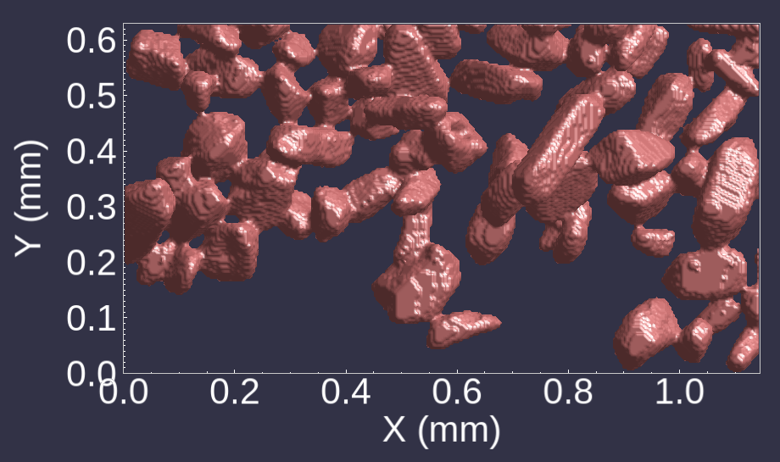
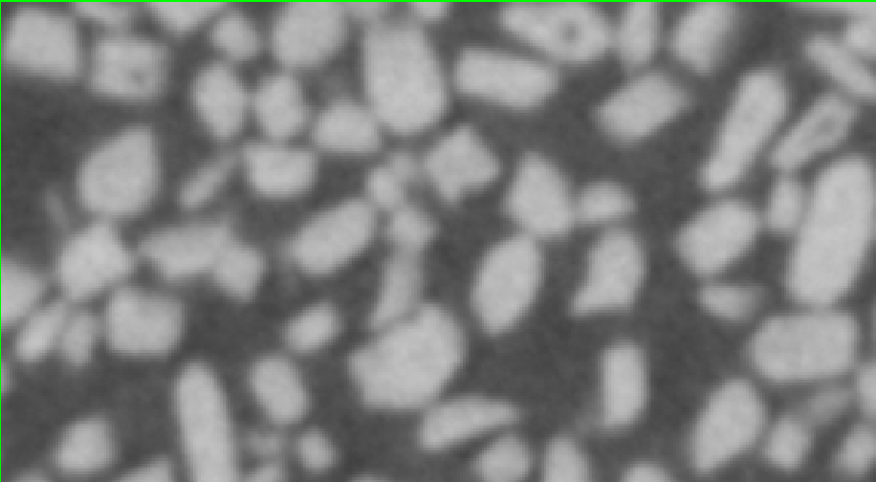
How to separate?

Slide 3
The Watershed Algorithm
Main Idea:
Identify “watersheds” separated by “divides”
Usual method: Basin Fill
  Mark low points/basin centers
Example CT number traverse
Credit: ImageJ Wiki

Slide 4
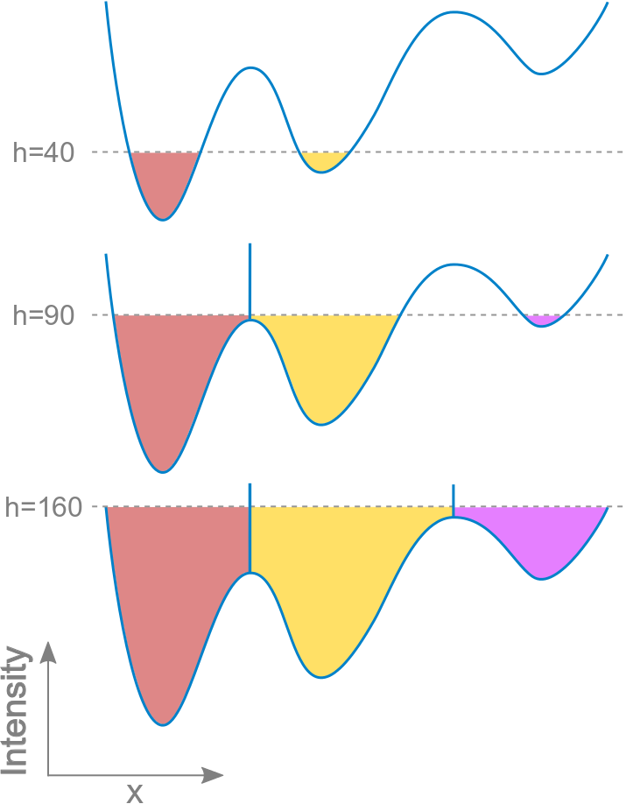
The Watershed Algorithm
Main Idea:
Identify “watersheds” separated by “divides”
Usual metehod: Basin Fill
  Mark low points/basin centers
  Start adding water from bottom, at markers
    How: Maintain a list of all points adjacent to marked areas, sorted by elevation
    Claim them one by one, in elevation order, according to their marker
    Add new adjacent points to list
  When two areas merge, mark their boundary
Credit: ImageJ Wiki

Slide 5
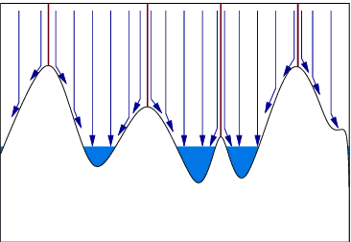
Rainfall Watershed
One-pass watershed (fast!)
  Rainfall method (based on Bieniek & Moga 2000)
    Follow each drop downhill
    Classify all voxels in path
    Stop when hit classified voxel
  Faster than any current open-source watershed algorithm

Slide 6
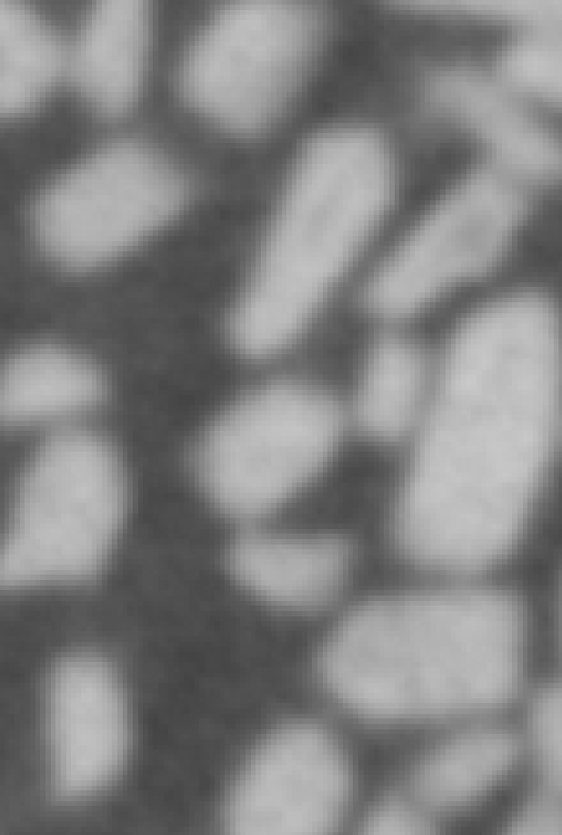
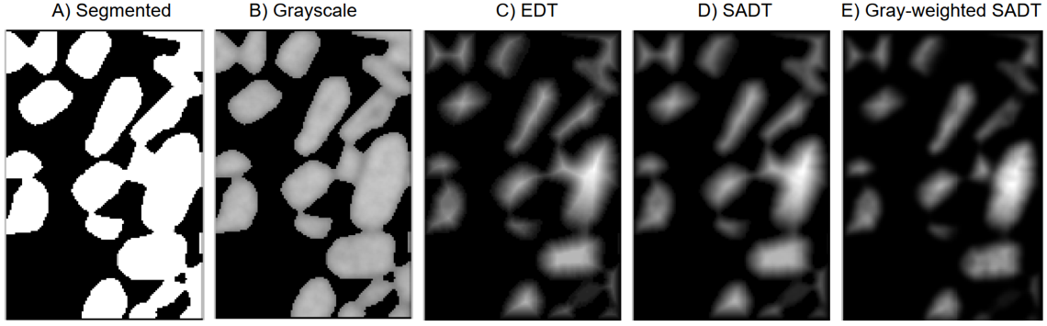
What defines “topography”?
Distance transforms:
Brightness = distance from nearest edge
EDT: Euclidean Distance Transform
SADT: Smoothed Approximate Distance Transform
CT data
Ketcham, 2025

Slide 7
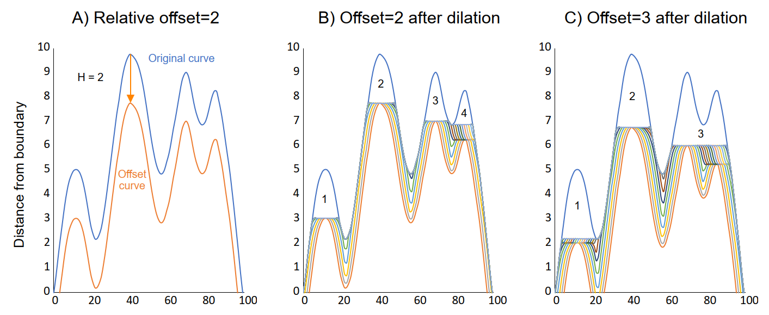
Marking high (or low) points
Ketcham, 2025

Slide 8
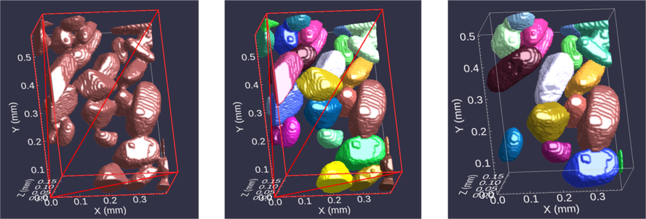
Interactive watershed processing
Segmented subvolume; red lines indicate cut faces with more data beyond
Watershed applied
Blobs on cut faces postponed for later processing;
rest are accepted or refined further
Time required reduced to a few seconds/grain

Slide 9
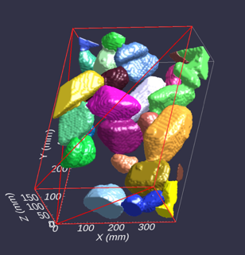
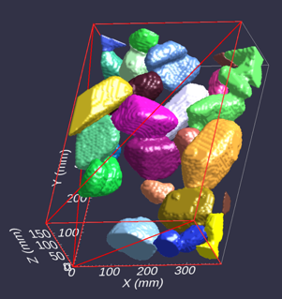
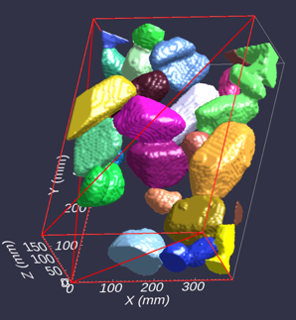
Post-watershed smoothing
No smooth
Smooth = 1
Smooth = 2

Slide 10
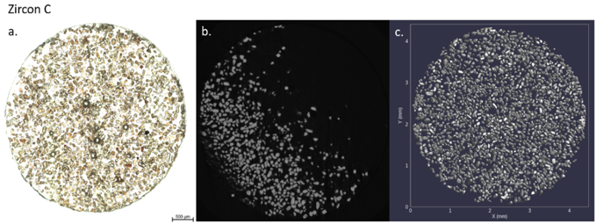
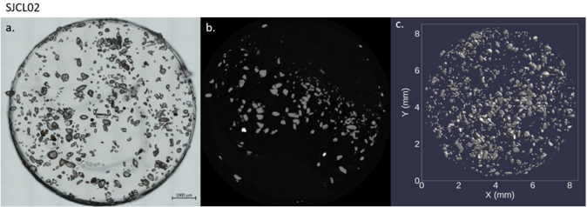
Application: detrital zircon
Epoxy grain mounts
  4-6 mm diameter
  100’s-1000’s of zircon grains
Want to measure
  Size
  Shape
  Crystal morphology
Match to laser U/Pb date
  Need to get every grain right!

Slide 11
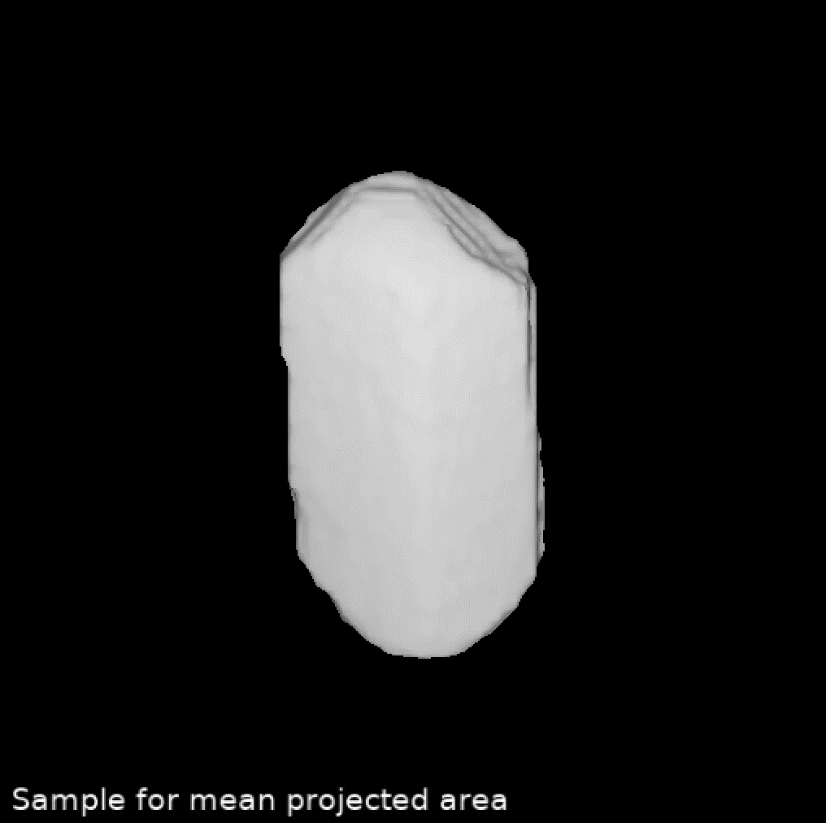
Shape analysis behind the scenes

Slide 12
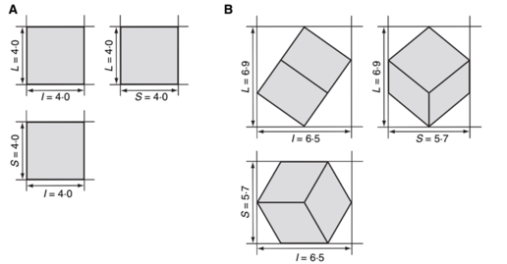
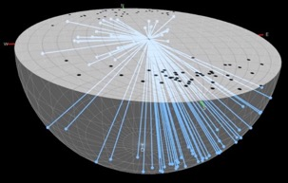
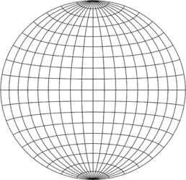
Extracting crystal shapes
“Box”
“Shape”
Stereonet
C: Shortest axis
B: Shortest ortho to C
A: Axis ortho to B+C
A: Longest axis
B: Longest ortho to A
C: Axis ortho to A+B
From Blott and Pye, 2008

Slide 13
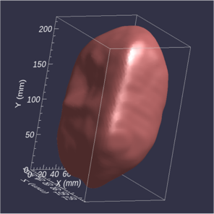
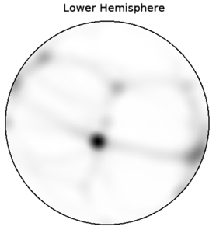
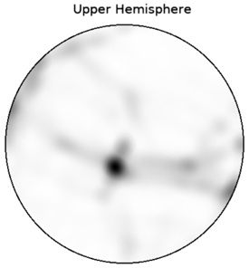
Reading crystal face nets
py
py
py
py
py
prism
face 2
90°
prism face 1
45°
prism face 1
prism face 2
Each isosurface facet orientation (normal) projected to stereonet

Slide 14
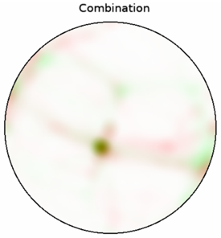
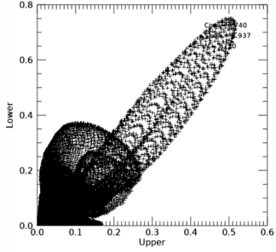
Reading crystal face nets
Well-formed crystal (corr. = 0.74, skew = 4.9)
Preliminary statistics:
high correlation coefficient = symmetry = crystallinity
high standard deviation = angular

Slide 15
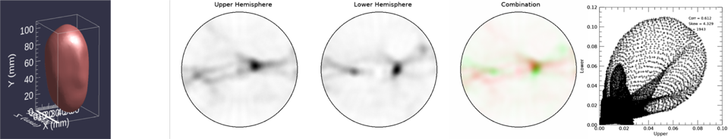
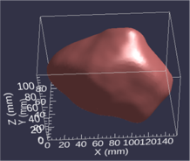
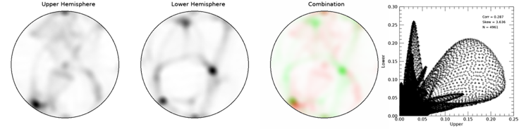
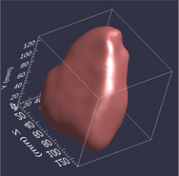
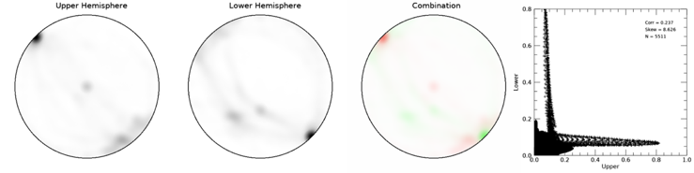
Crystalline but slightly rounded
Crystal shard; some fair faces, one paired set.
Crystal shard; possibly rounded remnants.

Slide 16
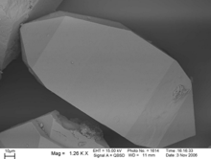
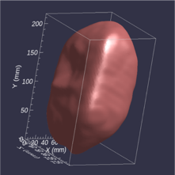
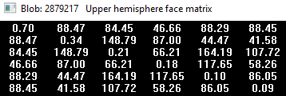
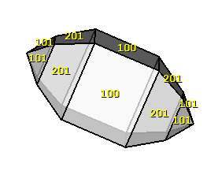
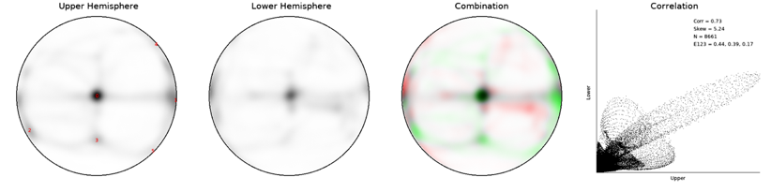
Reading facial angles
Strength
Interfacial Angles
4
1
0
5
3
Ideal zircon 100-101: 47.85
4
0
1
2
3
5

Slide 17
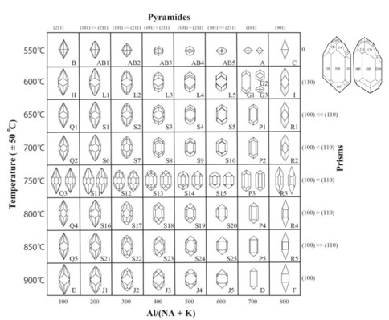
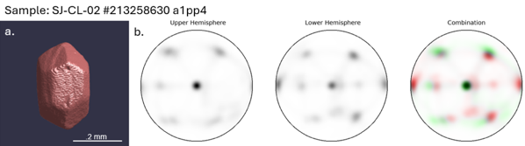
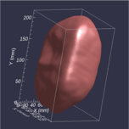
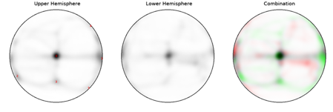
What crystal form might tell us
after Pupin (1980)

Slide 18
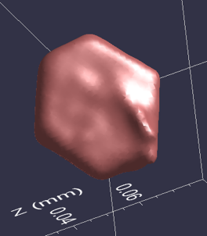
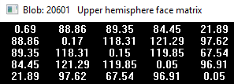
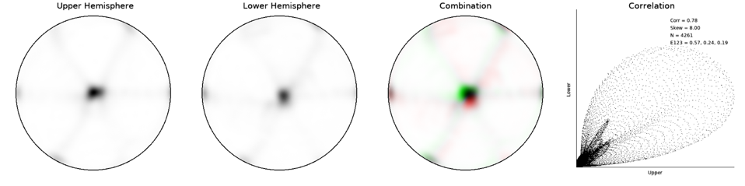
Reading facial angles
Pyrrhotite (from Ryugu)

Slide 19
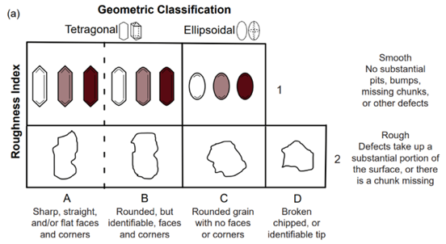

Grain classification (by human)
Each grain assigned code by human:
  A,B,C,D: Geometry
  1,2: Roughness
  Codes for tips
  1-4: Confidence
Using both 2D and 3D data
Over 5000 grains classified in 4 samples
from O’Leary MS Thesis (2025),
after Zeigler et al. (2023)

Slide 20
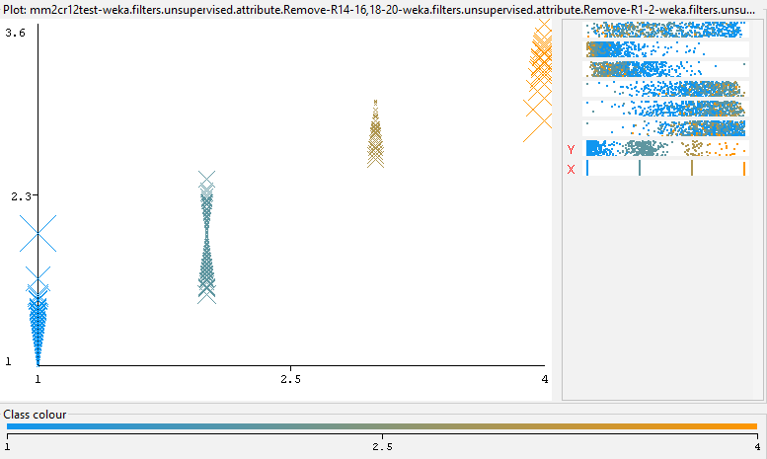
Autoclassification with Random Trees ML
Grain Shape
A
B
C
D
5.34 ( 2565) XlStdev(mh)
4.68 ( 2256) XlRdev
2.96 ( 1292) Shape Factor(D05)
2.59 ( 1535) c/b
2.35 ( 1593) Sphericity
1.86 ( 2859) XlCorr(mh)
Using Weka (Waikato Environment for Knowledge Analysis) v3.8.6

Slide 21
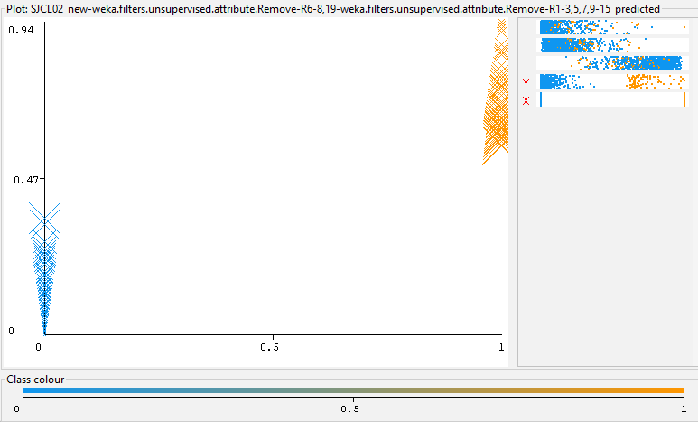
Autoclassification with Random Trees ML
Brokenness
Unbroken
Broken
1.11 ( 1439) Sphericity
0.92 ( 4588) SNSVR
0.68 ( 5052) XlStdev(mh)
Using Weka (Waikato Environment for Knowledge Analysis) v3.8.6

Slide 22
End of Part 1

Slide 23
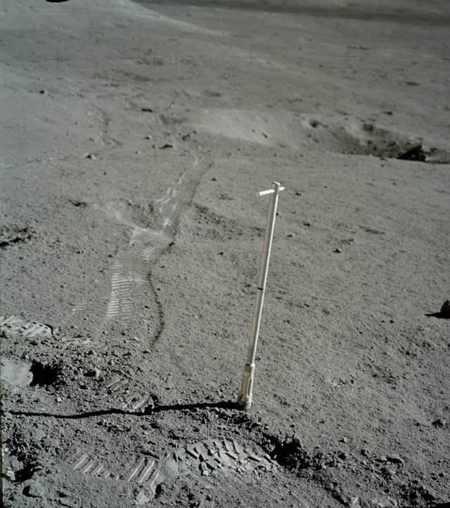


Sedimentological Analysis of In Situ Lunar Regolith from Apollo 17 Double Drive Tube 73001/2 using X-ray Computed Tomography
Melanie Garza
Master’s Thesis

Slide 24
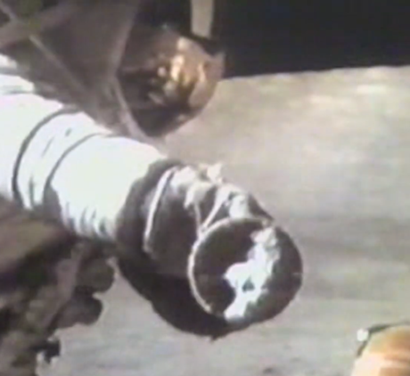
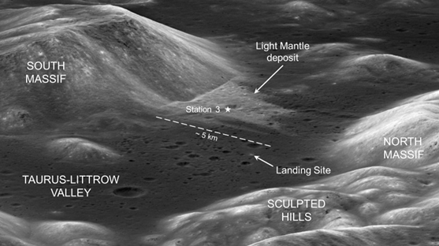
Sample Collection
73002: 430 g and 20 cm (upper section)
73001: 803 g and 35 cm (lower section)

Slide 25
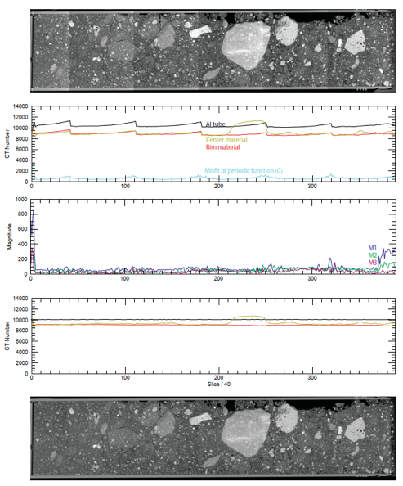
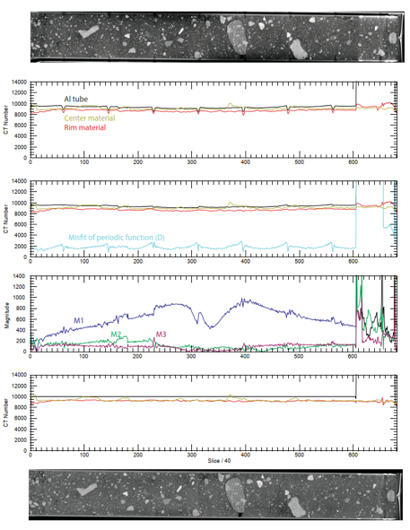
73002 (2019)
73001 (2021)

Slide 26
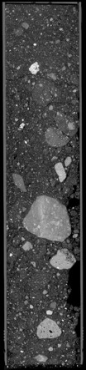
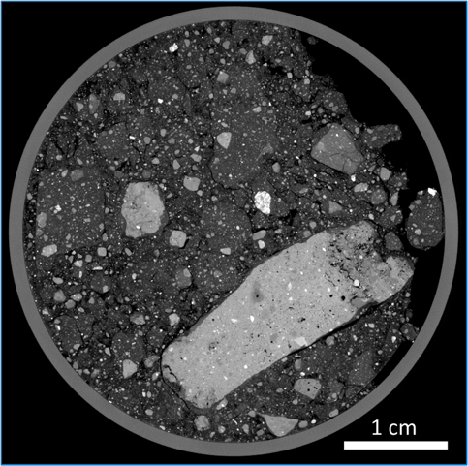
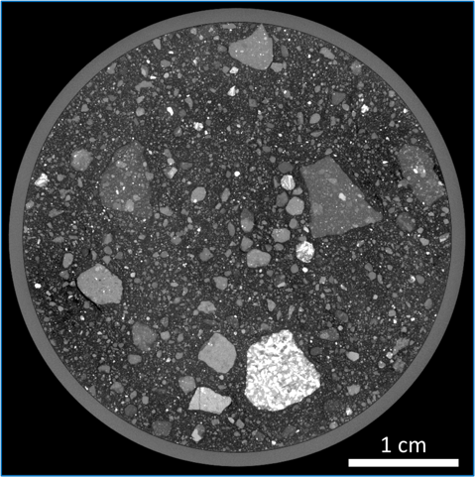

Scan Data
Disrupted Regolith
Regolith Breccias
Soil clod
“Ped”
Impact Melt Breccias
High-Ti Basalts
73002
73001

Slide 27
Objectives
XCT images allowed to observe regolith from a lunar landslide, providing an opportunity to gain insight into sedimentary processes on the surface of the moon.
  How did spillage affect scan data interpretation?
  How does lunar regolith density vary with depth?
  How does particle distribution and shape vary with lithology?
  What processes do particles undergo on the lunar surface to create varying degrees of rounding?

Slide 28





Disruption in 73002
Also: 1973 X-ray

Slide 29


Ped Curvature
Lunar soil peds in 73002 exhibited flat/curved surfaces.
Curvature tests showed ped surfaces measured at or below the 4.12 cm tube diameter. Thus, they were created during collection.
Peds reflect the true state of the regolith prior to disruption.

Slide 30


Verifying post-correction CT numbers
Used histograms of high-Ti basalts (prominent phases: plagioclase, pyroxene, ilmenite), air, Al tube

Slide 31


Lunar Soil Density & CT Numbers
A central volume of interest (VOI) was placed within peds in 73002 and in areas of regolith in 73001 to develop a profile.
Histogram mode is representative of lunar dust compaction.

Slide 32

Regolith Density Down the Core
77 peds were sampled in 73002
21 VOIs were sampled in 73001.
Regolith density decreases with depth down the core.
Unexpected!
LOST FROM SPILLAGE

Slide 33

Deep Learning Segmentation
How can shape data be acquired?
Sensor3D and U-Net models were trained to classify high-Ti basalts, regolith breccias, and impact melt breccias.
3D shape data created across the core through segmentation.

Slide 34
Deep Learning Segmentation
Many challenges . . .
Multiple days spent training models
High-Ti basalts segmented a smaller clasts size that was not possible for regolith and impact melt breccias.
Grayscale and textural similarities required deep learning to differentiate clasts.

Slide 35


High-Ti Basalts
After Blob3D processing, 793 high-Ti basalts were segmented. 231 (73002) and 562 (73001)
Majority of clasts are small. Larger clasts are found clustered in 73002 and distributed in 73001.
Last ~30% of 73001 has an absence of large clasts.

Slide 36


Regolith & Impact Melt Breccias
Regolith breccias (blue) include 91 clasts. 56 (73002) and 35 (73001)
Impact melt breccias (yellow) include 100 clasts. 44 (73002) and 56 (73001)
Reminder: Smaller clasts present, but not segmented.
There is an apparent fining downward. Last ~20% of 73001 also has no large breccia clasts.

Slide 37


Rounding from the Landslide
Short / Intermediate Axis
Intermediate / Long Axis

Slide 38






Rounding and Fragmentation on the Lunar Surface
High-Ti Basalts
Regolith Breccias
Impact Melt Breccias
Short / Long Axis
Fragmentation line
Intermediate / Long Axis
Long Axis (mm)
Universal Fragmentation Law

Slide 39
Conclusions/Interpretations
Peds aided in reconstructing the soil density despite the disruption. Density decreased with depth in the core → Unexpected!
3D models of lithologies were created using machine learning segmentation.
Regolith and impact melt breccias show more rounding than high-Ti basalts. High-Ti basalts show signals of rounding in the smallest particle size not available in the other two lithologies.
Rounded particles could be a result of the 10 km distance, including 5 km runout, traveled during the Light Mantle landslide.

Slide 40
End of Part 2

Slide 41


The Carbonado Conundrum
Polycrystalline
  Bimodal: 10’s -100’s µm and ~1 µm
Found only in Brazil and Central African Republic
Age 2.6-3.8 Ga
Large (up to 3167 carats)
Light δ¹³C: -24 to -26 ‰
Highly porous, nm to mm scale
Patinaed surfaces
Crustal inclusion suite
  florencite (hydrous REE phosphate)
  native metal: Fe, Ni-Pt, SiC, etc.
  No mantle minerals

Slide 42


3D Petrographic Microscope

Slide 43

Old-fashioned petrography…in 3D!
Observations with 29-µm resolution data
  Large bright grains only near rim (zircon stuck in pore)
  Megapores only near rim
  Banding beneath patinaed surface
  Grading of small inclusions
5 mm

Slide 44
Interpreting CT numbers

Slide 45




140 kV, μ_{eff} > almandine
40 kV, μ_{eff} ≥ almandine
40 kV, μ_{eff} ≥ apatite
40 kV, μ_{eff} ≥ calcite

Slide 46


Slide 47


3D shape analysis (SVD)
Shows preferred orientation; oblique to grading and patinaed surface

Slide 48

5-µm resolution data (5 mm FOV)

Slide 49



5-µm observations
Fabric mainly in small inclusions
Mid-sized pores parallel inclusions
Virtually all inclusions polymineralic
Disequilibrium textures
Dodecahedral pseudomorphs

Slide 50


Dual-energy scanning
60 kV
120 kV

Slide 51

1-µm resolution data (1 mm FOV)

Slide 52

Setting up the cut

Slide 53


D’oh!

Slide 54



SEM and EDS
Extensive but heterogeneous microporosity
Most common minerals kaolinite and florencite

Slide 55
A rough model
Sudden shear event deforms bubbles
Pressure change massively increases diamond nucleation rate
<1 µm diamonds nucleate, deform while growing
Micro-diamonds, other phases settle in magma chamber(?)
Remnant liquid rich in C, incompatibles (U, REE)
Bubbles are trapped, but tend to rise

Slide 56
A rough model
Over time (Gyrs), radiation damage destroys dodecahedral phase
Atoms migrate through pore network, recrystallizing at shallow P,T
“AWOLite”?

Slide 57





But you can’t do just one!
Another pseudomorph?
5 mm
Spatially vary pore filling - original mineralogy, limited migration?
Inclusion long and short axes
New images by Scott Eckley

Slide 58

3D Imaging
tarynstravelswithkayla.blogspot.com

Slide 59

Fractured limestone
Voxel size: 0.042 mm(!)
Specimen courtesy of Dr. Brenda Kirkland-George; Scanned summer 1997

Slide 60


The same, in reverse
1 cm
1 cm
Felis concolor skull
turbinates
Homo sapiens calcaneus
trabeculae

Slide 61


Thin features look dimmer… why?

Slide 62





What’s behind the blurring?
1) Partial Volume Effect
2) Other blurring from…
Large X-ray focal spot
Large detectors
Detector crosstalk
CT reconstruction algorithm
Geometric imprecision
Scanner acting up that day…
System noise
Each pixel = 86 µm

Slide 63



Point-Spread Function (PSF)
*

Slide 64

PSF and Thin Features
“Real”
thickness
Measured
profile
1-2D Example: Membrane thickness

Slide 65

Fracture Shades of Gray
Pixel size = 50 µm

Slide 66

So what?
Thresholding can remove the effects of blurring when the feature is large compared to the PSF.

Slide 67





Stepping back
Lower by half again: 54
Correct threshold for thick bone: 144
Lower threshold half way to air: 84
And half again…: 39
Down to: 30

Slide 68

Same with trabeculae
Not enough!
Too much!

Slide 69

Rule 6 for picking the correct CT number for segmenting thin features
There is no correct CT number for segmenting thin features

Slide 70


What resolution do we “need”?
80 µm resolution
22 µm resolution
30 mm
5 mm

Slide 71




Histogram methods dangerous!
“Hi-res”
Otsu/Trussell = 110
Vol frac = 0.20
“Lo-res”
Otsu/Trussell = 94
Vol frac = 0.28
Smoothing shifts lower-abundance phase as f(surface area)

Slide 72
The upshot…
If features are small with respect to the PSF, thresholding cannot give a correct result
  Including adaptive thresholding, indicator kriging, iterative optimization, etc.
  If the method is based on histogram analysis, that’s a bad sign
What to do:
  Get better data (if you can)
  Interpret your data with modesty
  Measure the PSF and use it

Slide 73

Counting up the attenuation

Slide 74

Deconvolution made simple
Inconvenient
reality
(or reasonable representation thereof)
Reality
(albeit pixelated)
What we get
*
=
… someplace where we can assume this…
… and figure this out
Take this…

Slide 75

Using the PSF to measure aperture
Model (fitted) PSF Noise Data

Slide 76


Calculates a raw PSF and a mean PSF based on 9 parallel traverses
Corrects for non-orthogonality of the intersection plane, voxel anisotropy
Accumulate a list of PSFs over a dataset
Also measures orientation of interface
Blob3D
PSF Measurement Tool
PSF param = 4σ
(diameter of region with 95% of signal from voxel)

Slide 77





Solution: Measure and use PSF
Required “knowledge”: PSF parameters, air CT number

Slide 78


IPSF in action
New Blob3D tool

Slide 79




IPSF vs. Thresholding
Threshold
Threshold
Subtle density contrast
Severe density contrast
Key point: the more information you provide, the better you can do

Slide 80
End of Part 2

Slide 81



Moving on to 3D…
GOLD!!!
Au grains in quartz and chalcopyrite, Grasberg mine, Irian Jaya (from Kyle and Ketcham 2003)
Issues:
High atomic number; artifacts
Odd shapes
Economic at ppm (or g/t) level; scan a lot to see a little
  Particles usually “small” with respect to scan resolution

Slide 82


A simple experiment
1 mm
Gold grains
(with a little silver mixed in)
2D images; scale bars all 200 µm
This and following from Ketcham and Mote (2019), JGR

Slide 83

A simple experiment
(c. 2004)
Grains embedded in quartz+epoxy “sandstone core”
10 mm
“Core” placed in series of
cylinders with more quartz powder
The Question: Can we get the same answer when measuring across grain sizes and scan resolutions?

Slide 84



A hint of problems ahead
10 mm FOV
50 mm FOV
Scan/recon parameters unchanged except FOV
Grains both blurrier and darker at low resolution
  Blurring/partial volume effects
  Beam hardening

Slide 85

A simple experiment (updated 2018)
ACTIS
MicroXCT
10 mm
“Core” placed in series of cylinders with more quartz or garnet powder
The Question: Can we get the same answer when measuring across grain sizes, scanners, enclosing materials, and scan resolutions?

Slide 86
How to segment and measure?
Threshold segmentation: what value to use?
10-mm ACTIS scan (10 µm resolution)
  Matrix ~40, Au-max ~160
  Threshold at 100?

Slide 87
How to segment and measure?
Threshold segmentation: what value to use?
10-mm ACTIS scan (10 µm resolution)
  Matrix ~40, Au-max ~160
  Threshold at 100?

Slide 88
It gets worse as objects get smaller relative to resolution

Slide 89
What’s in a voxel?
Partial Volume Effect
  Grayscale/CT number reflects attenuation within voxel
  Voxels with multiple materials will have some averaged CT number
Blurring
  Contamination from, and transfer to, surrounding voxels
Operating assumption: attenuation conserved

Slide 90
Reminder: PSF on thin features
“Real”
aperture
Measured
profile
1/2D Example: Fracture aperture

Slide 91


3D PSF effect on spheres (midsection)
r_{PSF} = 2-sigma diameter of Gaussian smoothing curve, or 4σ radius
As object gets smaller compared to r_{PSF}, object gets dimmer, and “correct” threshold falls
Ketcham and Mote, 2019

Slide 92

Segment by including the blurring
Start with a generous
threshold…
and expand a bit from there
Idea: Capture the entire volume that includes the signal from the grain

Slide 93


Sum to get volume (again)
Numbers you need:
CT_{mat} = CT number of matrix
CT_{f} = “True” CT number of feature
2D example of 3D operation

Slide 94
“PVB” method can get good answer at all sizes…

Slide 95
“PVB” method can get good answer at all sizes…

Slide 96
… and scales and instruments!
Volume < 6 voxels
Within each subset, resolution decreases from left to right

Slide 97
Threshold for correct volume varies with size and shape
Two scanners, same trend when normalized by measured PSF
Main shape concerns: surface to volume ratio; corners

Slide 98


Shape affected a bit…
High-res
Low-res
The trick: Customize each threshold based on PVB-corrected volume

Slide 99


Shape and orientation recoverable, but affected by blurring
Shape stable (consistent across resolutions) if 3rd axis > r_{PSF}
Orientation of 1st or 3rd axis stable if varies from intermediate by > ×2

Slide 100
Details to consider
Calibration
  How do you get CT_{mat}?
  How do you get CT_{f}?

Slide 101

CT_{mat} is easy
Just measure an average value for matrix
If heterogeneous or locally variable, you can measure only matrix surrounding feature
  Encompass boundary blurred into grain; r_{PSF}

Slide 102
Ways to get CT_{f}
Brightest parts of largest grains?
  Possible, if shortest dimension > 2r_{PSF}
Calibrate using a “known” grain
  Phantom would need same size, shape, composition as sample
  Best: higher-res subvolume scan to image grain at sufficient resolution
    Resolution invariance: if you get one right, you get the rest right
First principles?
  Calculate expected CT number, based on composition…

Slide 103
Can CT_{f} be derived from first principles?

Slide 104
CT_{f} depends on X-ray spectrum AND particle composition AND size AND what’s surrounding it (AND…)

Slide 105
CT_{f} depends on X-ray spectrum AND particle composition AND size AND what’s surrounding it (AND…)
But why the dropoff?
Some trends match expectation: grt increases CT_{f} at 150 kV, decreases at 80 kV

Slide 106
CT_{f} depends on X-ray spectrum AND particle composition AND size AND what’s surrounding it (AND…)
And beam-hardening correction throws another spanner in the works…

Slide 107
Takeaways
“Seeing” is one thing, measuring is another
  When feature is small relative to data resolution, special care is needed
  Global thresholds don’t work
  Guessing is… guessing

Slide 108

More examples
Distinguish multiple phases by plotting size vs. max or mean CT number
Tungsten and steel shot into particle board
Tungsten
Deblurring
With beam hardening?
Steel
Plotting vs. maximum (or mean) CT number is a useful trick…
But keep possible shape effects in mind

Slide 109



Distinguishing multiple phases
garnet
ilmenite mixed with quartz and feldspar
zircon
garnet
25 mm

Slide 110
Distinguishing multiple phases

Slide 111
Distinguishing multiple phases

Slide 112
Distinguishing multiple phases
ilm+
qtz+spar
zircon
garnet

Slide 113

So, what’s in a CT number?
PVB approach works on any small feature
  Grains, pores, etc.
  Volumes are accurate, resolution-invariant
  Shape and orientation dicier, but we can tell when they become unreliable
“Attenuation conservation” principle works
  But, there are devils in the details
  Calibration needs to be empirical at this point

Slide 114
End of Part 3

Slide 115
Moving on to the Continuum
Pore space often shows up well in CT
  Big density difference between rock and void!
  If pores are too small to be resolved individually, they can still be detected

Slide 116

Partial porosity measurement
25-mm mini-cores
“Align3D”
(or other tools)

Slide 117





Incipient alteration
3R
11R

Slide 118




High alteration
9R
17R

Slide 119


Recent results from
Chicxulub
Pre-flow test
After drying(!!)
Difference
Standard drying step for permeability analysis (40°C oven)
dessicated clay particles!

Slide 120

It’s a gas!
Porosity in matrix and fine-grained rims in Murchison meteorite
Xe gas at 2.76 MPa (400 psi; 27.2 atm)
from Hanna et al, 2022

Slide 121
End of Part 3

