Slide 1


Fundamentals of X-ray Computed Tomography
Romy Hanna
UTCT
Jackson School of Geosciences
University of Texas at Austin
Notes:
- Hello, welcome the first lecture in the lecture series for the UTCT Shortcourse on quantitative analysis of CT data.
In this lecture, which consists of 3 parts, I’ll introduce you to our lab and how we’ve been utilizing CT technology since our start in 1997.
Then, we will delve into the details of the physics of XCT technology and the components of a CT system, and finally we will cover the most common artifacts in CT data, and how to recognize them and correct for them.

Slide 2
Part I:
Where Does My data Come From?
Goal: Understand how XCT data is generated so you can effectively design your experiment and interpret your data.
Notes:
So, the final part of this lecture is a discussion about scanning artifacts, how they are caused, and how to recognize and correct them

Slide 3
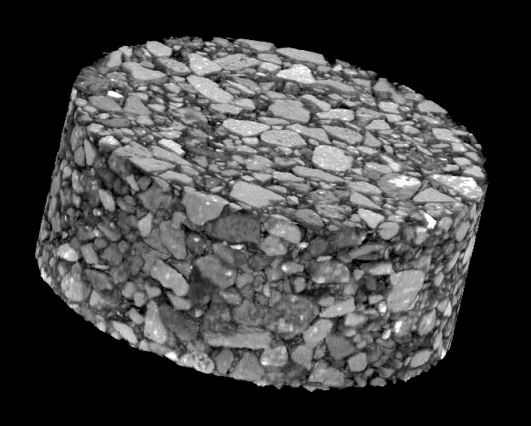
What does CT mean?
Computed Tomography
  Tomography: From Greek, tomos = act or result of cutting
  Computed: Use a computer to do it
  CAT form: Computed Axial Tomography
Notes:
First, what does CT even mean? It stands for computed tomography, where the computer is building a 3D model of an object by cutting it up into pieces, usually equidimenional voxels.

Slide 4
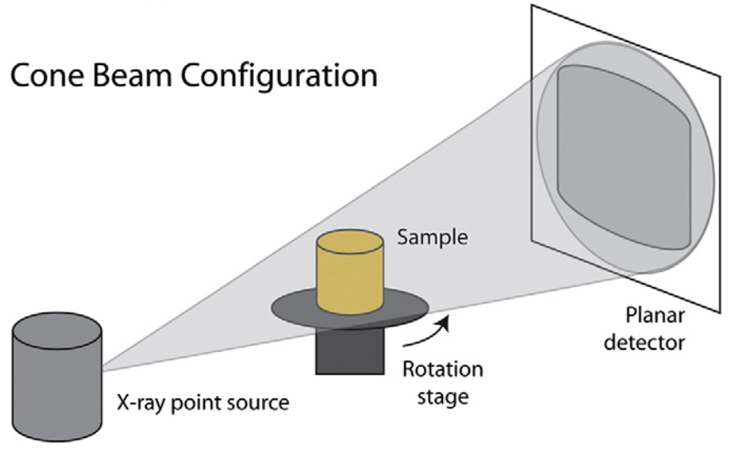
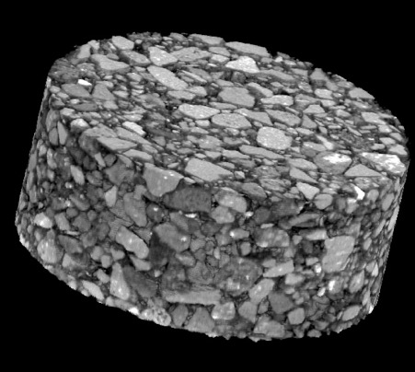
X-ray CT (XCT)
Source produces X-rays
Sample rotates and attenuates the X-rays
Detector records attenuated X-rays
Computer reconstructs detector images into 3D data
asphalt aggregate core
Each step can result in artifacts
Kyle and Ketcham 2015
Notes:
Most XCT systems use a cone beam geometry, but all share the same parts.
First there’s an X-ray source, …

Slide 5
X-ray Tube Components
(High-Z target (W, Cu, Mb))
Low-Z window (Be, diamond)
https://phys.libretexts.org/
Notes:
- So, looking at the first step, how do you generate X-rays?
- A standard X-ray tube has several components. The first is a filament, usually made out of Tungsten, that when heated produces free electrons. The size and geometry of this filament is a major factor in the X-ray focal spot size which we get to later.
- Then, a potential difference is applied between the filament, which is the cathode, and the target, which is the anode, to accelerate these electron towards the target material. This target material is made from a high Z, or high atomic number, such as tungsten or copper, which when hit with electrons generates x-rays
- Since the whole tube is encased in a vacuum to enable the movement of the electrons, a window is provided, made of a material with a low atomic number so it doesn’t absorb the X-ray so the X-rays can be emitted from the tube.

Slide 6
X-ray Tube Settings
Potential in kV: how fast electrons go
Filament in mA: # of electrons
Total input power (watts) is limited
W = mA x kV
X-ray production very inefficient (<1.0 %)
W target at 100 kV is 0.6% efficiency; rest is heat
Notes:
- As an operator you can change the electron flux in the tube to control the X-rays produced
- First, you can modify the electron density from the filament by changing the amperage applied, this is in milliAmps
Then you can also modify the kV of the tube, which is the potential applied within the tube and controls the speed of the electrons toward the Target
Together these numbers give a total wattage, which will be limited by the tube for stability.
For most X-ray scanners you modify the KV, and then either the amerpage or the wattage to keep the total power output the same
And, unfortunately, X-ray production is a very inefficient process. The majority of this power is dissipated as heat within the system.

Slide 7
X-ray Spectrum from Target
Bremsstrahlung X-rays
  Electrons pass through Coulomb field of nucleus, slows down, excess energy given off as photons
  Continuous up to source voltage (kV)
Characteristic X-rays
  Incoming electron knocks out inner shell electron, outer-shell electron cascades to replace it, gives off energy equal to energy loss of transition
  Discrete
Most photons low-energy
Characteristic X-rays
Max X-ray energy
Bremsstrahlung X-rays
Characteristic X-rays
Notes:
- So, the X-rays emitted from the target are of a couple of different types
The majority of x-rays are produced as the electrons interact with the nucleus of the target material atoms and slow down
This energy is given off as Bremsstahung X-rays (Bremsstrahlung is german for braking radiation)
These are in a conitunous spectrum, with the maximum energy as the source voltage
A second source of X-rays are characteristic X-rays.
These occur at discrete energies when an incoming electron knocks out an inner shell electron, and an outer shell electron gives off energy to cascade down to replace it.
So, for a lab based X-ray system, the X=rays are polychromatic, or at various X-ray energies, and most of the X-ray photons are at lower energy so the mean of the X-ray spectrum is less than ½ of the maximum energy.

Slide 8
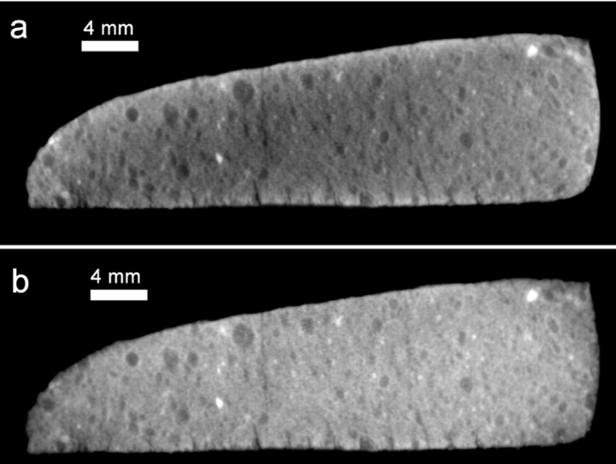
X-ray Spectrum Filtering
Sample filters beam, especially low energy X-rays – Beam Hardening
CM Murchison 120kV, 0.25 mA
Software correction
Hanna & Ketcham 2017

Slide 9
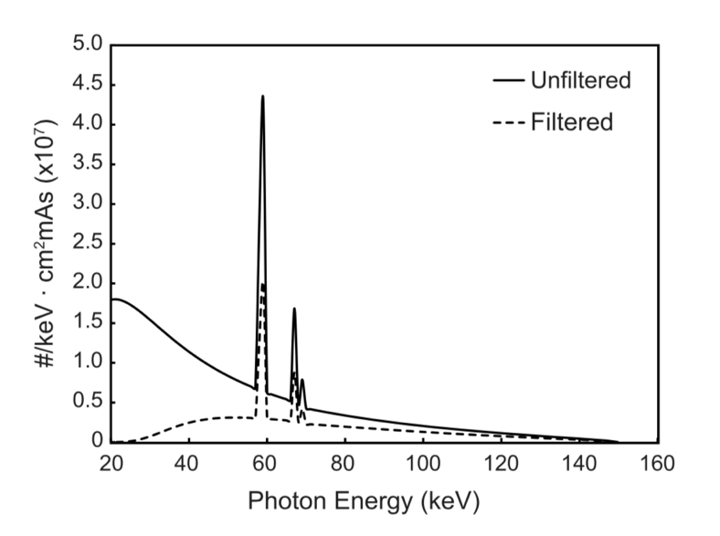
Filtering the X-ray Spectrum
Objective: only use higher-energy X-rays
Procedure: X-rays pass through material (brass, Al) before sample
Result: Lower-energy X-rays are preferentially diminished
Drawback: All energies diminished somewhat (lower SNR*)
*Signal to Noise Ratio
Unfiltered
Mean energy
48 keV
(10 mm Al)
Filtered
Mean energy
69 keV
Hanna and Ketcham (2017)
Notes:
Because polychromatic X-rays can cause various artifacts, mainly due to the presence of the lower energy X-rays, it is sometimes desirable to filter the X-rays coming out of the target
This is done by placing an attenuating material such as alumimum or brass, after the X-rays leave the source and before the reach the object
The graph on the right shows the difference in the X-ray spectrum, and mean energy, between an unfiltered source, and one that has been filtered quite heavily with a centimeter of aluminum.
The lower energy X-rays are greatly diminished, but all energies are somewhat diminished, which can lead to noisier CT data.

Slide 10
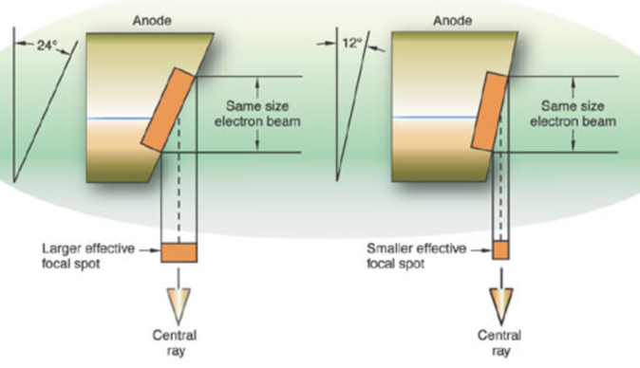
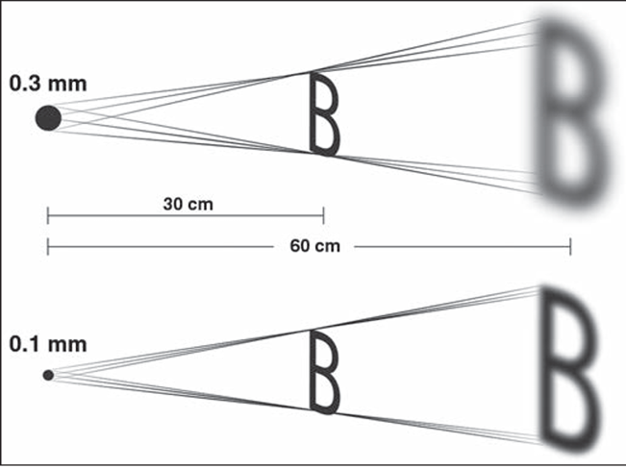
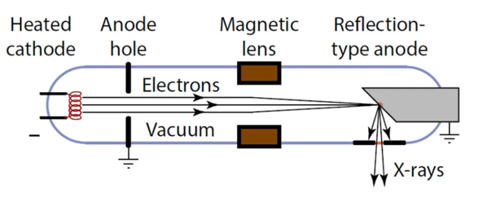
X-ray Focal Spot
Controlled via target angle or size of beam
https://rrcmrt.wordpress.com/
Huda & Abraham 2014
Metrology.news
Notes:
This shows effect of X-ray focal spot. Smaller better (although less flux) and two ways to control the size of the spot size – either with magnetic lenses, basically controlling the size of the incoming electrons much like in an SEM. Or, with the angle of the anode.

Slide 11
X-ray Source: What’s Good?
High X-ray flux (power)
  More photons = better counting statistics (higher SNR)
Small X-ray focal spot
  Improves image clarity, resolution
  Reduces number of paths through any one point in object
Appropriate kV for your object
  High kV = better penetration, less noise
  Low kV = better discrimination, more contrast
Reality:
  Systems limits power (max W) to prevent target damage
  Higher W (higher kV or mA) necessitates enlarging spot (defocusing) to prevent target damage
Notes:
So, if you’re setting up an X-ray CT experiment, what are the best parameters for your X-ray source?
Well, a high flux (i.e.) power is good because it will ultimately reduce noise.
A small focal spot on your source is good as well, because it improves image clarity and resolution by reducing the number of path through any one point in the object being scanned (we’ll look at resolution in more detail shortly)
And, selecting an appropriate energy for your object is key. A higher Kv (which again, is the highest energy of the X=ray spectrum) provides better object penetration and less noise, but as we’ll see shortly, can come at the cost of phase discrimination within the sample.
In reality, there are limits on all of these parameters put in place by the scanner you are using.
There is an inherent power (or wattage) limit on all systems to prevent target damage, because if you provide too much power you could damage or melt your target
And tied to this, if you do want to run at the highest power on the system, it will enlarge the spot size automatically to present damage.
The smallest spot sizes on a system are usually only allowed with lower power settings (so smaller Kv or less amperage).

Slide 12
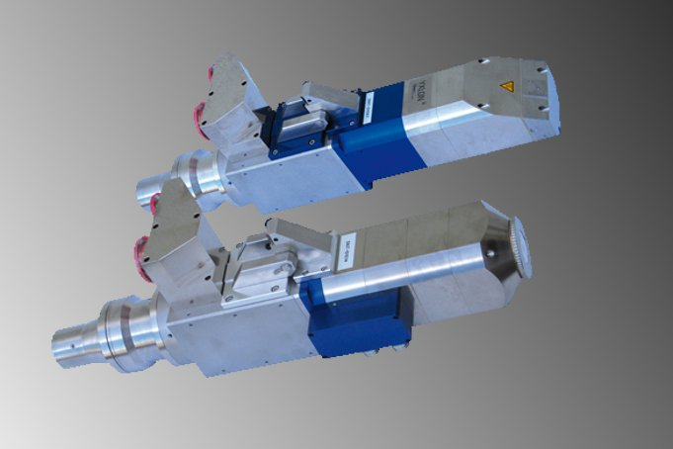
X-ray Sources
Directional source
Filament grid
Anode
{
Xylon.com
X-rays
Magnetic
focusing
Directional: X-rays from “thick” target
Transmission: X-rays emanate “through” thin target
  Smaller focal spot (< 1 um)
  Lower intensity, energy
Liquid metal target – high flux - thermal damage to target not a concern
Synchrotron
Target
Transmission source
Filament grid
Anode
Magnetic
focusing
Target
X-rays
Notes:
So what are the limits of an XCT system? It all depends on the X=ray source type.
Higher energy XCT systems typically use directional source, where the electrons hit a thick target and X=rays are produced at an angle.
The target is manully rotated, on ours we just use an allen wrench every few months, to prevent pitting.
Transmission targets are where the target material is very thin, and the electrons essential hit the back of it and x-rays emanate from it. These are capable of smaller focal spots, and thus better resolutions, but at the expense of flux and energy
The latest higher power scanners use a liquid metal target. This allows a higher flux or higher total power) because thermal damage to the target is no longer a concern.
And finally, there’s synchrotron-based X-ray sources. These are completely different, and use an electron gun as the filament, which can accelerate the electrons must faster, at higher energy, close to the speed of light
The electrons out of the gun are incredibly high energy, on the order of Gigavolts, and X-rays are produced when their trajectory is changed, i.e., by going around a ring.
The X-rays produced from these trajectory changes are such high flux that the X-rays can essentially be filtered to a single, monochromatic X-ray energy.

Slide 13
X-ray CT (XCT)
Source produces X-rays
Sample rotates and attenuates the X-rays
Detector records attenuated X-rays
Computer reconstructs detector images into 3D data
asphalt aggregate core
Each step can result in artifacts
Kyle and Ketcham 2015

Slide 14
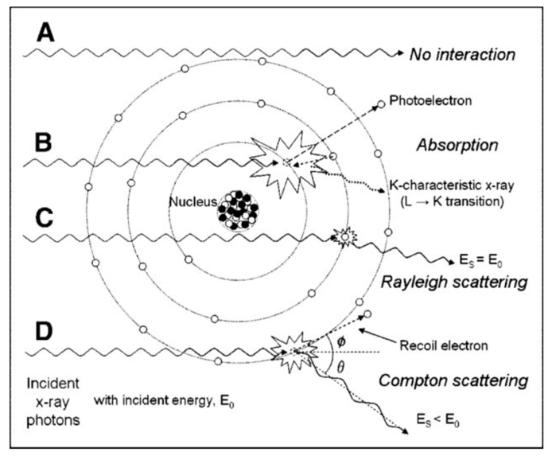
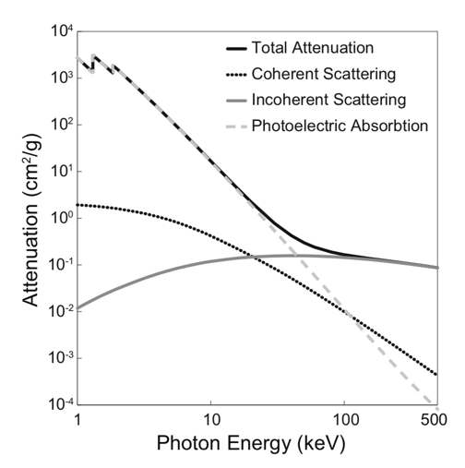
X-ray Attenuation
Lambert-Beer’s Law
I=I₀exp(−µx)
Linear attenuation coefficient: µ
Photoelectric absorption
Coherent (Rayleigh) Scattering
Incoherent (Compton) scattering
Seibert & Boone (2005)
Hanna & Ketcham (2017)

Slide 15

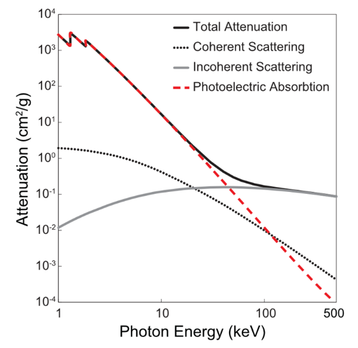
Photoelectric Absorption
X-ray photon hits inner-shell electron which ejects (ionization)
All energy lost (completely absorbed)
∝ Z⁴ - very atom-dependent!
Dominant at < 70 keV and high Z
Hanna & Ketcham (2017)
Seibert & Boone (2005)

Slide 16
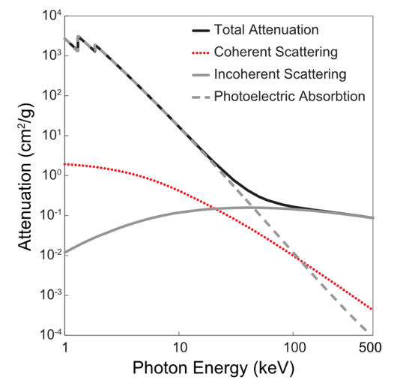
Coherent (Rayleigh) Scattering
X-ray photon transfers all energy to an electron that emits X-ray at same energy
No energy loss (elastic scattering)
∝ Z² and only significant at at low E (< 70 keV)
Hanna & Ketcham (2017)
Seibert & Boone (2005)

Slide 17
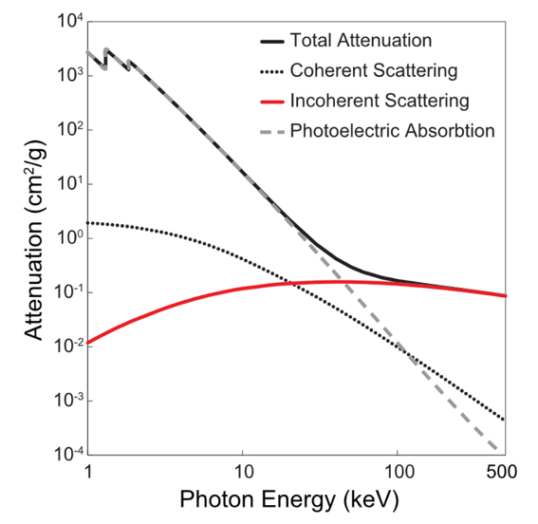
Incoherent (Compton) Scattering
X-ray photon hits one or more outer electrons, losing partial energy (inelastic scattering)
∝ density rather than Z so less sensitive to composition
Hanna & Ketcham (2017)
Seibert & Boone (2005)

Slide 18
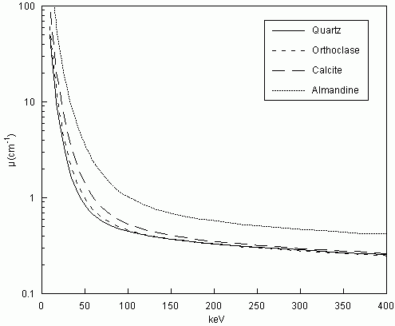
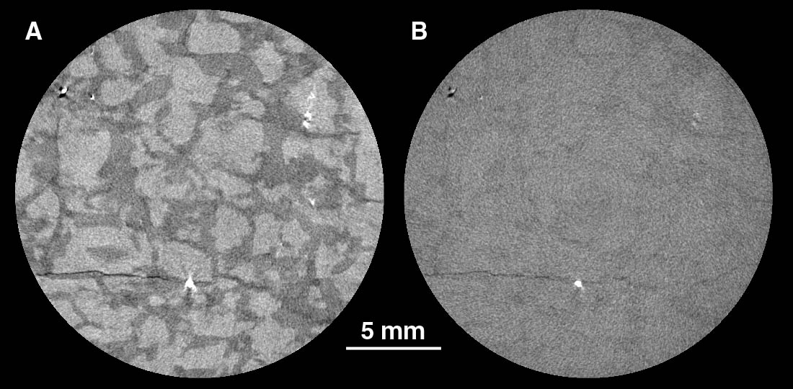

X-ray Attenuation
100 keV
200 keV
Lambert-Beer’s Law
I=I₀exp(−µx)
µ more highly dependent on Z (∝ Z⁴) as energy is lowered
Ketcham & Carlson (2001)
100 kV
200 kV
Orthoclase
Slightly higher Z
Quartz

Slide 19
X-ray Attenuation
x
Simple: I = I₀exp(-µx)
  I₀ = number of photons going in
  µ = linear attenuation coefficient
  x = distance
  I = number of photons getting through
Multiple materials:
I = I₀ Σ exp(-µ_{i}x_{i})
  CT reconstruction algorithm solves for this
Multiple energies:
I = Σ I_{0,j} Σ exp(-µ_{i}(E_{j}) x_{i})
  µ also a function of X-ray energy
  CT reconstruction algorithm does not solve for this → beam hardening artifacts
I₀
I
µ
x₁
x₂
I₀
I
µ₁
µ₂
x₁
x₂
µ₁
µ₂

Slide 20
X-ray CT (XCT)
Source produces X-rays
Sample rotates and attenuates the X-rays
Detector records attenuated X-rays
Computer reconstructs detector images into 3D data
asphalt aggregate core
Each step can result in artifacts
Kyle and Ketcham 2015

Slide 21
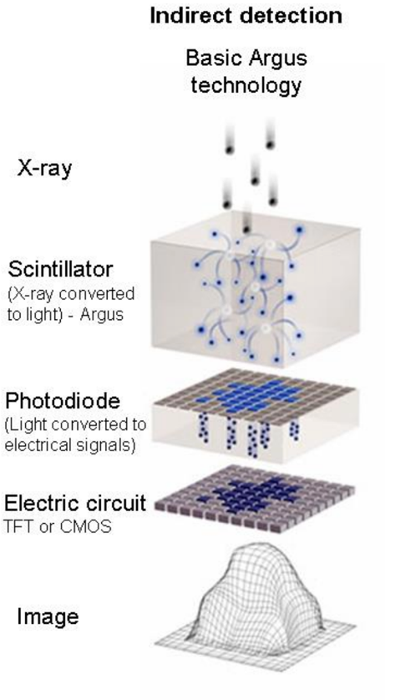
X-ray Detection
Counts photons that get through sample along certain ray paths
Detection mechanism: scintillation
  Incoming photon causes flash of light; flashes counted
Efficiency
  Low-energy X-ray photons easier to count
  Different detectors optimized for different energies
Walter et al. 2016

Slide 22
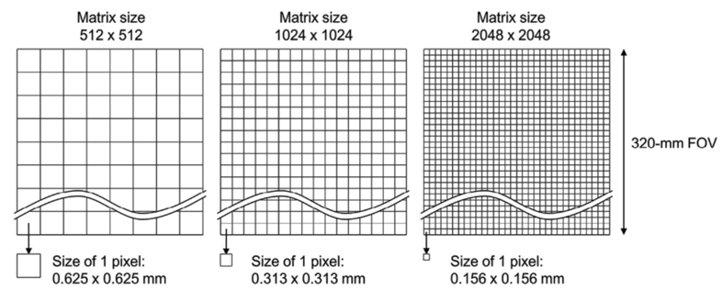
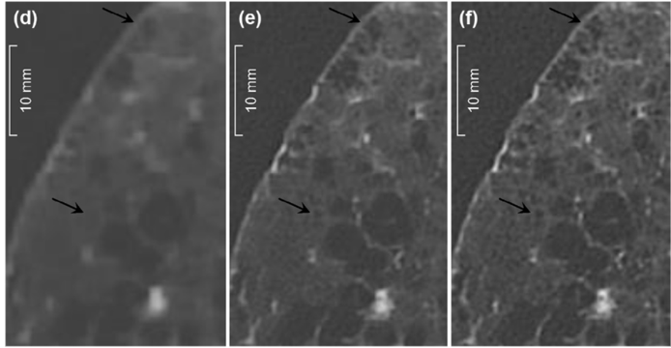
X-ray Detection: What’s good?
Uniform signal across all energies
Fast – get reading and clear for next one (no shadowing)
Small-sized detector elements
  Higher resolution
Minimal crosstalk
  Communication between adjacent detector elements
High bit depth
  Typical range 16-32 bits; more provides better contrast
Durability
Hata et al. 2018

Slide 23
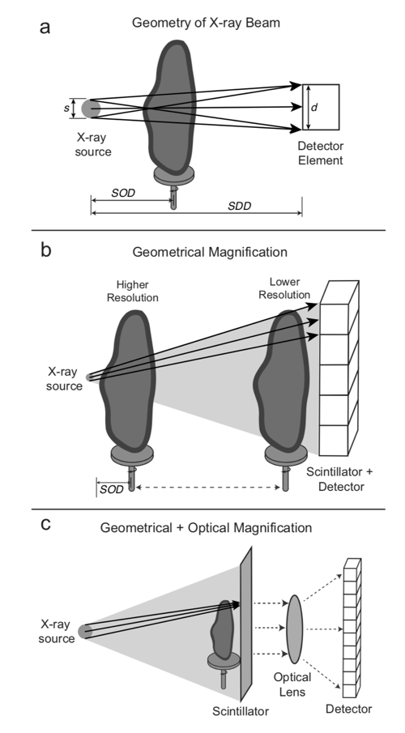
Imaging vs Feature Resolution
Most CT systems use geometrical magnification
Zeiss incorporates optical lens magnification
Each detector element ‘sees’ a portion of the object = Imaging (spatial) resolution
  1 inch core / 2048 detector elements: ~13 µm spatial resolution (voxel)
Spatial resolution ≠ feature resolution
  13 µm x 3 = ~39 µm features resolved
Hanna & Ketcham (2017)

Slide 24
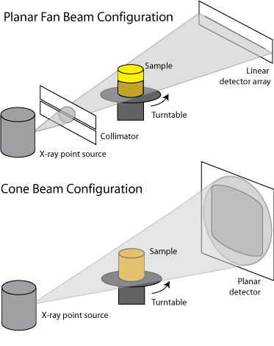
Lab CT Systems
Lab-based systems primarily cone beam
e.g., Nikon XT H, Zeiss Versa, Phoenix v|tome, SkyScan, NSI
Some distortion at edges of FOV
Collimation (planar fan beam) or helical scanning can avoid distortion
Kyle and Ketcham (2015)
www.industrial.ai
Notes:
So, putting it all together into one CT systems
In the lab, CT systems have polychromatic (so, many energies) X-ray sources and are cone beam geometry, which means that the X-rays come from a point source and spread out to a 2D planar detector, like we saw a few slides back.
All the major manufactors have lab systems in this configuration – Nikon, Zeiss, Phoeniz, etc.
The main drawback of this is distortion at the edges of the field of view, but this can be overcome in one of two ways
The first is to collimate only the central part of the beam, so its more of a planar fan beam geometry. This is ideal because due to parallax, the central rays between the source and object are always the least distorted. To scan a full sample you move the object up and down
A more sophisticated version of this is helical scanning, where the sample still moves up and down but continuously so one rotation sees a spread of vertical throw. This greatly speeds up the acquisition, if the software can correctly reconstruct the geometry.
It also allows a imaging of specimens that are significantly longer in one dimension.

Slide 25
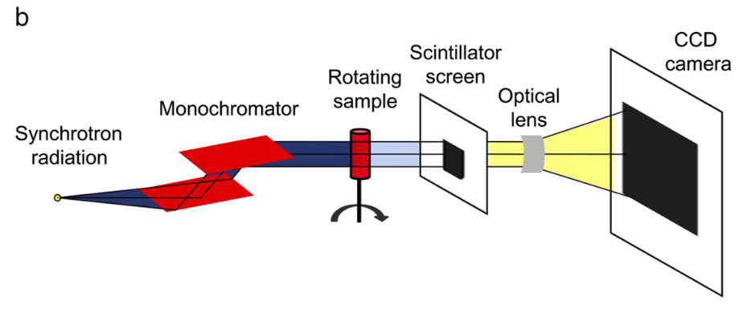
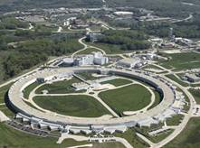
Synchrotron XCT
Cnudde & Boone 2013
Advantages
  Monochromatic radiation
  High intensity
  High resolution
  Ancillary modalities (fluorescence, diffraction, phase contrast)
Disadvantages
  Availability
  Low-energy radiation (< 100 kV) so limit in sample size for high Z material
Advanced Photon Source (APS) at Argonne National Laboratory

Slide 26
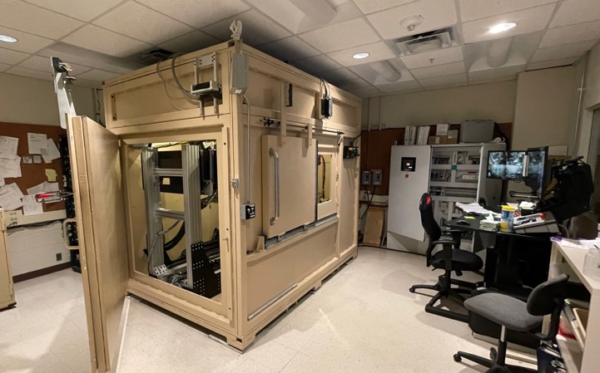
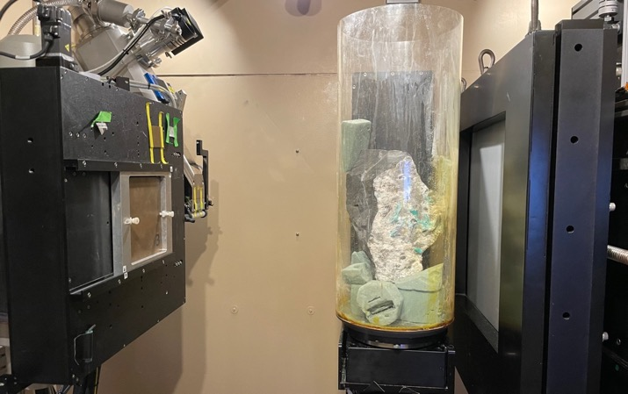
UTCT Instrumentation
NSI Sources
  450 kV GE Titan; dual spots: 0.4 mm (700W), 1.0mm (1500W)
  225 kV Microfocal Comet; 8W for <5 µm spot, usually run defocused
NSI Detectors
  2048x2048 16” Perkin Elmer flat panel
  Helical, MosaiX (large objects), and SubpiX (double spatial resolution)
Notes:
- So, what does UTCT have in our lab?
We have two main systems. The first, which was upgraded by NSI and retrofitted to fit in our original walk in lead-encased enclosure from 1997, has two sources and two detectors which can be all be interchanged.
The larger, higher energy source is a 450 kV GE is used for the largest, densest objects
The second source is the 225 kV Feinfocus which is used more commonly,, usually in conjuction with our 2048x2048 Perkin Elmer detector that is also cabable of subpixel and mosiaing. The subpixel feature always an almost doubling of the spatial resolution, and mosaicaing allow larger samples to be imaged by moving the detector.
We also have a Linear detector array which essentially provides the fan beam geometry that I discussed earlier, although we don’t use it much because the new NSI system also allows a helical scanning configuration.

Slide 27
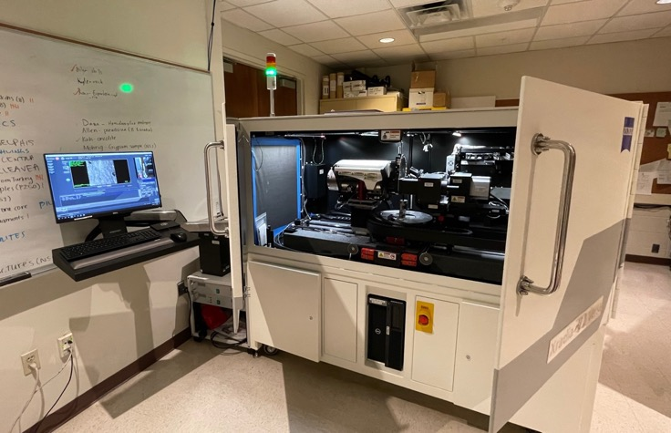
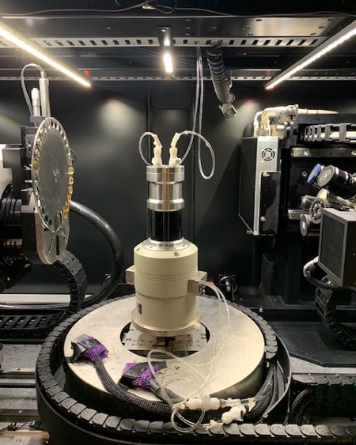
UTCT Instrumentation
Zeiss Versa 620
  Installed January 2020 from 1.2 M NSF MRI award
  30-160 kV and 25 W
  0.5 µm feature detection – down to ~ 0.04 voxel resolution
  Diffraction Contrast Tomography (DCT) module (3D EBSD)
  Subvolume imaging with 0.4x, 4x, and 20x objectives
  Accepts experimental cells for in-situ imaging at various P/T
Notes:
And then our newest addition in January of 2020 is a Zeiss…..

Slide 28
Part II:
What’s Data and What’s Not?
Goal: Make sure you don’t “interpret” things that are just artifacts of the scanning process.
Notes:
So, the final part of this lecture is a discussion about scanning artifacts, how they are caused, and how to recognize and correct them

Slide 29
X-ray CT (XCT)
Source produces X-rays
Sample rotates and attenuates the X-rays
Detector records attenuated X-rays
Computer reconstructs detector images into 3D data
asphalt aggregate core
Each step can result in artifacts
Kyle and Ketcham 2015

Slide 30
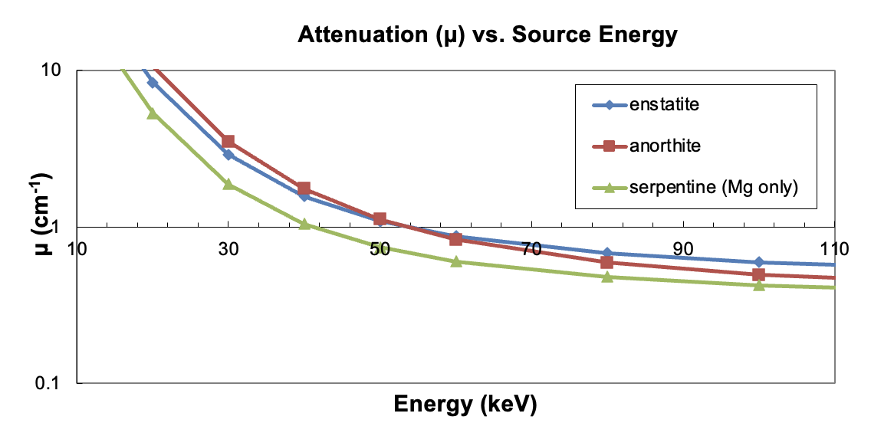
Data Analysis & Artifacts
Artifact: an image feature that is not part of the physical object
CT data represents x-ray attenuation which can be identical for very different materials
Lower kV not always better - MuCalc Tool - www.ctlab.geo.utexas.edu/software/

Slide 31
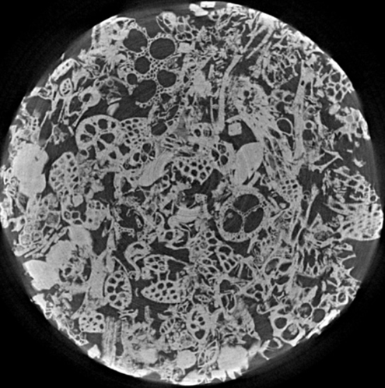
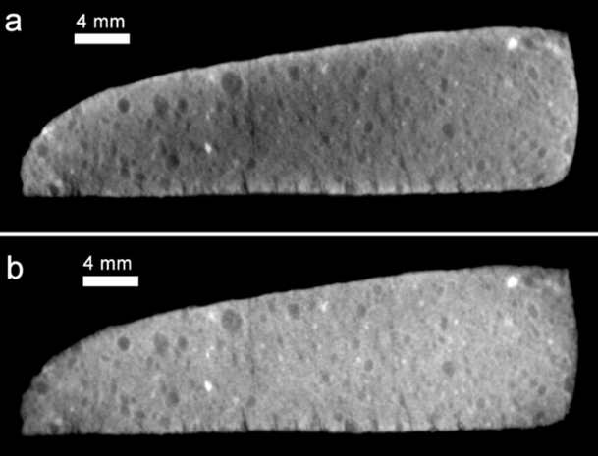
Artifacts: Beam Hardening
Edges of object appear brighter than center
Preferential or total attenuation of low-energy x-rays
Mean energy of beam changes (CT reconstruction algorithms assume it doesn’t)
Limestone core
CM Murchison meteorite
(Bottom corrected)
Wildenschild & Sheppard 2013
Hanna & Ketcham (2017)

Slide 32
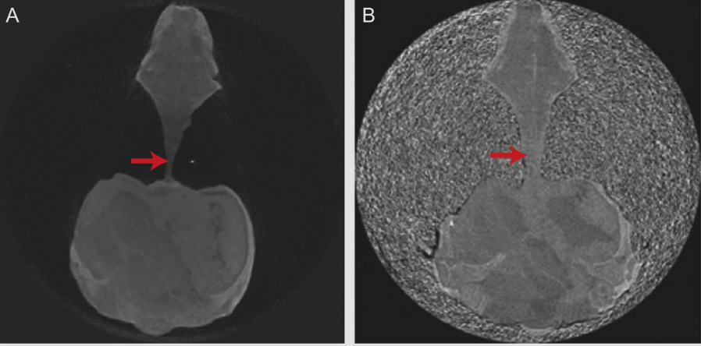
Beam Hardening Solutions
Use higher-energy x-rays
Pre-harden the x-rays (filter)
Take wedge through similar material (i.e., filter and make path lengths all the same)
Software correction during reconstruction
Rooneyia fossil, FOV 50 mm
Ketcham & Hanna (2014)

Slide 33
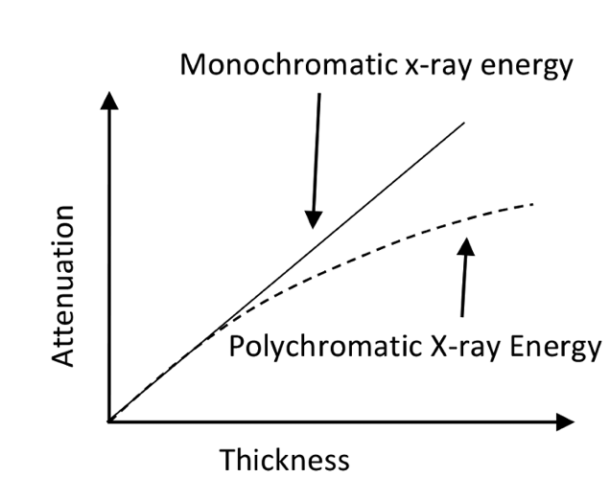
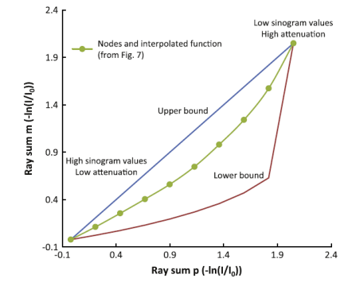
Beam Hardening Correction
Most CT reconstruction software allows a form of linearization in the form of a simple polynomial
Input is single number or series of polynomial coefficients (2-4)
Ahmed & Song (2018)
Ketcham & Hanna (2014)

Slide 34
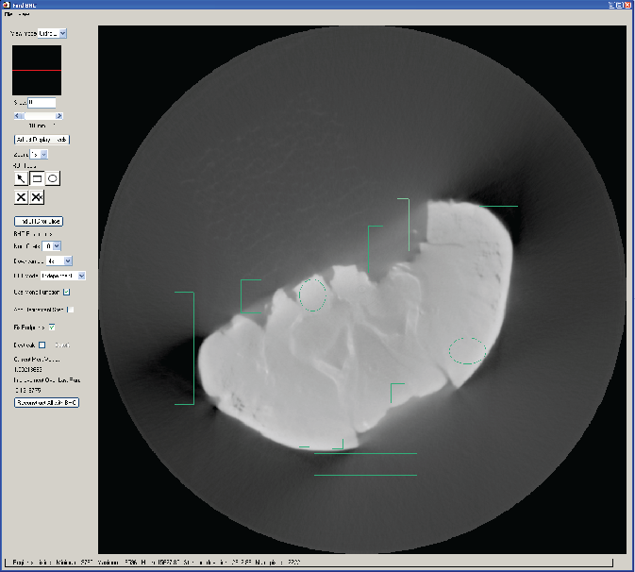
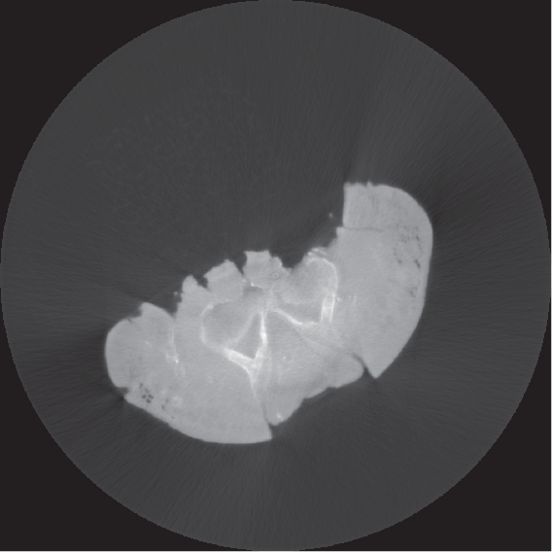
Beam Hardening Correction
Iterative algorithm finds a function to minimize artifacts in marked locations where artifact is dominant (Ketcham and Hanna, 2014)

Slide 35
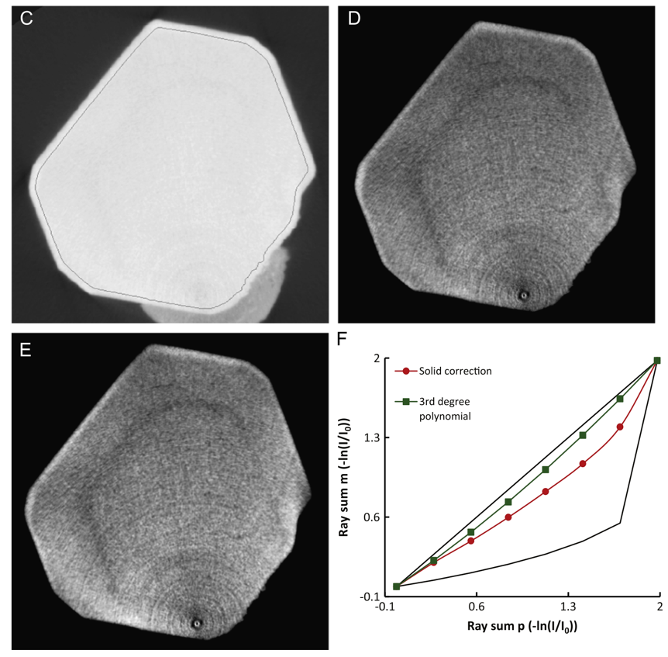
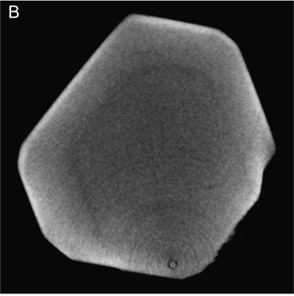
Beam Hardening Correction
Apatite
35 mm FOV
Solid correction
3rd degree polynomial
Ketcham & Hanna (2014)

Slide 36
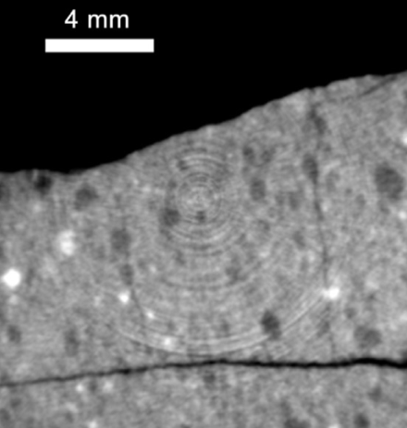
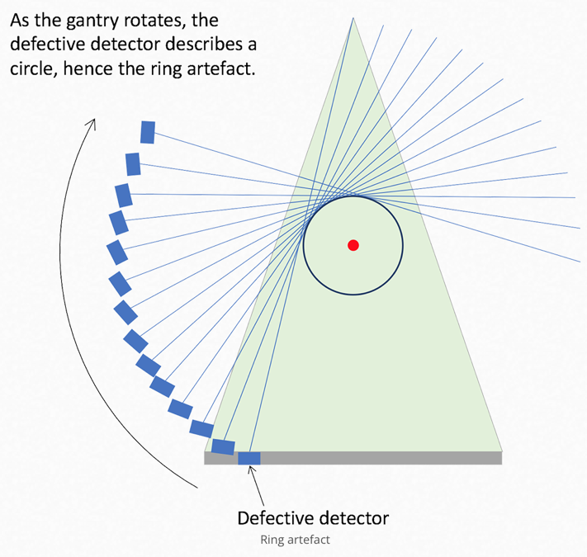
Artifacts: Rings
Hanna and Ketcham 2017
sample
Caused by source drift, differential detector element response, detector energy dependence
Solutions:
  Dithering (move stage or detector)
  Multi-energy calibration
  Pre-reconstruction correction
  Post-reconstruction (image) correction
www.radiologycafe.com/

Slide 37
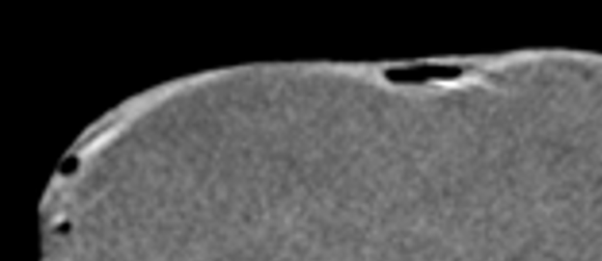
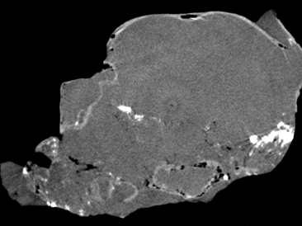
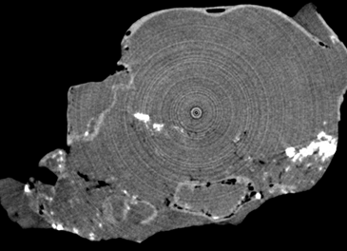
Artifacts: Rings
Archaeopteryx: early bird fossil
Post reconstruction software correction (meh)
Uncorrected
5 mm

Slide 38
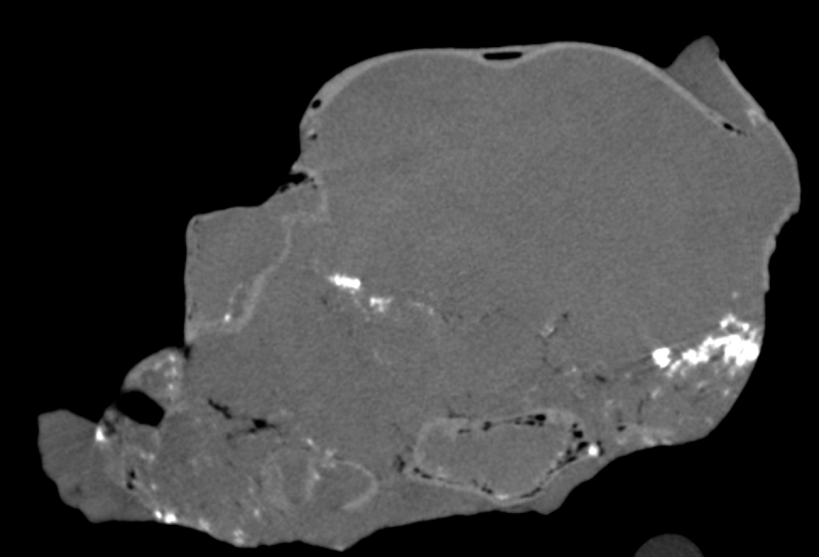
Artifacts: Rings
Pre-reconstruction software correction (better)

Slide 39
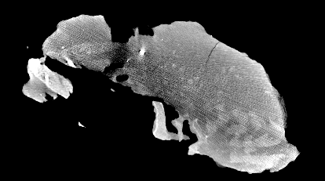
Artifacts: Streaking
Caused by low SNR along long beam paths
Solutions:
  Longer acquisition times
  Smoothing during pre-reconstruction in low-signal areas
Prosauropod fossil

Slide 40
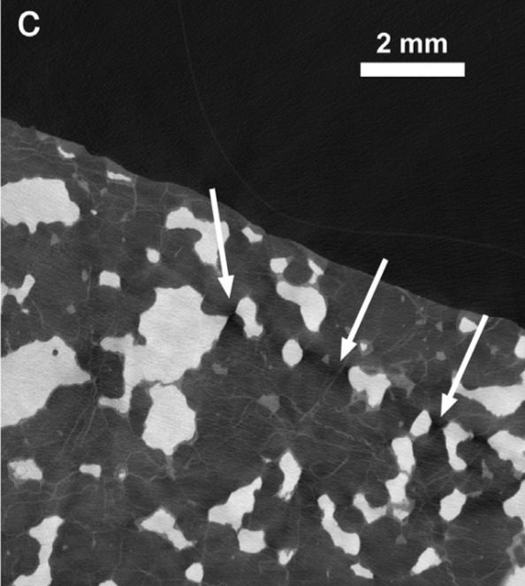
Artifacts: Shadowing
Dark areas in the ‘shadow’ of highly attenuating materials (usually metal)
Cause: extreme filtering of beam
  Also called “photon starvation”
  Present even when using high-flux synchrotron sources
Hanna & Ketcham (2017)
Metal and olivine in lodranite NWA 2993 meteorite
Notes:
Another related artifact that is a bit harder to avoid is something called shadowing.
This occurs in the presence of a highly attenuating material, usually metal, where in certain paths with a lot of of the highly attenuating phase you get extreme filtering of the beam.
Also referred to as photon starvation and it’s pretty hard to overcome, even at synchrotron systems

Slide 41
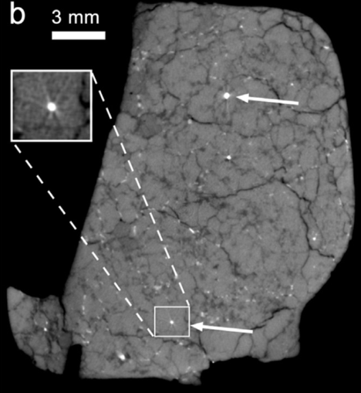
Artifacts: Starbursts
Results from large attenuation contrasts combined with low-energy X-rays
Sources: metal, oxides/sulfides
Sipalocyon
Oxides in fossil
Hanna & Ketcham (2017)
Metal in Almahata Sitta meteorite
Notes:
If the highly attenuating material, again usually metal, are discrete particles within a relatively low attenuation matrix, you get a starburst pattern that emanates from the particle.

Slide 42
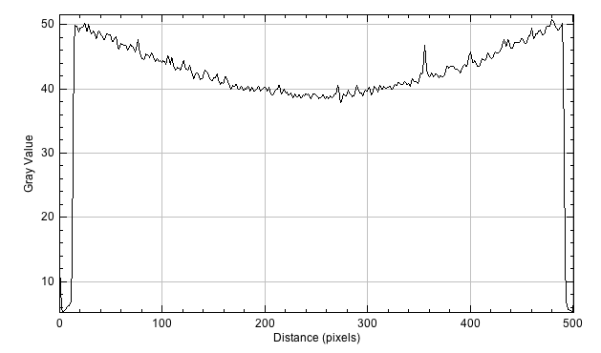
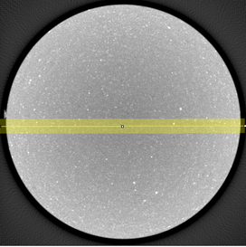
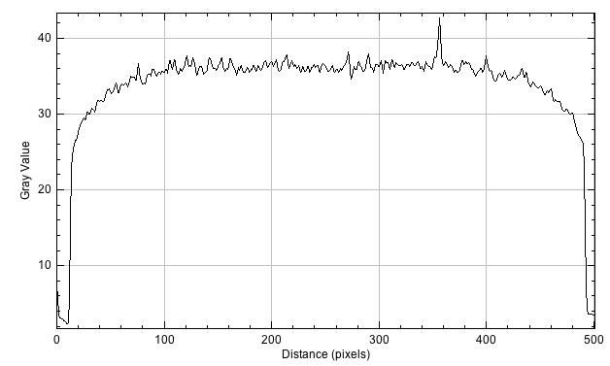
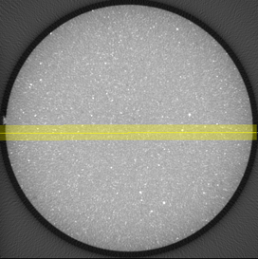


Artifact post-correction
An experienced analyst can recognize a CT artifact, but not necessarily a (botched) correction….
Uncorrected
Overcorrected
Best

