Slide 1
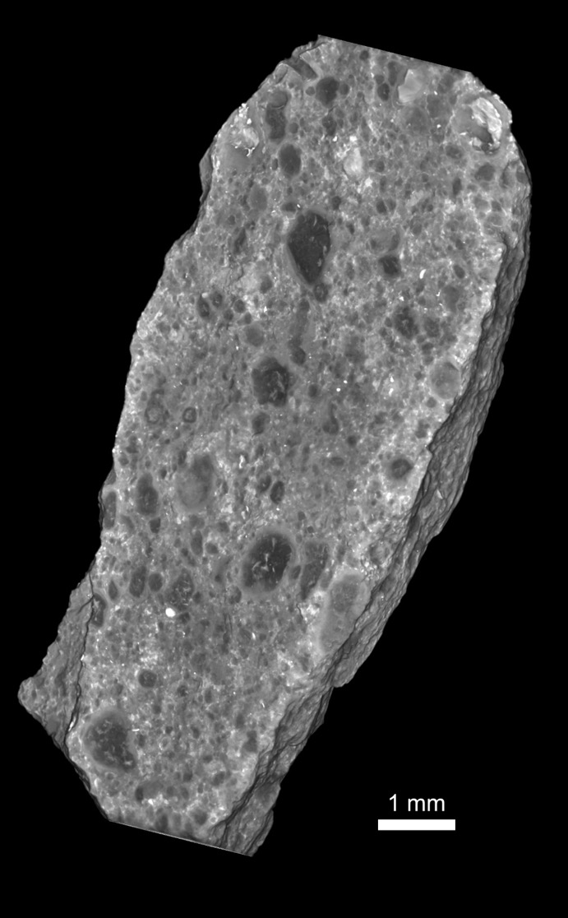


3D Submicron Porosity in CM Murchison with Xe and XCT
Romy Hanna
Also: Rich Ketcham, Dave Edey, Josh O’Connell
UTCT
Alan Whittington
University of Texas at San Antonio
XCT data CM Murchison Meteorite

Slide 2
Porosity and XCT
Direct imaging of pores with X-ray computed tomography (XCT) has a resolution limit
3 mm
200 µm
Hawaiian basalt: 18.4% porosity via XCT measurement
(46.9 µm/voxel)
CM Murchison: 1.9% porosity
via XCT measurement (3.00 µm/voxel)
22.1% porosity (Macke et al., 2011)
Notes:
For the last few years, we’ve been working on a project to use XCT to image porosity in cabonacous chondrite meteorites. Typically, XCT is used to measure pores that are large relative to the data resolution. This is because for direct imaging of a feature, you need a few voxels across it to accurately measure it.
So, on the left, this is CT scan of a Hawaiin basalt with huge vesicles so most of them can be measured even with this low resolution CT data.
On the right, is a typical sample that I work on, which is a primitive meteorite. This one is called CM Murchison, and we know from helium pycnometry that has around 22 % porosity. But, even with a 3 micron CT data, we can only measure a tiny amount of the actual porosity present.

Slide 3
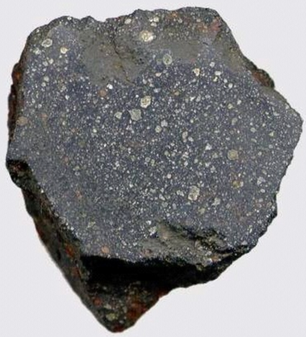
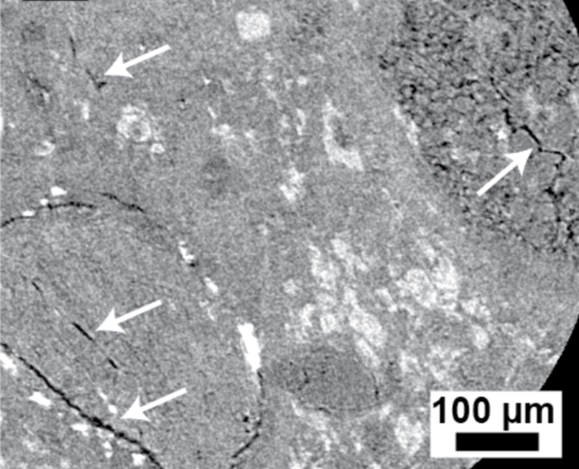
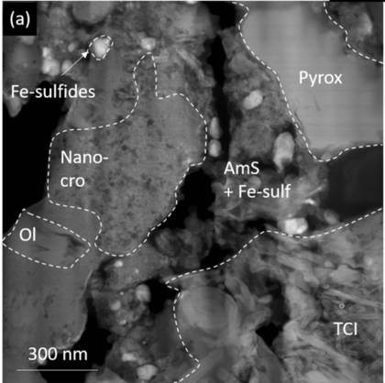
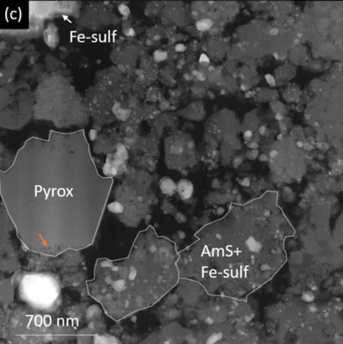
CM Chondrites: Submicron Porosity
CM chondrites: primitive, fine-grained samples of the early Solar System
1 cm
CM Murchison / Trilling @ NAU
Fine-grained rim (FGR)
chondrule
Matrix
matrix
chondrule
CM Murchison: XCT 1 µm/voxel
CM Paris: TEM
Zanetta et al.2021
Notes:
This is because, in these types of samples, known as CM chondrites, the porosity is mostly submicron to micron size.
The image at the top shows what this meteorite looks like in hand sample. The data on the left is CT data at 1 micron resolution. We can still not see very much of the porosity. The images on the right are from a TEM study of another CM chondrite called Paris. This shows that the porosity, mainly contained in the fine-grained areas, is mostly below a micron in size.
So, our issue is that we want to examine this fine-scale porosity in 3D in these samples, but in something bigger than the tiny volume required for TEM analysis.

Slide 4
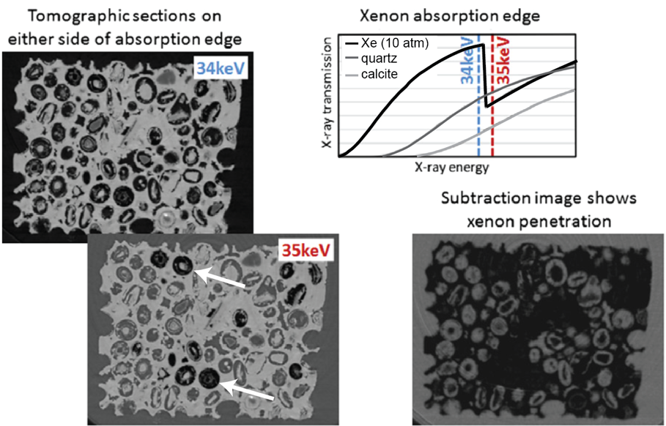
XCT With Noble (Xe, Kr) Gas
Scan twice and subtraction image shows Xe penetration and thus porosity
Pore size smaller than single voxel will change less than 100%
Adapted to laboratory setting for asteroid return samples (scan with and without the noble gas)
Adapted from Mayo et al. 2015
Notes:
One technique that’s been useful for examining porosity even below the native resolution of the CT data is combining XCT with a noble gas. The idea is that the heavier noble gases like Kr and Xe are attenuating to x-rays, and so reveal the presence of a pore, even if it’s smaller than the size of a voxel by only changing the attenuation of that voxel partially.
This has mainly been done on synchrotrons by imaging on either side of the xenon absorption edge. But we are adapting the technique to work in a laboratory setting, by scanning the sample both with and without the noble gas, so it can be applied to asteroid return samples.

Slide 5
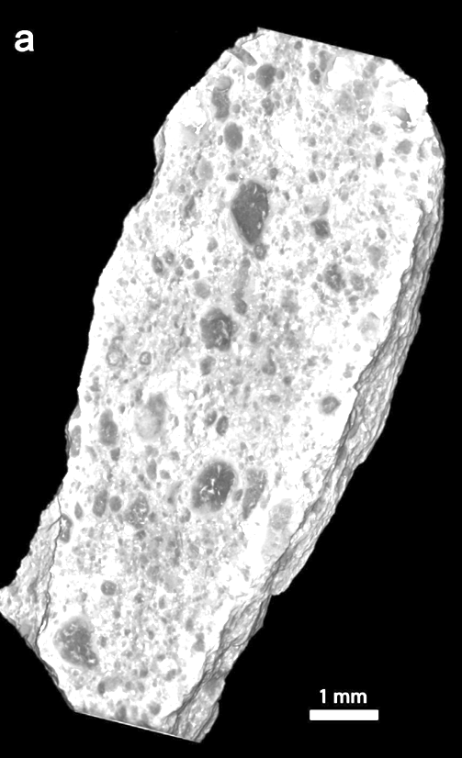
CM Murchison with Xe gas
CM Murchison
Sample inside PEEK* chamber
(3 mm interior)
Scanning conditions:
  Zeiss Versa 620 XRM
  90 kV, 12W
  0.4x detector, 1601 views, 2 frames per view
  3.01 µm voxel
*thermoplastic (polyetheretherketone)
XCT data; Hanna & Ketcham 2018
Notes:
So, the chip of CM Murchison that we have been working with is pictured here, although trimmed down to a bit since this data was collected. We are doing this work on our Zeiss Versa 620 and this first dataset I’ll be discussing was scanned in a PEEK chamber (PEEK being a thermoplastic) These first set of scans were done on the macro detector at 90 kv with a resconstructed voxel size of 3 microns..

Slide 6
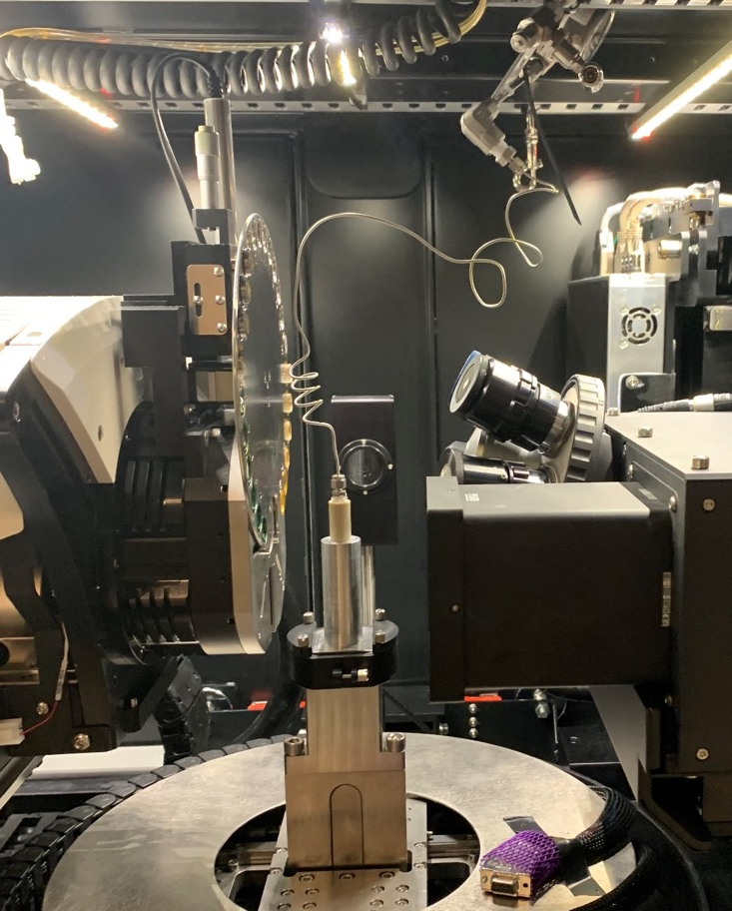
CM Murchison with Xe gas
  Pump chamber to low vacuum
  Fill with Xe @400 PSI
  Xe Scan (15 hours)
  Release Xe (sit for ~30 minutes)
  Air Scan (10.4 hours)
  Rescale Air Scan
  Xe Scan – Air Scan = Porosity (proxy) Volume
Source
detector
Notes:
This shows the sample on the scanner. The red arrow is pointing to the PEEK chamber that holds the sample. We used PEEK because it is rated for high pressure work and has a relatively low x-ray atteunation. The blue arrow points to the valve and connections that are used to pump and fill the chamber with xenon.
So, for this experiment we first pumped the chamber to low vacuum, filled it with xenon at 400 PSI and loaded on the scanner. A 3 micron scan took 15 hours and afterwards we simply opened the valve at the top to let out the xenon but didn’t take off the rig. Then we scanned the sample again (called the Air scan) which was shorter because the highly attenuating xenon was not present. Then, after reconstruction we had to rescale the air scan data after which we could subtract the two datasets to get a porosity volume.

Slide 7
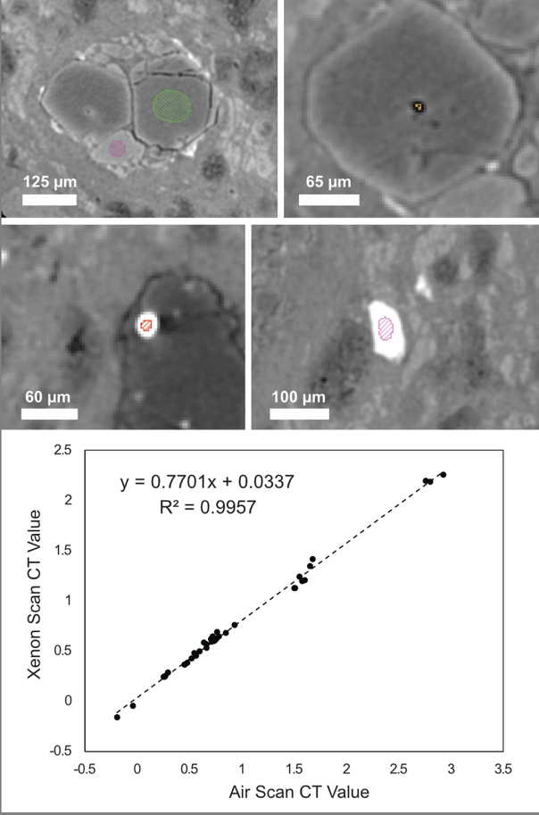
Rescaling Air Scan
Xe filters polychromatic X-ray
Different beam hardening corrections
35 non-porous minerals and isolated pores & inclusions
Linear rescale of air scan to match Xe scan
Hanna et al. 2022
Notes:
The rescaling was necessary because of we’re using a laboratory polychromatic beam. The xenon filters this beam heavily and so the sample sees a different source spectrum during the two scans. And then we have to apply different beam hardening corrections. So, a non-porous olivine for instance will have a different CT value between the two scans which is not what we want. We want the same CT value for anything non porous so the subtraction image shows nearly zero. So we searched for and found non porous materials in the sample that we could use to linearly rescale the air scan to match the attenuation values of the xenon scan.

Slide 8
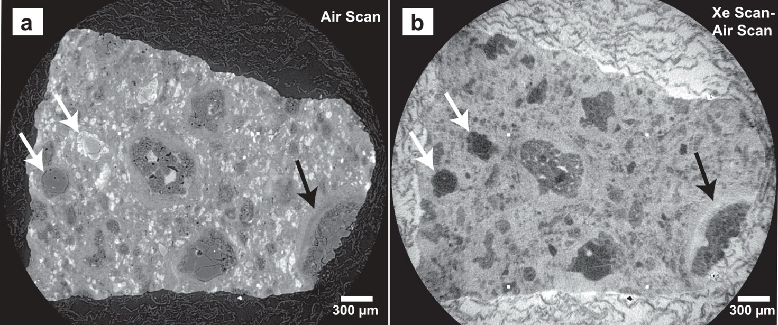
Subtraction Image ‘Porosity’
White arrows: both low porosity but different compositions (X-ray attenuations)
'Regular’ XCT Scan
Subtracted XCT Data
Hanna et al. 2022
Notes:
Here we see the CT scan in air of the sample on the left, and the subtracted XCT data on the right. Looking to the left first the white arrows point to two crystalline olivines with significantly different atteunations due to their differing iron content. And in the subtraction image on the right, both these, as expected, have very low porosity.
The black arrow on the left points to fine grained material around a chondrule known as a fine-grained rim. In the regular scan it’s not clear if this represents a compositional difference within the rim or not, but the image on right highlights that it is in fact due to a porosity difference, and that the porosity is below the 3 micron scanning resolution. We cannot directly see the pores themselves, but we know that they are there because the xenon was able to infiltrate them.

Slide 9
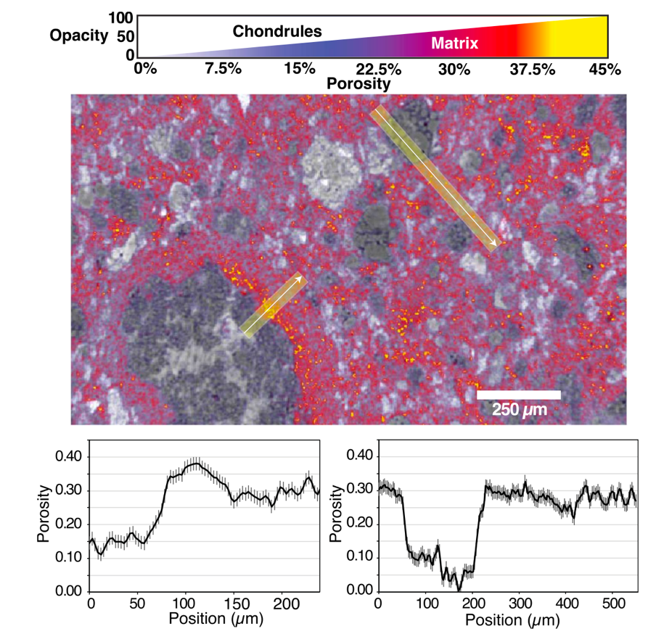
Conversion to Porosity Space
Beam hardening still present
Cropped to interior volume
No reliable 100% porosity value within sample
Converted to porosity using bulk porosity (22.1%) from He pycnometry (Macke et al. 2011)
Hanna et al. 2022
Notes:
Next we have to convert our subtraction volume to porosity, because it is still just representing a difference in CT value as measured by our instrument. And unfortunately as you may have noticed on the previous slide an artifact called beam hardening was still present, complicating the results especially around the edge of the sample. So, we cropped in the sample interior where there was minimal beam hardening artifacts.
And while we think we know the CT value of zero porosity areas, there was no reliable 100% porosity area within the sample interior. So, we converted the volume by anchoring it to the bulk porosity measured of Murchison from previous work. And I want to point out that this was not the measured porosity of this chip in particular, but Murchison in general. This results in the 3D porosity volume a slice of which is shown on the right. Here the XCT scan of the sample is in greyscale, and the porosity is overlain ontop of it in color.
Here we render the low porosity areas transparent, which are mainly the chondrules, to highlight the higher porosity in the matrix. The line profiles below show that the matrix is generally around 30% porous, with locally high porosity the fine-grained rim next the chondrule.

Slide 10
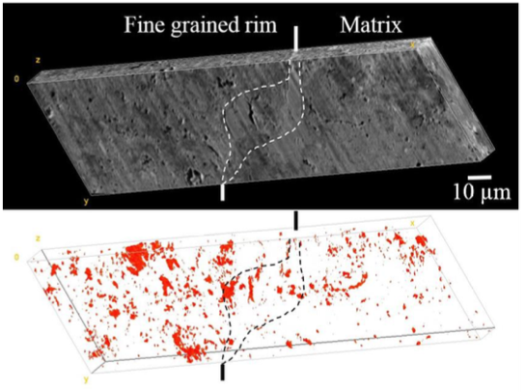

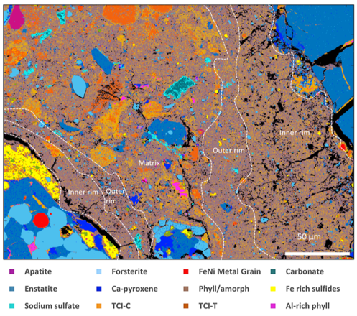
Consistent with Previous Studies
Fine-grained rims (FGRs) suggested to have variable porosity, sometimes higher than matrix
P-FIB serial sectioning with BSE/SE
CM EET 96029
Daly et al. 2018
CM Paris
Zanetta et al. 2021
Hanna et al. 2022
Notes:
And this is consistent with few previous studies, done in 2D, of CM chondrite porosity. The images on the right are both from scanning electron microscopy and show that the fine-grained rims around chondrules can be more porous than the nearby matrix. So, we’re confident that our technique worked as expected, and highlights the porosity variation, well below the scanning resolution, in our fine grained Murchison sample.

Slide 11
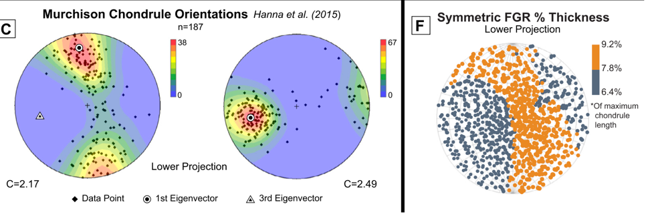
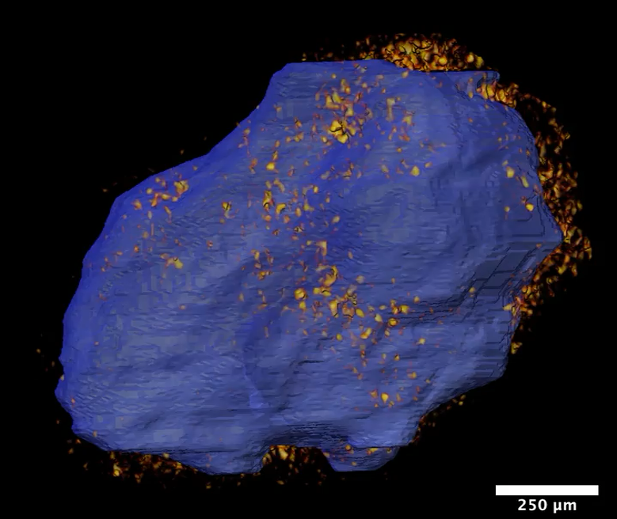
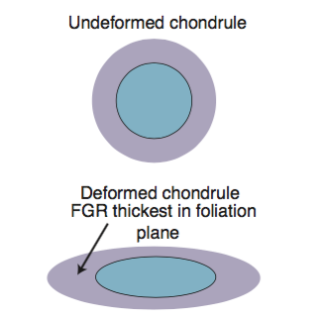
FGRs Compressed From Impact
Long Axes
Short Axes
3D porosity via XCT and Xe gas. Blue chondrule surface with areas of porosity >35% rendered
Hanna & Ketcham 2018
Central Question:
How was FGR porosity modified by impact?
Vertical Compression
Hanna et al. 2022
Foliation
plane
Notes:
- So, we had a 2018 study that examined the shape of the chondrules and fine-grained rims in this particular piece of Murchison, and found two tthings:
- First, the chondrules were deformed by impact into the parent body, and
- SECOND, the fine-grained rims, or FGRs, were measurably thinner in the direction of impact.
- This diagram illustrates the concept, whereby chondrules are deformed and are aligned in a foliation plane defined by their long axes.
- These long axes are plotted on the left, and their alignment shows the orientation of a foliation plane.
- Plotting the average thickness of the rims shows that they are thicker in the folation plane and thinner in the direction of compression.
- In other work we have developed a technique to examine submicron porosity in chondrites using xenon gas with XCT imaging.
- We saw that the porosity of the FGRs varied around the chondrules, but it was not clear if this was an original signature or due to the impact compaction that was modifying the rims.
- So our central question is how was FGR porosity modified by impact, if at all?

Slide 12
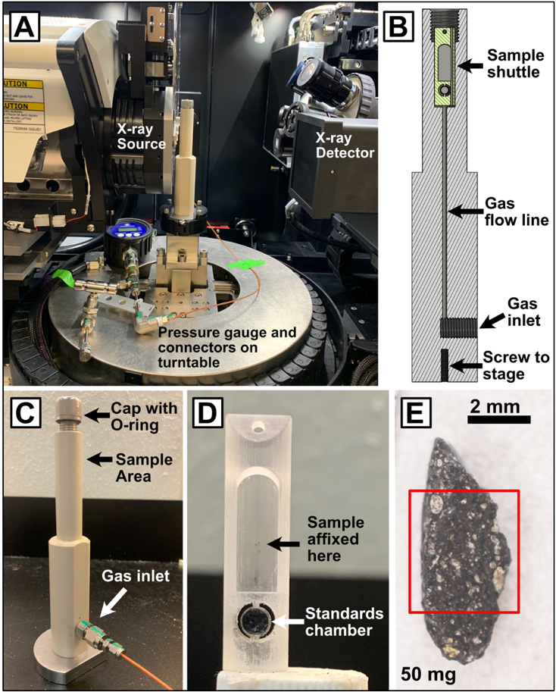

Higher Resolution Scan
Redesigned fixture
Increased pressure and longer scan times
Zeiss Versa 620: 100kV, 14W, 1.9 µm/voxel
Scanned in Xe @450 PSI (54 hrs) and vacuum (30 hrs)
Chip bulk porosity = 32.01$±$4.22 (He pycnometry)
Hanna et al. in prep
Notes:
- So we are using this tecuniquye of imaging the chip with XCT in the presence of pressurized xenon gas. This method is detailed in Hanna et al. 2022
- Fpr this chip, shown here, we secured it to the top of an alumumin tube that was super glued to the top cap of our rig, shown here.
- It was actually covered in carbon tape to keep it stationary since it was hanging upside down.
- We used our Zeiss Versa 620 and ran two scans at 100 Kv and 1.9 microns per voxel.
- The first scan was in pressurized xenon at 450 PSI, and due to the high resolution, relatively large rig and attenuating xenon, this scan took 54 hours.
- After that we vacuum pumped the xenon out and kept it at low vacuum during the next scan, which only took 30 hours.
- After scanning we measured the bulk porosity of the chip using a helium pycnometer. The relatively large error is due to its small size.

Slide 13
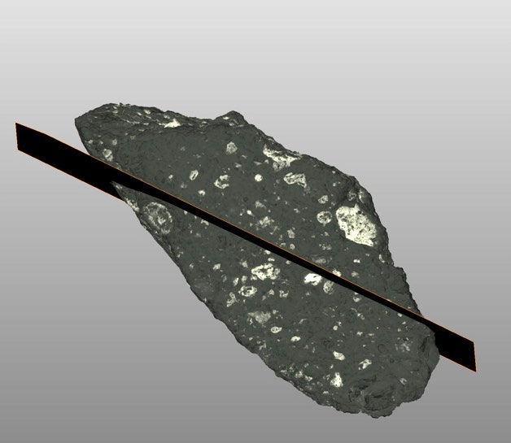
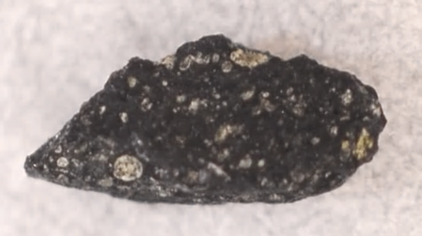
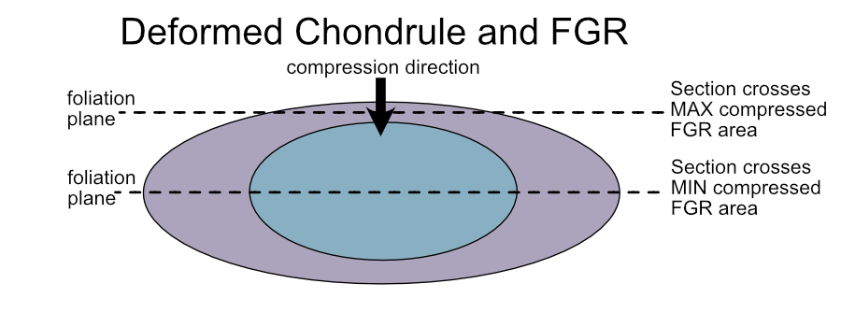
Sectioning and Compositional Analysis
Section cut parallel to foliation plane – final cut 6° off foliation plane
Volume rendering of XCT data showing desired thin section cut
2 mm
*Special thanks to Tim Gooding at the Smithsonian for an accurate section cut!
Notes:
- After this we sent the sample back to the Smithsion for them to cut a section approximately parallel to the foliation plane.
- This volume rendering on the right shows are desired thin section location and orientation, and in the end they produced an accurately located section.
- This diagram shows that we will see different amounts of compression in the rims depending on where the section crosses an individual chondrule.
- For chondrules where the section is near their midplane, there should be minimal deformation in the rim from Impact, assuming that the chondrule is acting as as less conpressible solid around which the rim is deforming.

Slide 14
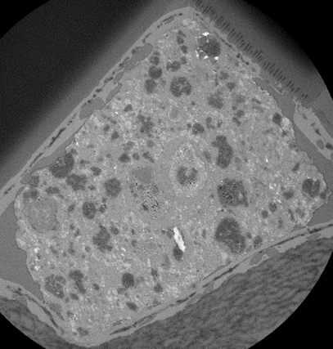
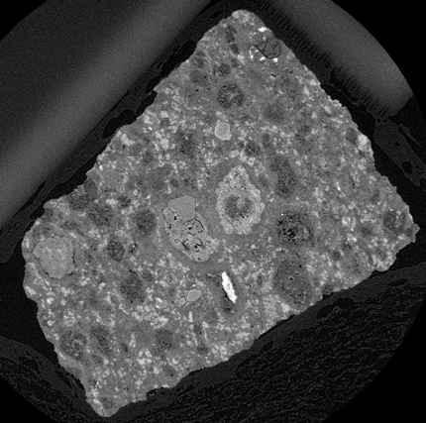
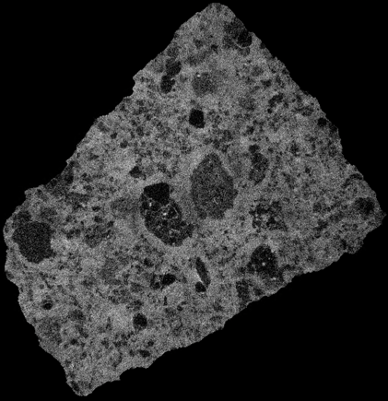
Porosity Data Derivation
See Hanna et al. 2022 for method details
Xenon volume
Vacuum volume
Porosity volume
-
=
(data rescaled and precisely aligned to xenon volume before subtraction)
(converted to porosity values using bulk porosity from He pycnometry)
Notes:
-This illustrates the processing required to derive the porosity from the two XCT scans
- The xnon scan on the left, vacuum scan in the middle, and to a first degres, you can tell there’s xenon filling a lot of matrix because it’s fkind of washing out the detail whtin it.
- The vacuum scan, after it is rescaled and precisely aligned) is substracted from the xenon volume, which results in a volume basically of xenon penetration, a proxy for porosity
- To convert this to porosity use the bulk porosity of the chip, as measured separately using He pycnometry

Slide 15
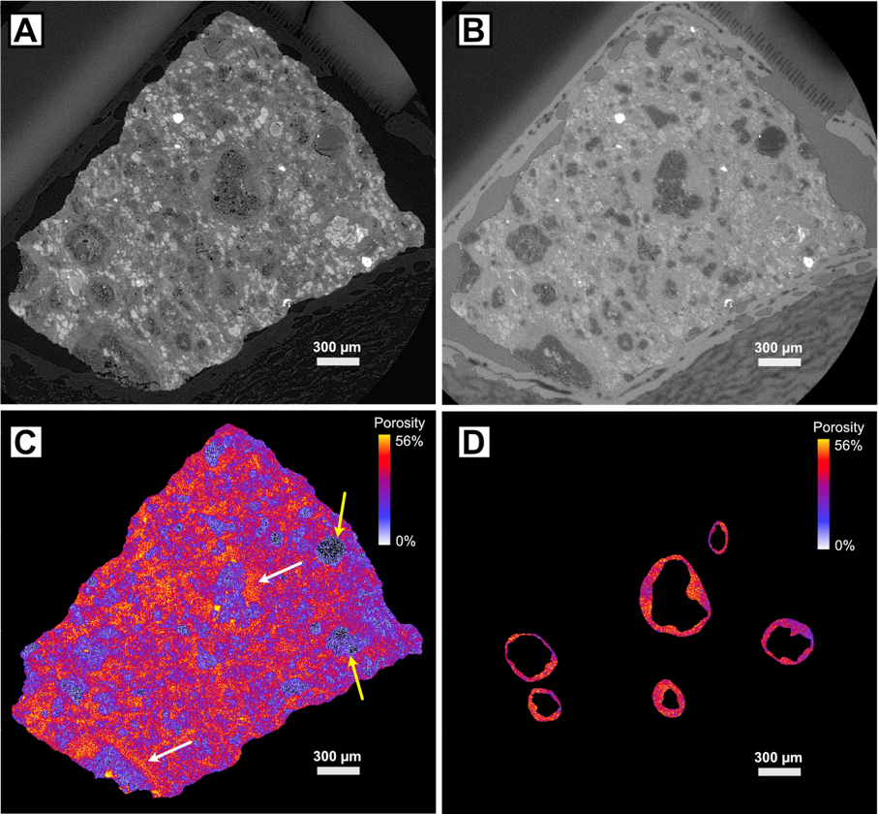
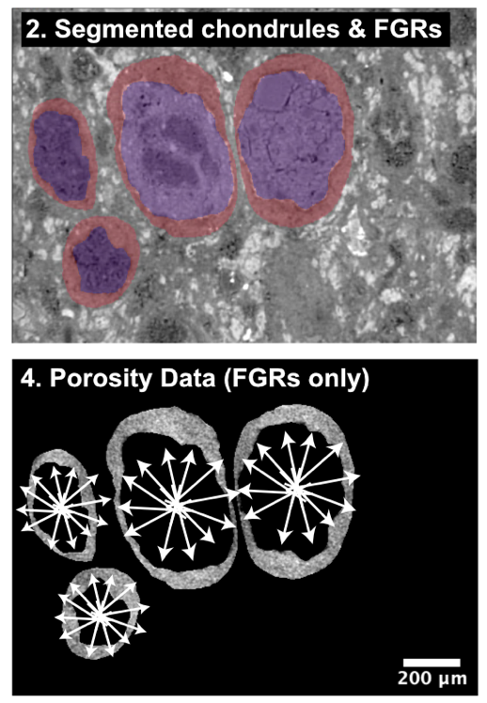
Porosity Measurement of FGRs
Avg. porosity in each direction recorded.
Hanna et al. in prep
Notes:
- And, to measure the porosity of the FGRs themselves, several steps are required.
- First we segment, or digitally isolate, the inner chondrule and their surrounding rims.
- Then we using the FGR segmentation only to isolate the porosity of the rims in the data.
- Using this final FGR porosity dataset, we look out from the center of each chondrule and record their average porosity in that direction.
- The average porosity of all chondrules in each direction is then averaged, so we get an average porosity, among all chondrules, in thousands of directions.

Slide 16
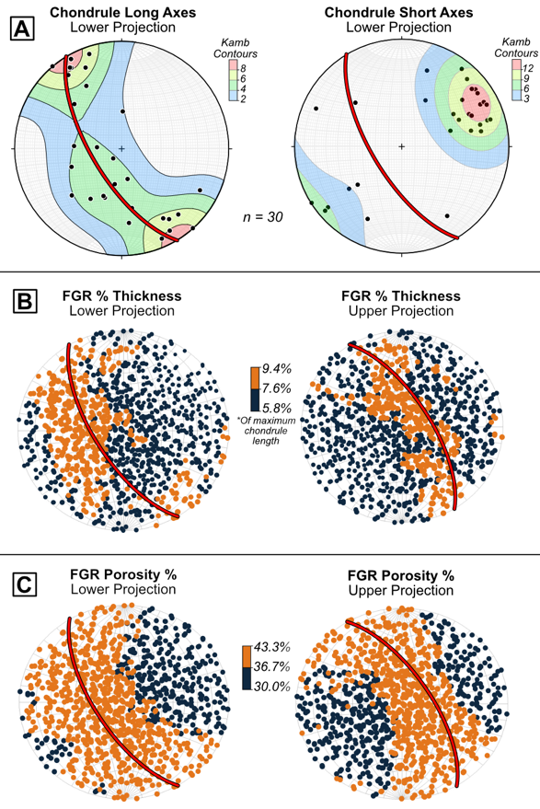
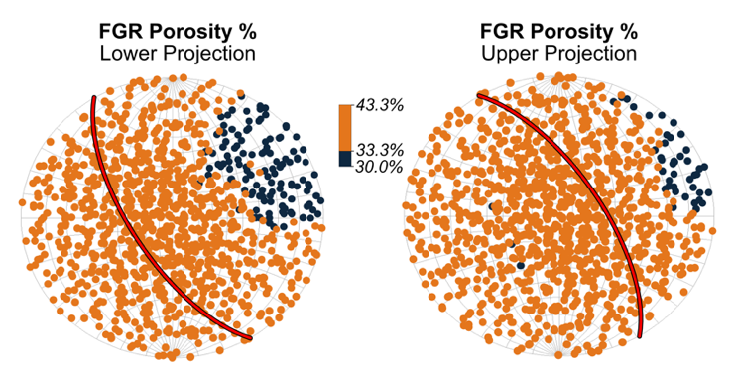
Compressed Porosity in FGRs
FGRs are thicker and more porous in foliation plane.
Reduced porosity in FGRs due to impact compaction and impact direction indicated.
Notes:
- So finally, results.
- plot on the left shows the long axes of each of the 25 chondrules segmented, and as expected they are foliated and define a plane, which is highlighted here.
- And again, we see that the FGRs are thickest around this plane of foliation.
- But now we see, which our new dataset, that the FGRs are also more porous in the foliation plane, and less porous in the direction of impact.
- This signifies that the impact is modifying the porosity within the FGRs, but preferentially reducing porosity along the direction of impact, where they are in contact with the more rigid chondrules.

Slide 17
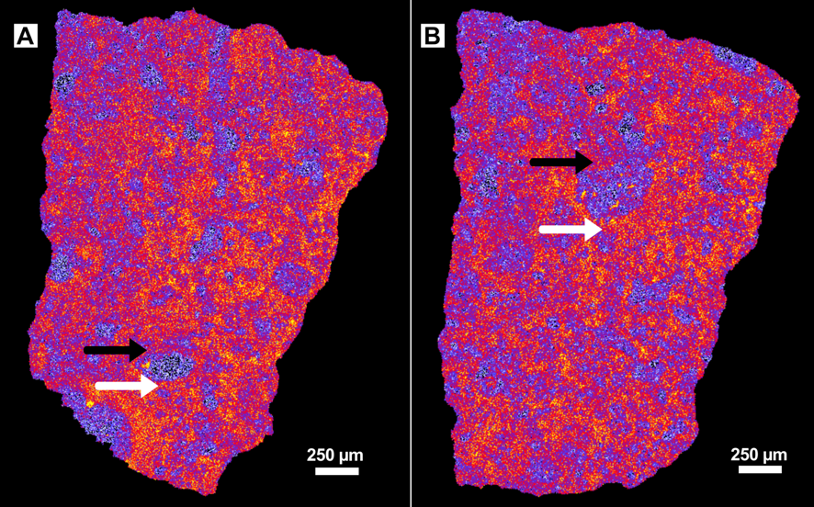
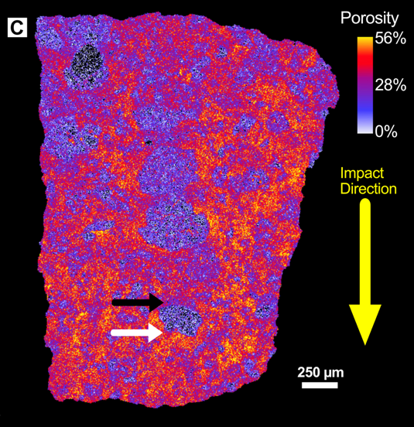
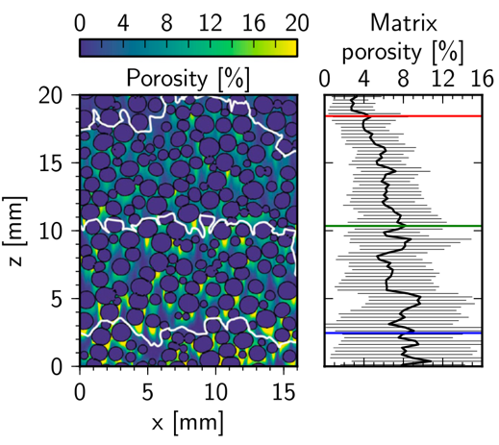
Strain Shadows
Higher porosity on lee (protected) side of chondrules.
Predicted in modeling of chondrule/matrix compaction (Bland et al., 2014; Davison et al., 2016).
Davison et al. (2016)

Slide 18
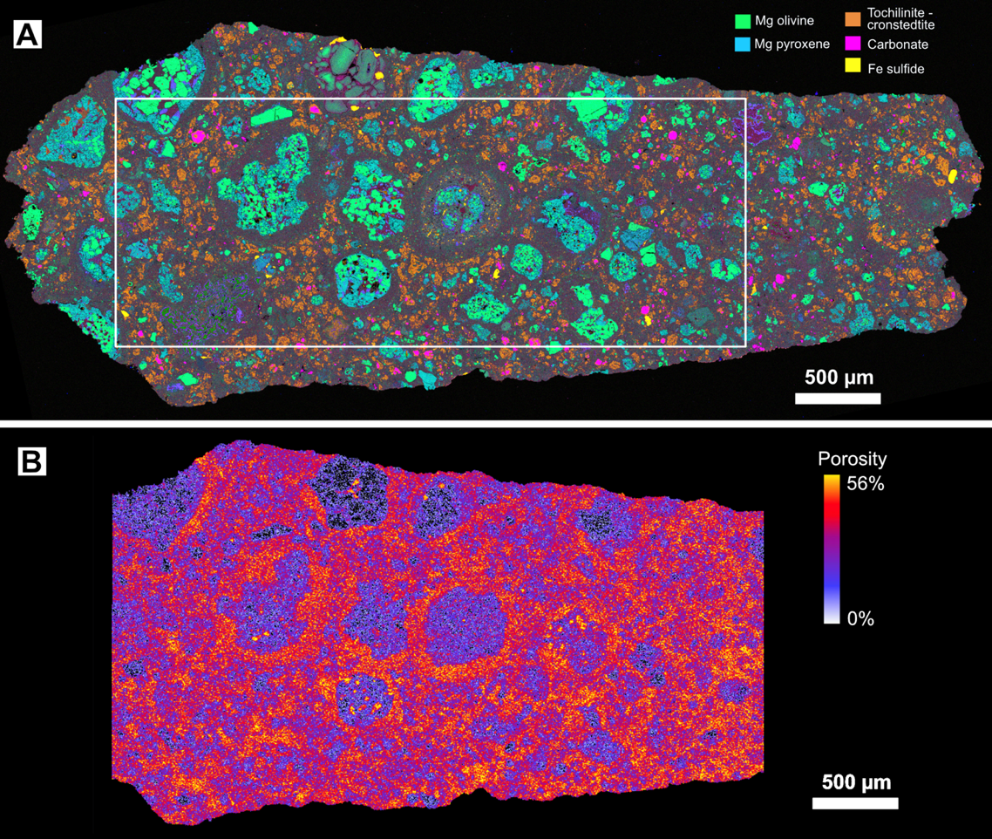
Foliation plane
Compression direction perpendicular (out of screen)
EDS-derived chemical map
XCT-derived porosity
Notes:
Here we see a slice of the porosity on the top, from the full 3D volume, that matches the thin section which is shown as a Back Scattered electron image on the bottom.
Again, this section was cut parallel the. Foliation plane, and so we wouldn’t expect any porosity varation in the FGRs around the chondrules due to impact because the compression direction is perpendular to this thin section.

Slide 19
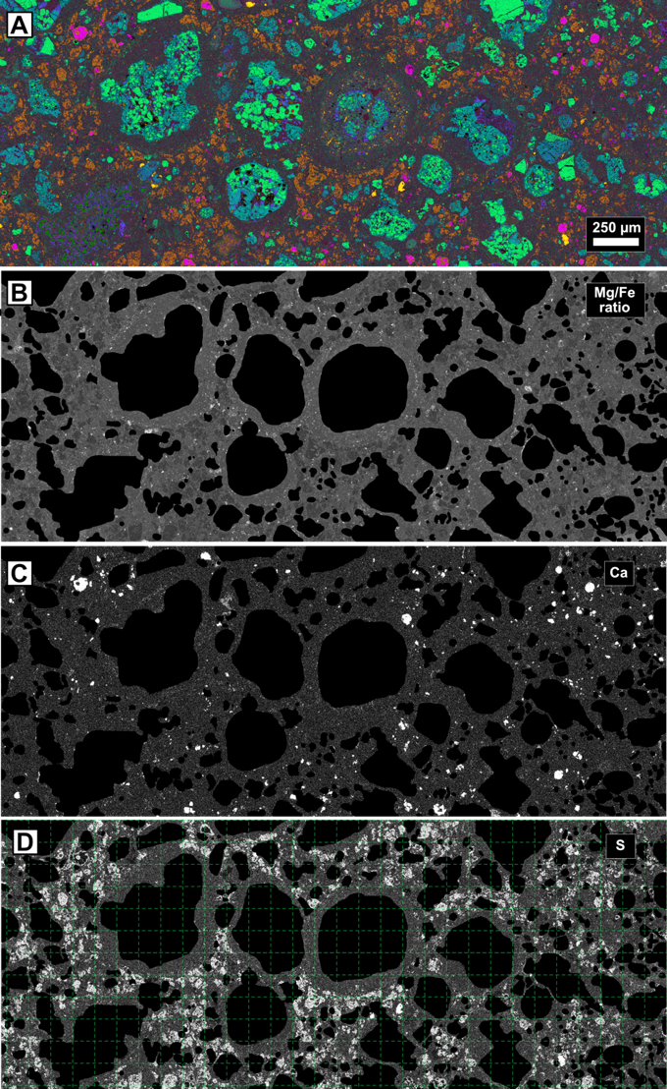
Porosity and Aqueous Alteration
Mg/Fe Ratio of matrix increases with alteration (e.g., Rubin et al., 2007, Howard et al. 2011)
Carbonate and sulfide can form during aqueous alteration (Suttle et al., 2021; Lee et al., 2014)
Testing for correlation between porosity and alteration
Gridded data from 6 µm to 720 µm

Slide 20
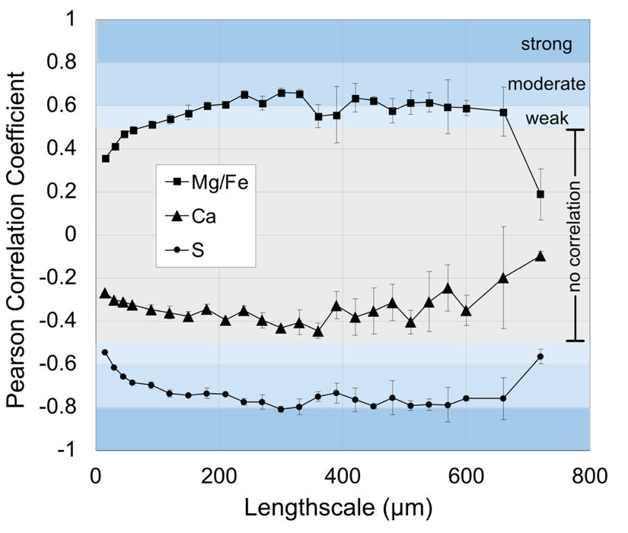
Mg/Fe and S Correlated to Porosity
Ca is not correlated to porosity – formed prior to impact?
Post-impact porosity gradients controlled alteration of fine-grained material
  Mg/Fe increased in phyllosilicate as more Mg silicates are altered
  S liberated from tochilinite to reprecipitate as large sulfides

Slide 21

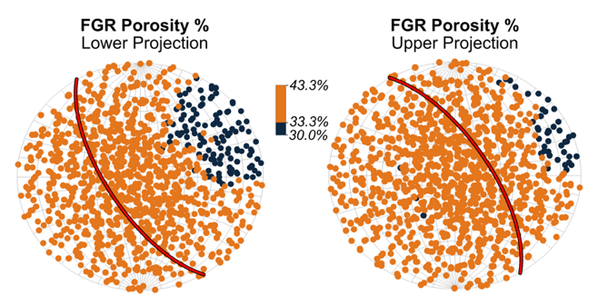
Conclusions and Future Work
Microporosity has been modified by impact
Impact direction can be inferred from porosity of FGRs
Post-impact aqueous alteration was controlled by microporosity gradients
Next – Bennu!
Funding Acknowledgement: LARS award #80NSSC21K0610 (PI Hanna). UTCT is a NASA PSEF facility award #80NSSC23K0199 (PI Hanna). Thanks to the Smithsonian for the loan of USNM 5487.
Notes:
- In conclusion, we have found that porosity of the fine grained rims has been modified by impact compaction and that the areas aligned with the compression direction are thinner with reduced porosity
- Further, a direction of impact is suggested by the presence of strain shows behind some chondrules.
- And finally, our future work includes chemical analysis, by EDS or WDS or both, of the FGRs to determine if any chemistry or mineralogy is correlated to porosity variation within the rims.

