Slide 1
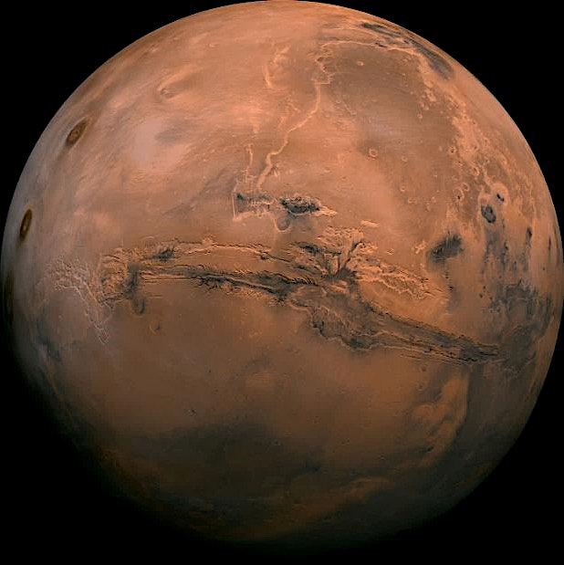
Magmatic thermal histories and emplacement mechanisms of Martian shergottite meteorites
Scott Eckley – September 22nd, 2025
LPI – UTCT Workshop: Tomography of Planetary Materials
Image: JPL/Caltech

Slide 2
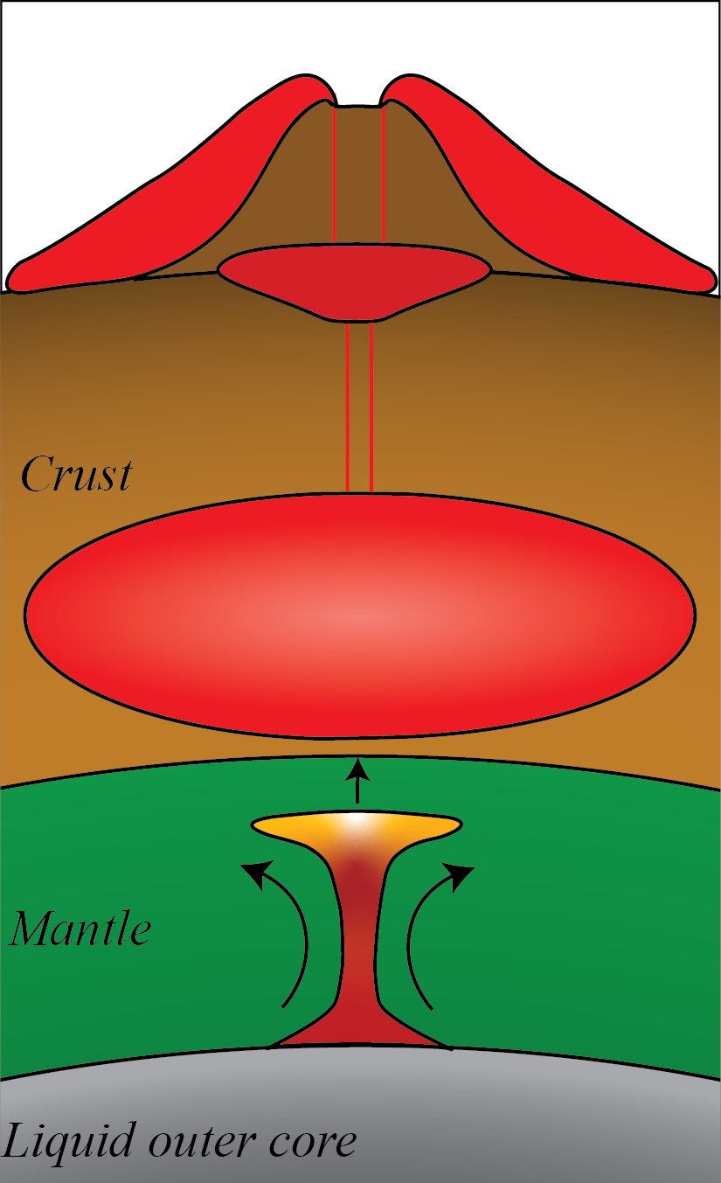
Objectives using XCT
  Solidification of Martian magmas
  Magmatism in Martian lower crust

Slide 3
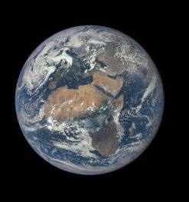
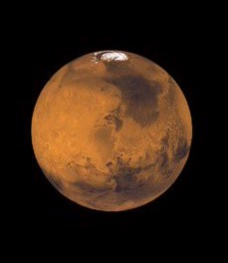
Martian Meteorites
Ejected from Mars by impacts

Slide 4
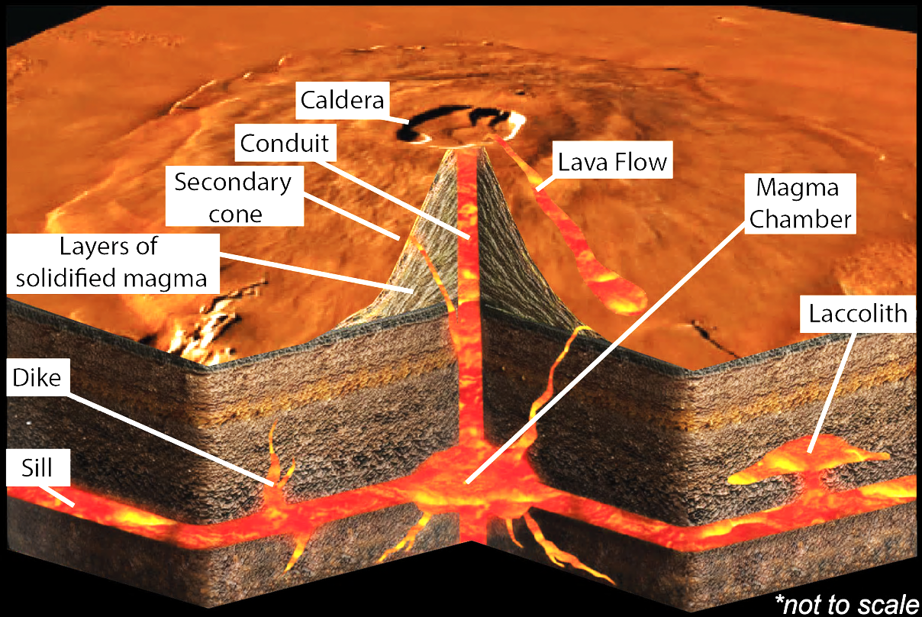
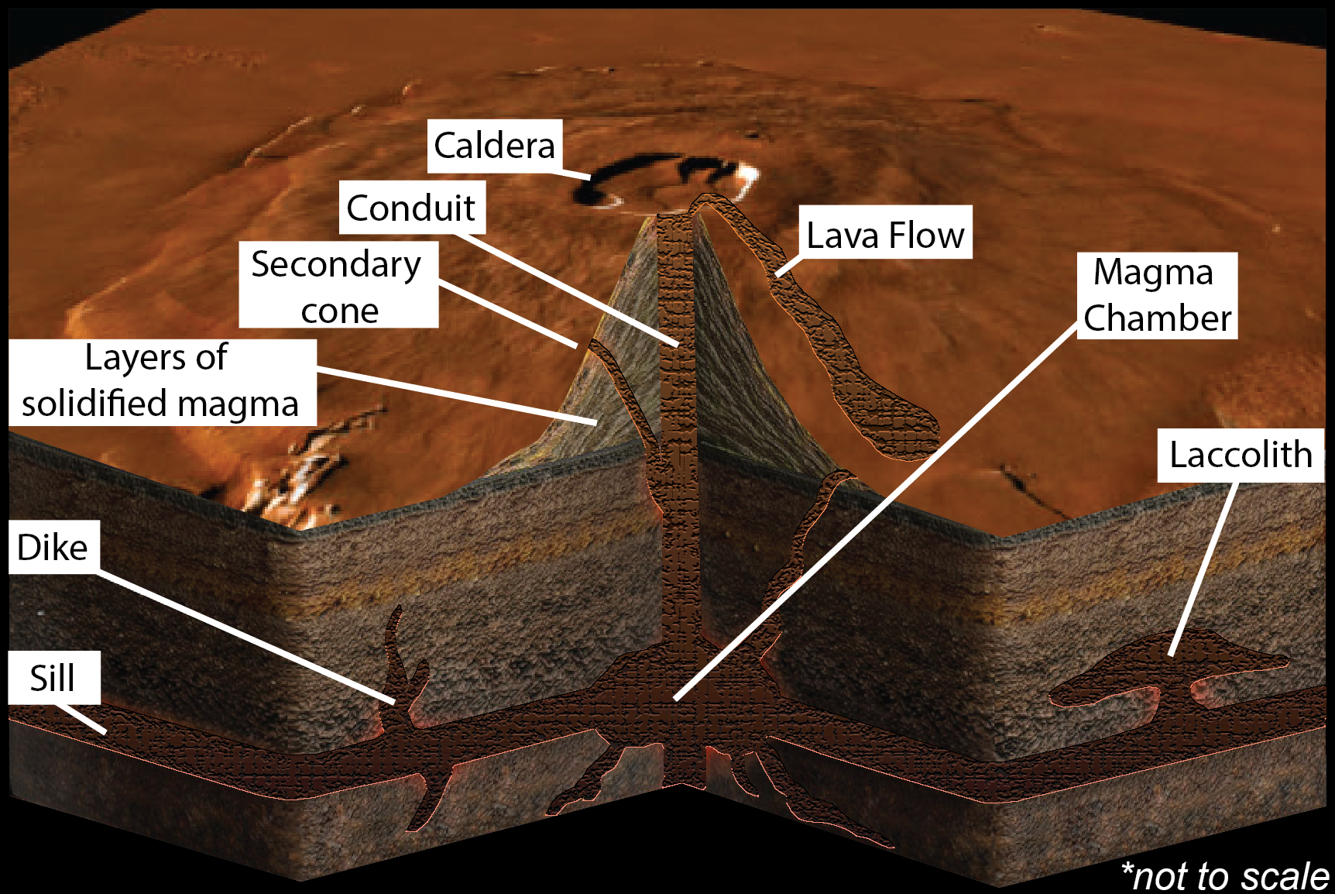
Magma on Mars
Images modified from 3D Geography and NASA

Slide 5
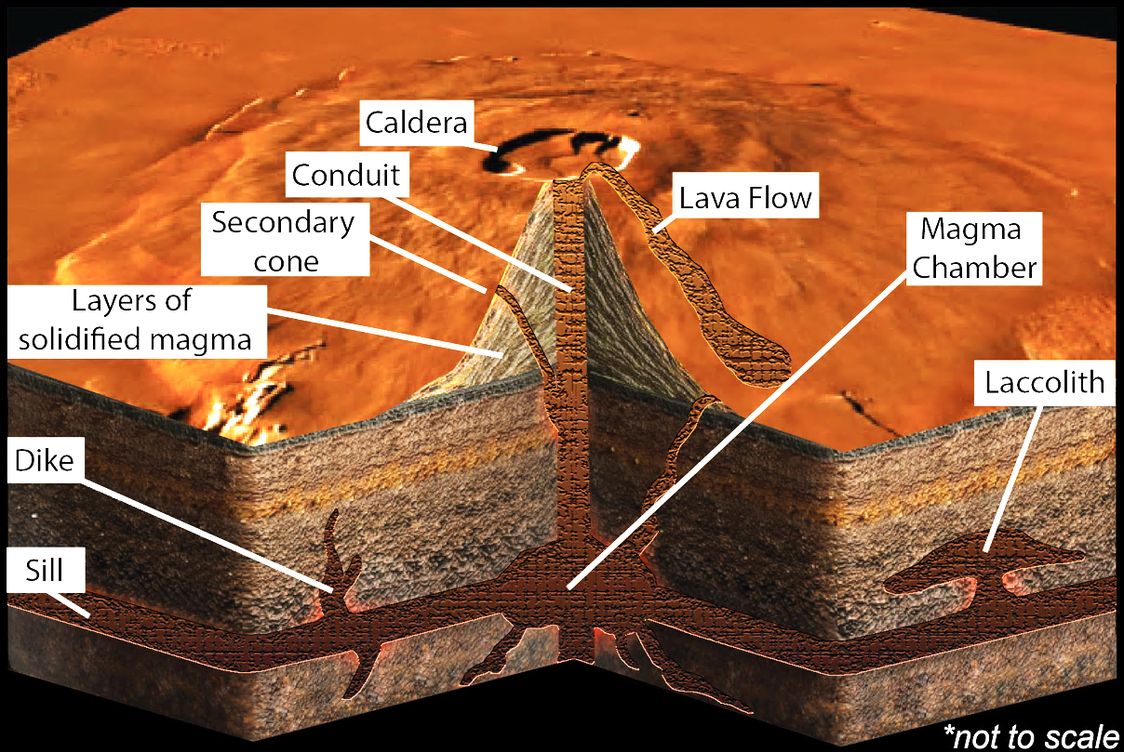
Igneous Rocks on Mars
Images modified from 3D Geography and NASA

Slide 6
Dragonfly Window – NWA 13134
Show overall texture
Highlight pyroxene crystal
Draw 3D rod
Show 3D whole rock volume with segmented pyroxene rods

Slide 7
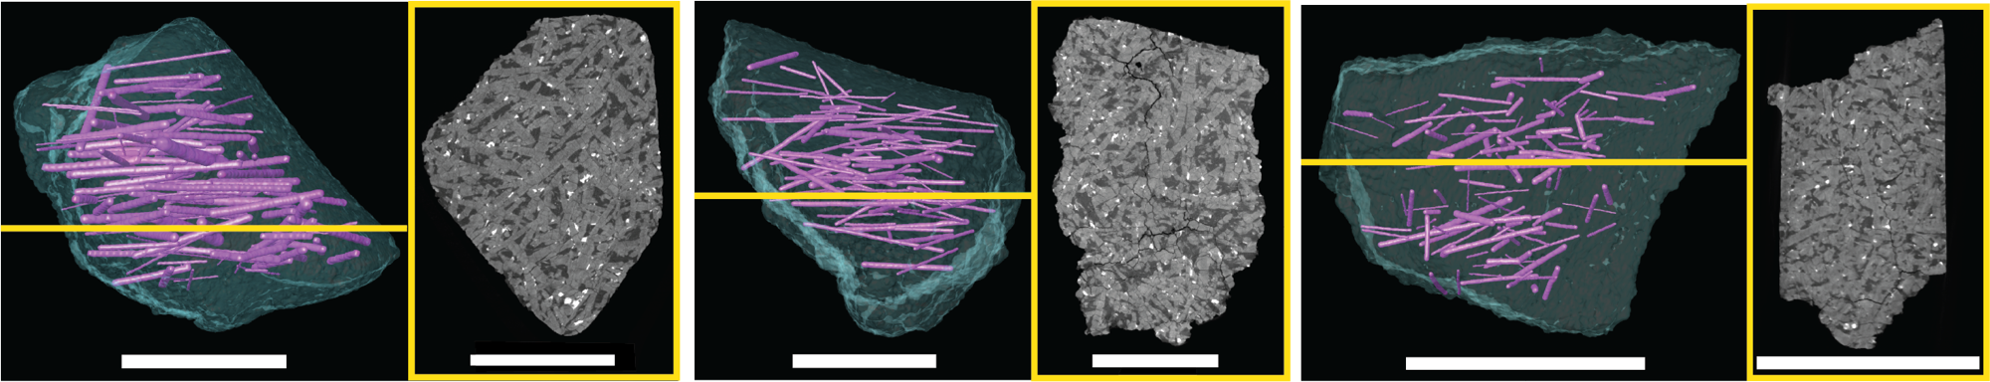
Pyroxene foliation
NWA 6963
NWA 13134
Zagami
n = 117
Avg. length = 5.8 mm
Max length = 13.0 mm
n = 110
Avg. length = 6.4 mm
Max length = 13.1 mm
n = 121
Avg. length = 2.3 mm
Max length = 6.7 mm
*scale bars = 1 cm

Slide 8
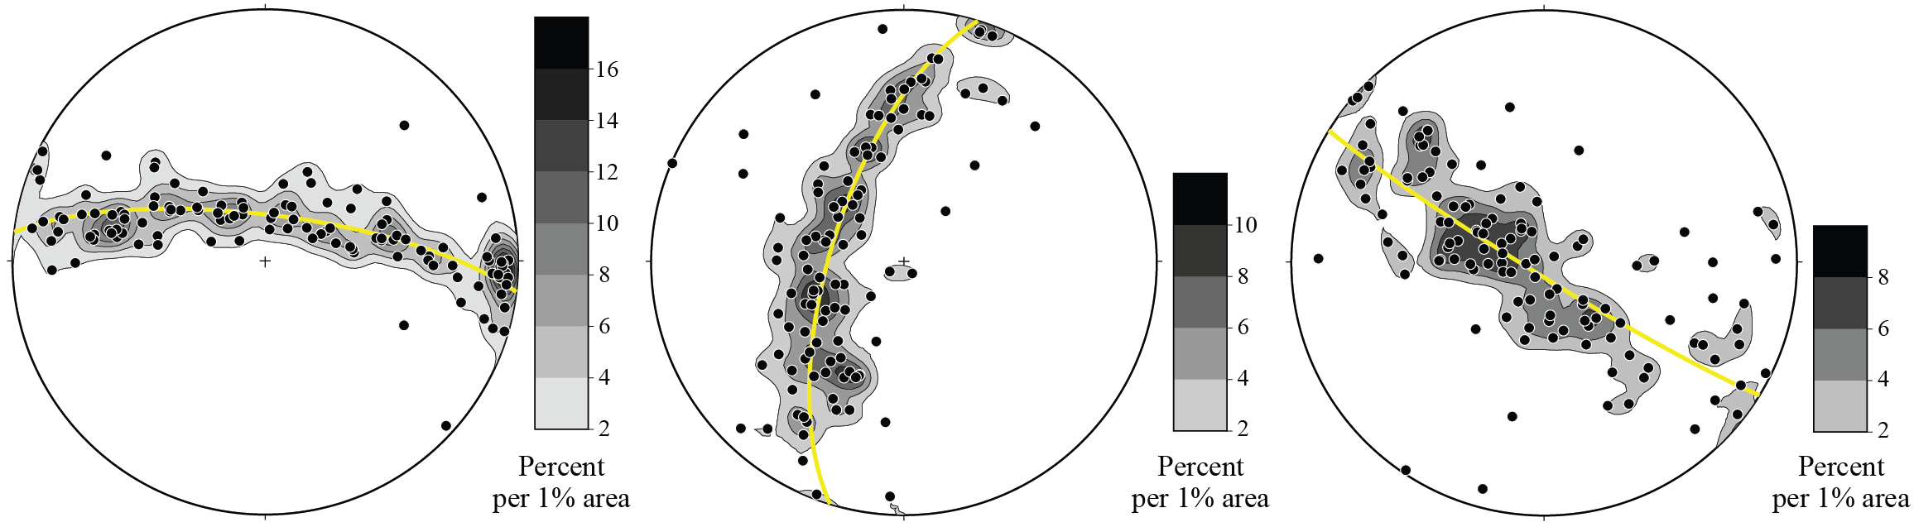
Pyroxene foliation
NWA 6963
NWA 13134
Zagami

Slide 9
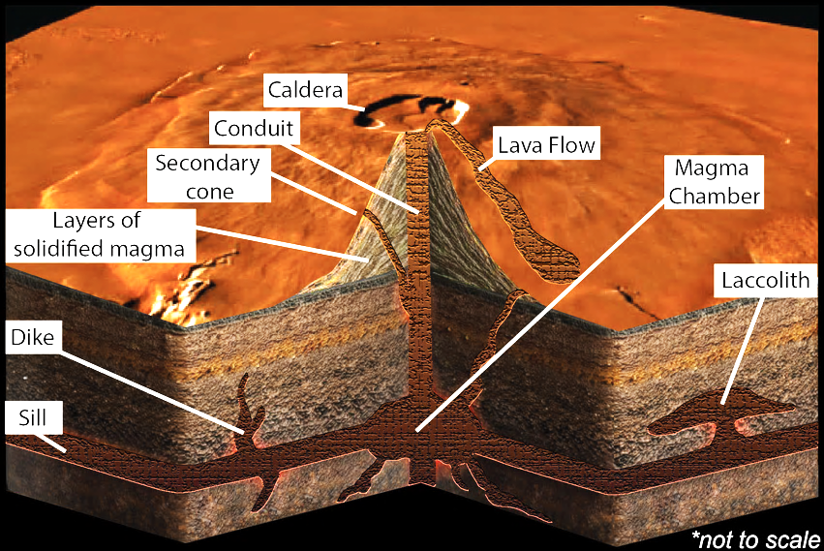
Gabbroic Emplacement
NWA 6963
NWA 13134
Crystal Settling and Compaction

Slide 10
Objectives using XCT
  Magmatism in Martian lower crust

Slide 11
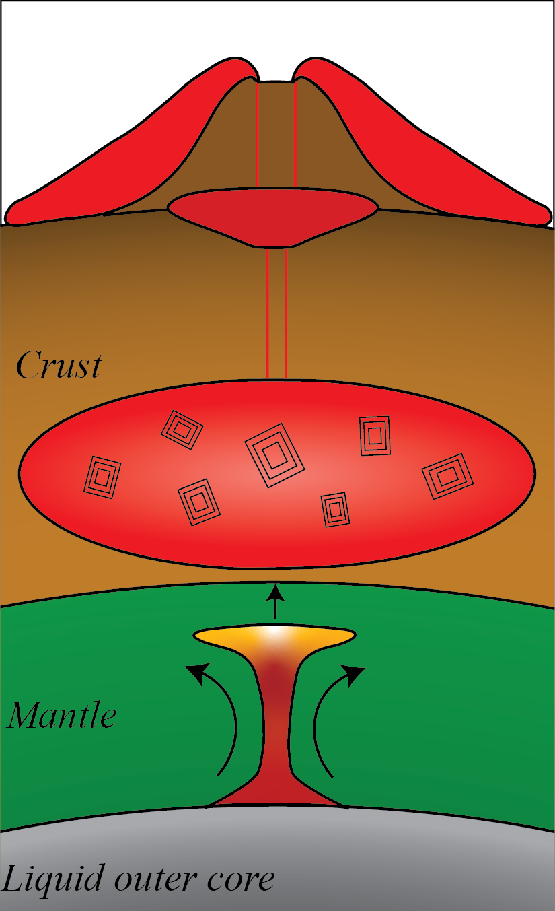
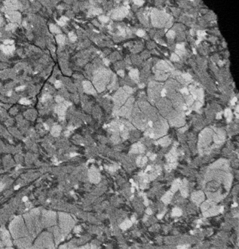
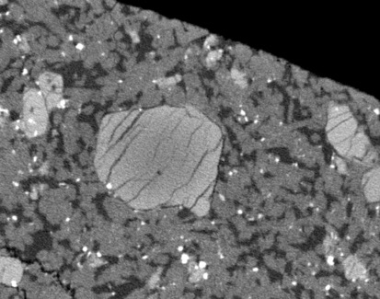
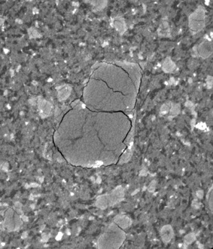
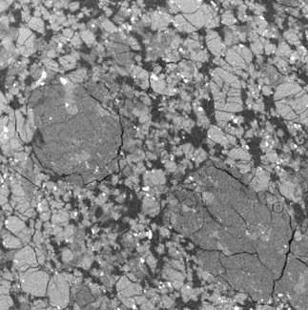
Magmatism in lower crust
Megacryst olivine
  First minerals to crystallize
  crystallized in lower crust (~30 to 85 KM)
LAR 12011
LAR 12095
Tissint
RBT 04261
interpreted to reflect equilibrium growth with constant and slow growth rates

Slide 12
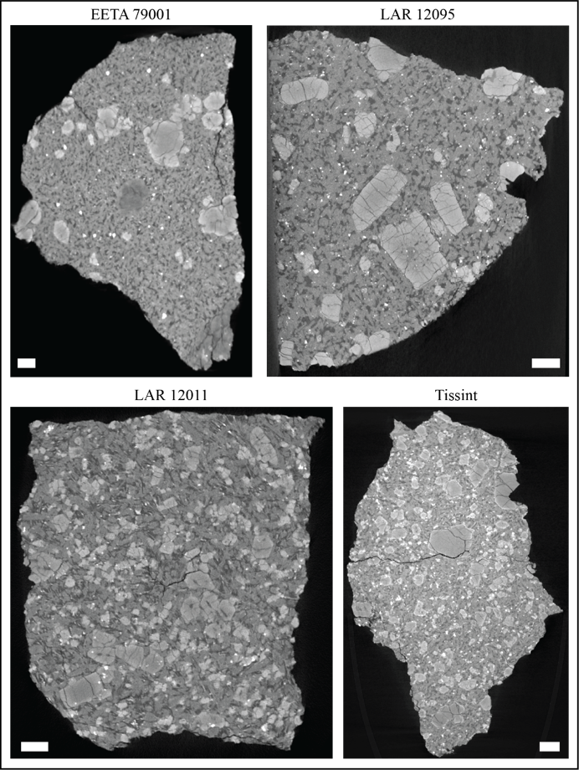
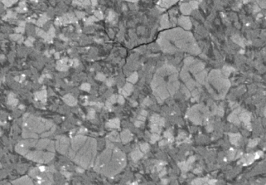
Magmatism in lower crust
Elongated melt inclusions
Scale bar = 2 mm

Slide 13
Dragonfly Window – LAR 12011
Show overall texture
Identify some olivine with rapid-growth textures

Slide 14
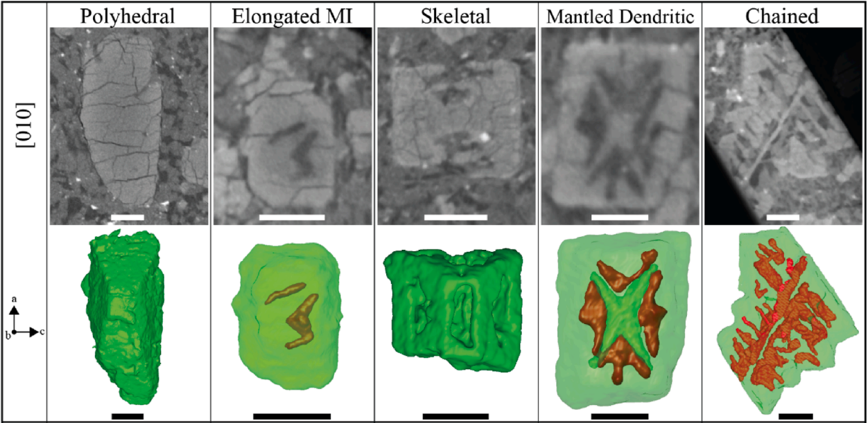
--------------Increasing Disequilibrium----------->
Eckley et al., 2024a – Scale bars are 0.5 mm

Slide 15
Dragonfly Window – LAR 12011
Show Target Plane for sectioning

Slide 16
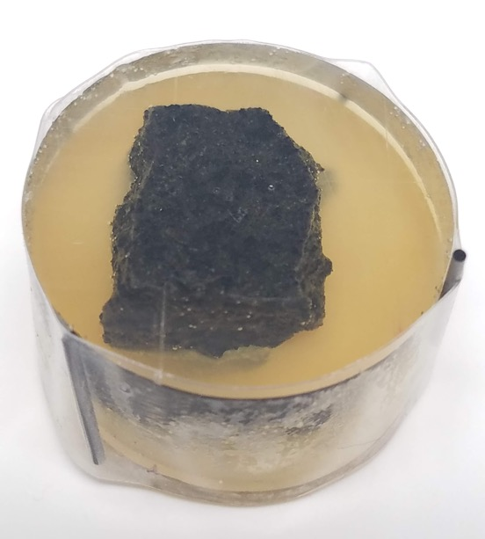
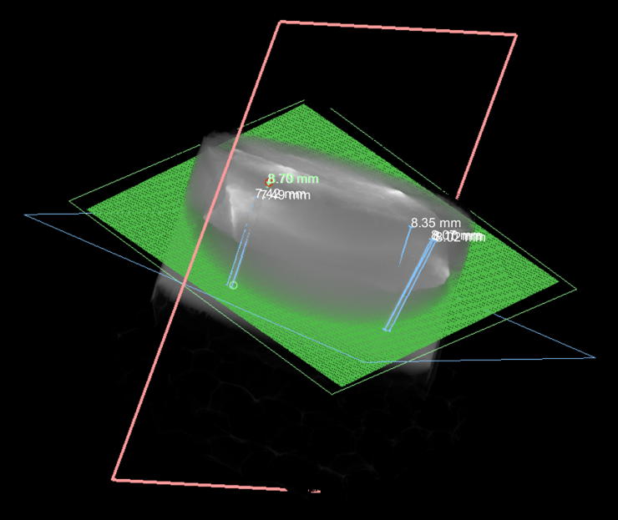
Fiducial Markers = pencil graphite
Measure where targeted plane (green) intersects fiducial markers

Slide 17
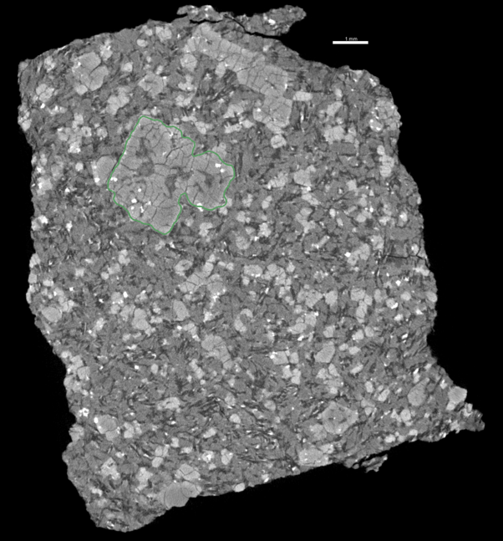
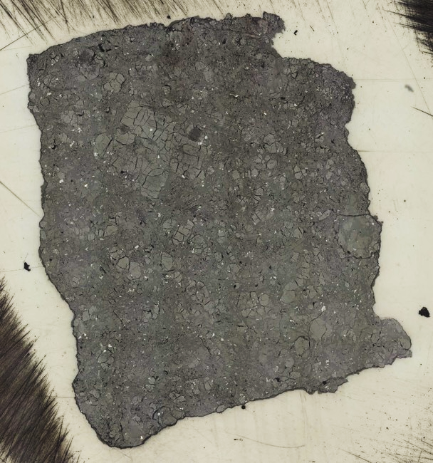

Target Plane
Cut Plane

Slide 18
Dragonfly Window – LAR 12011
Show Exposed Plane from sectioning

Slide 19
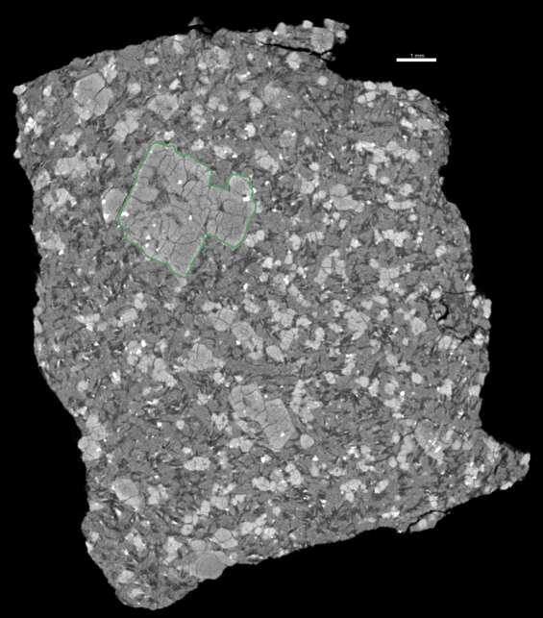
Target Plane
Cut Plane

Slide 20
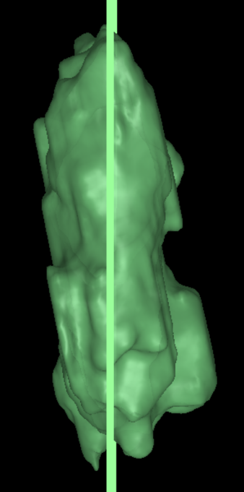
Target Plane
Cut Plane
1 mm

Slide 21
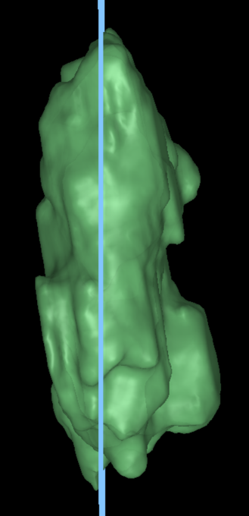
Target Plane
Cut Plane
1 mm

Slide 22
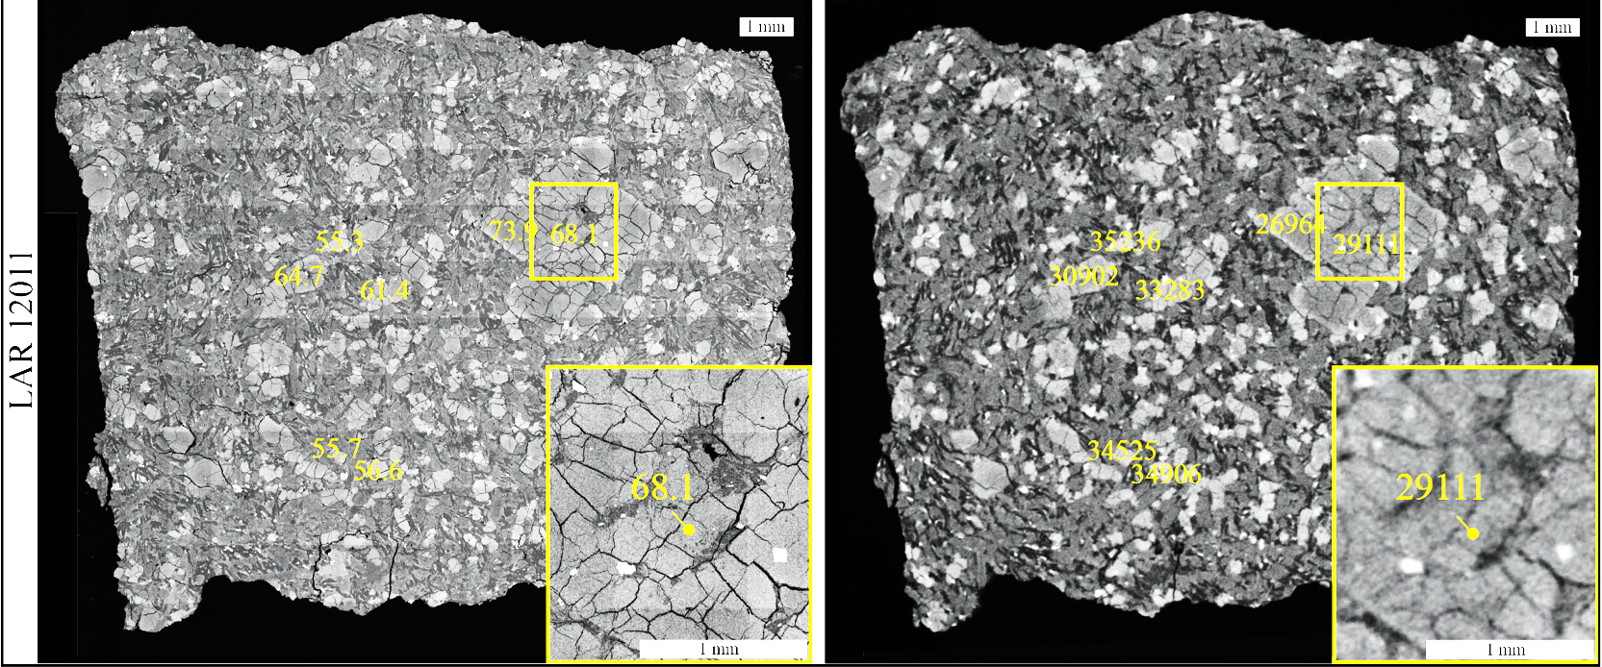
Convert Grayscale Values to Fo_{CT} #
EPMA
XCT

Slide 23
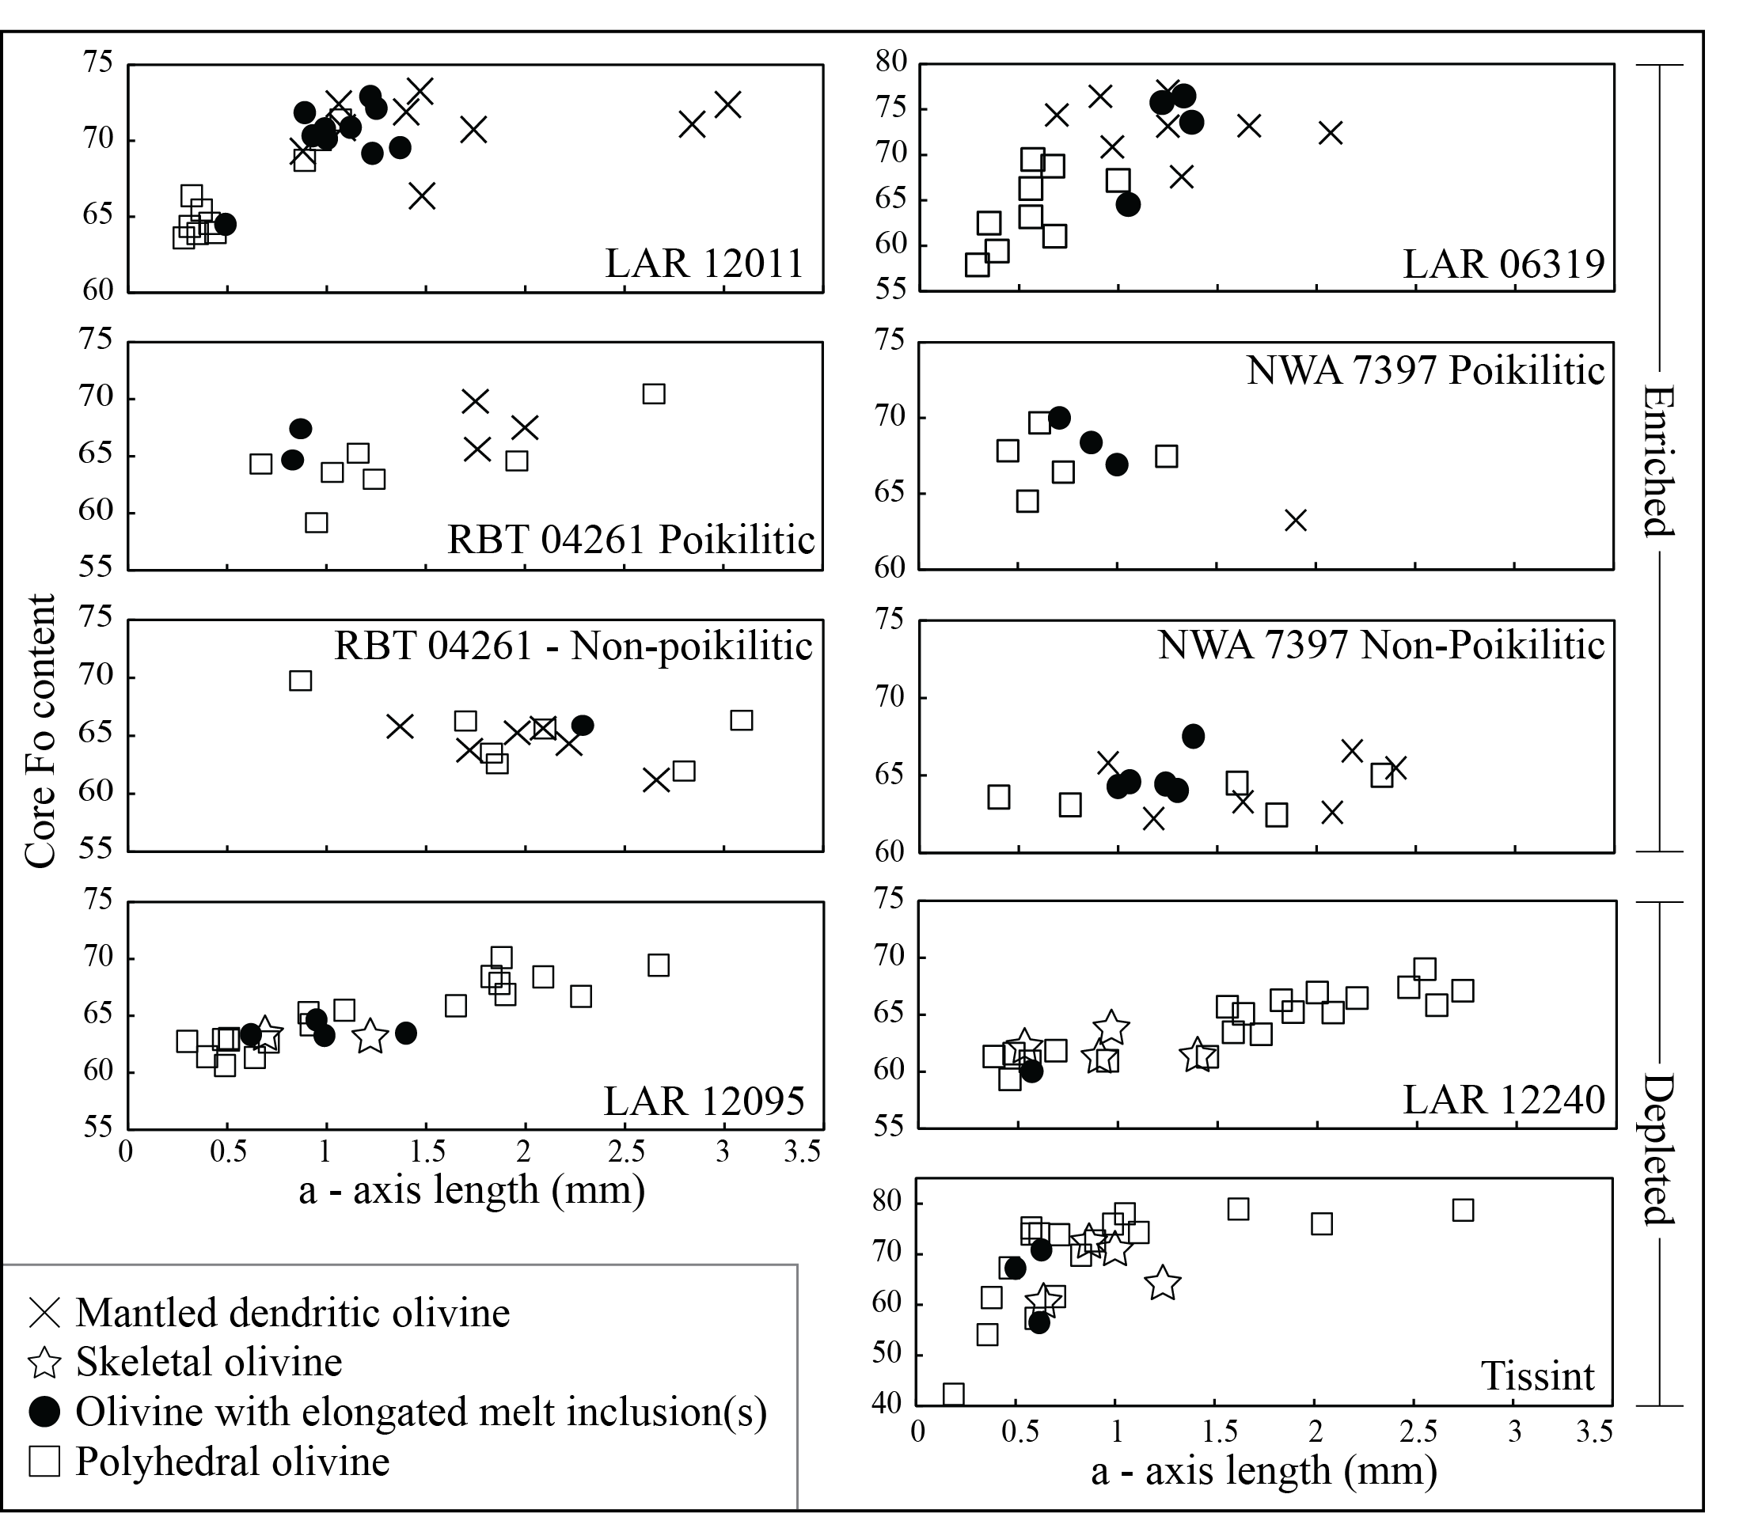
Correlation between thermal history and Geochemical classification

Slide 24
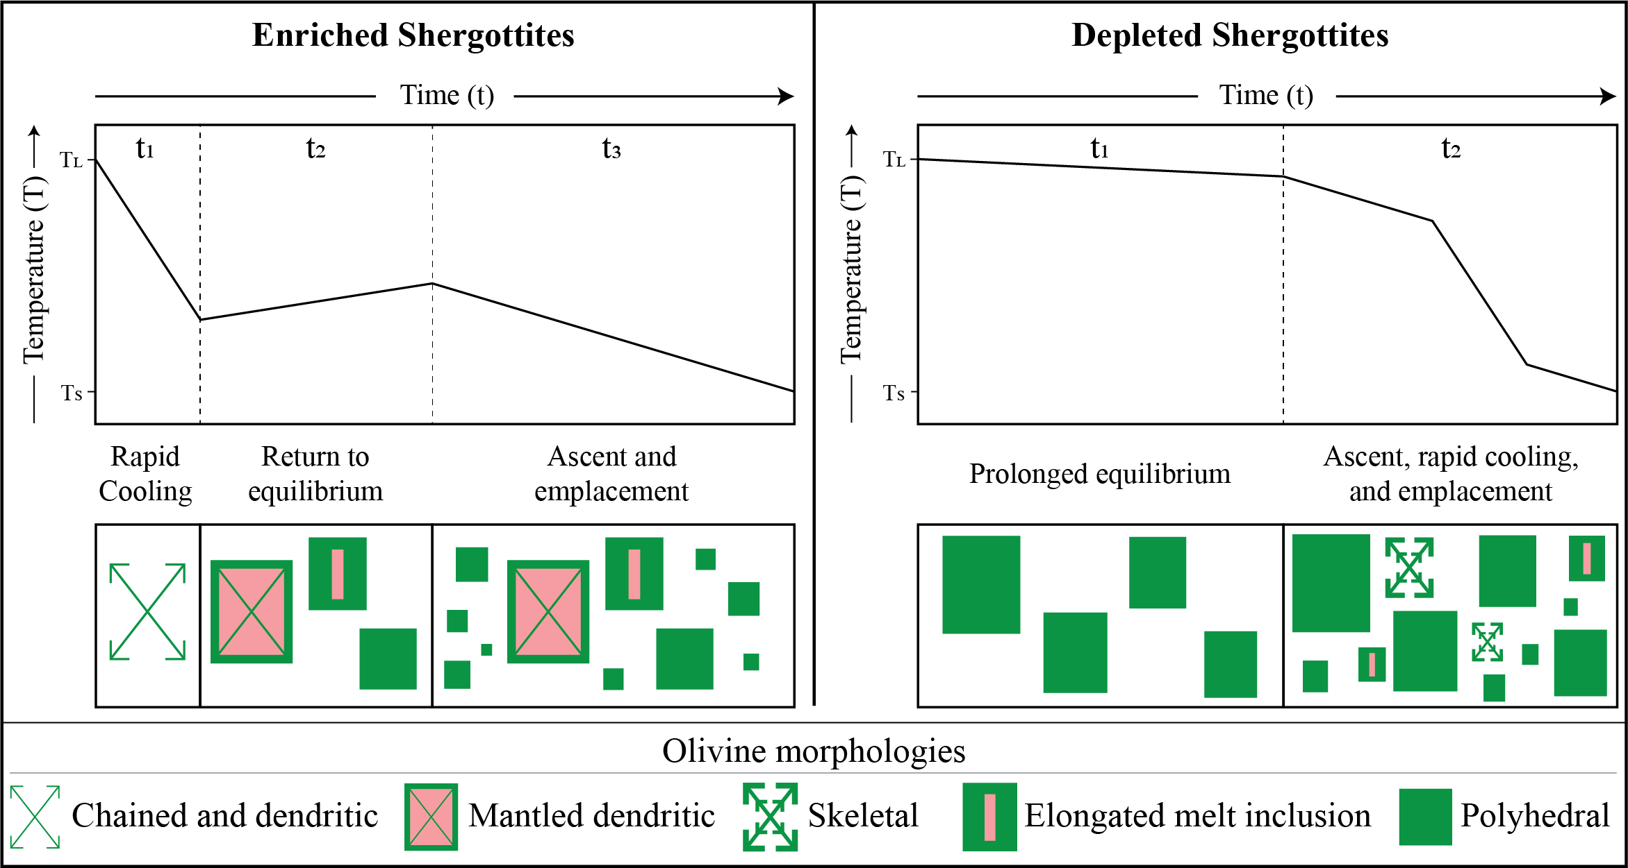

Slide 25
Thank you!!!

